Slide 1
The Wonderful World of Bridges
Welcome to a journey through different types of bridges!

Slide 2
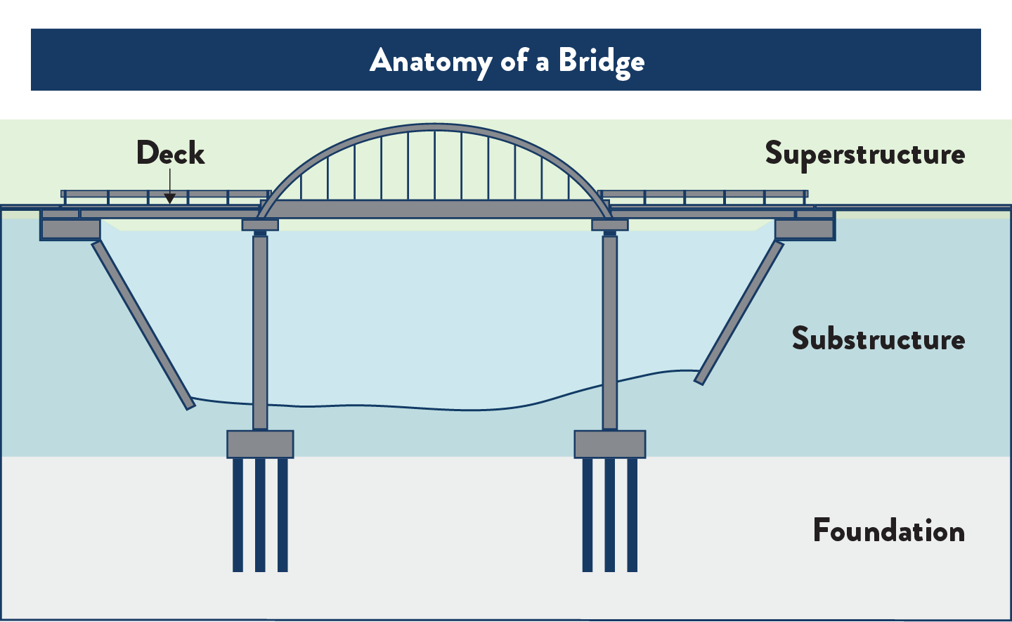
How do bridges work?
The superstructure is the muscular skeleton of the bridge. Think of it as a strong backbone, made up of towering girders or intricate trusses. These elements bear the brunt of the weight, carrying the bridge deck and the traffic it serves..
https://www.dot.state.mn.us/projectselection/images/bridge-anatomy.png

Slide 3
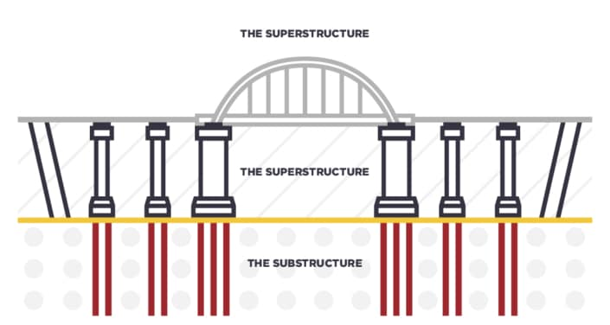
How do bridges work?
but…..wind can whip at the bridge, pushing it from side to side. Earthquakes can tremble, sending shivers through its very core. To counter these, the superstructure works in tandem with the substructure, the bridge's sturdy feet planted firmly on the ground. Pillars, abutments, and piers act as anchors, resisting the lateral forces and keeping the bridge grounded. Imagine them as strong legs, digging deep into the earth to ensure the bridge doesn't sway or teeter in the face of wind or earthquakes.
https://resource.midasuser.com/hubfs/Substructure_figure_Types%20of%20Substructures%20for%20Bridges.jpg

Slide 4
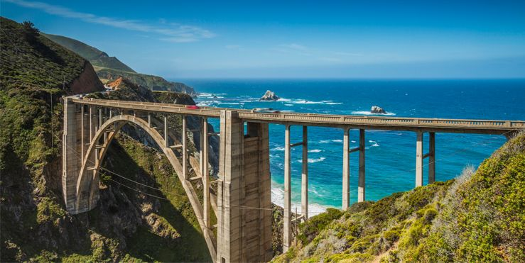
https://hips.hearstapps.com/hmg-prod/images/cool-bridges-1487970565.jpg
Types of Bridges
1
Beam Bridges
2
Arch Bridges
Beam bridges are simple and cost-effective, using horizontal beams supported by piers or abutments.
Arch bridges use a curved design to distribute weight evenly, making them ideal for spanning long distances.
3
Suspension Bridges
Suspension bridges have tall towers and cables that suspend the deck, allowing for longer spans.

Slide 5
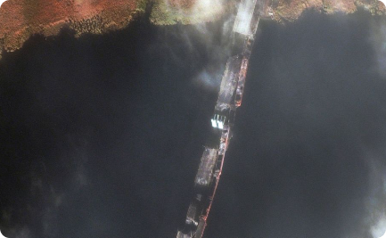
Suspension Bridges
Iconic Beauty
Huge Spans
Mind-boggling Structures
The Golden Gate Bridge is a famous San Francisco landmark and one of the most recognizable suspension bridges in the world.
The Danylo Halytskyi Bridge in Ukraine is one of the longest modern suspension bridges in the world. It spans over 1,545 meters and took over 6 years to build.
The Akashi-Kaikyo Bridge in Japan holds the record for the longest main span of any suspension bridge in the world. Its central span covers an incredible distance of 1,991 meters!

Slide 6
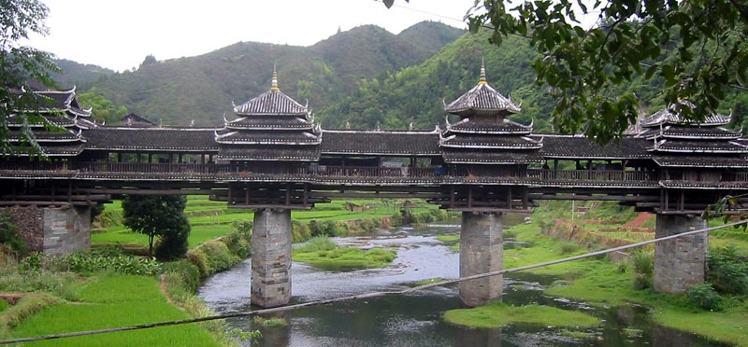
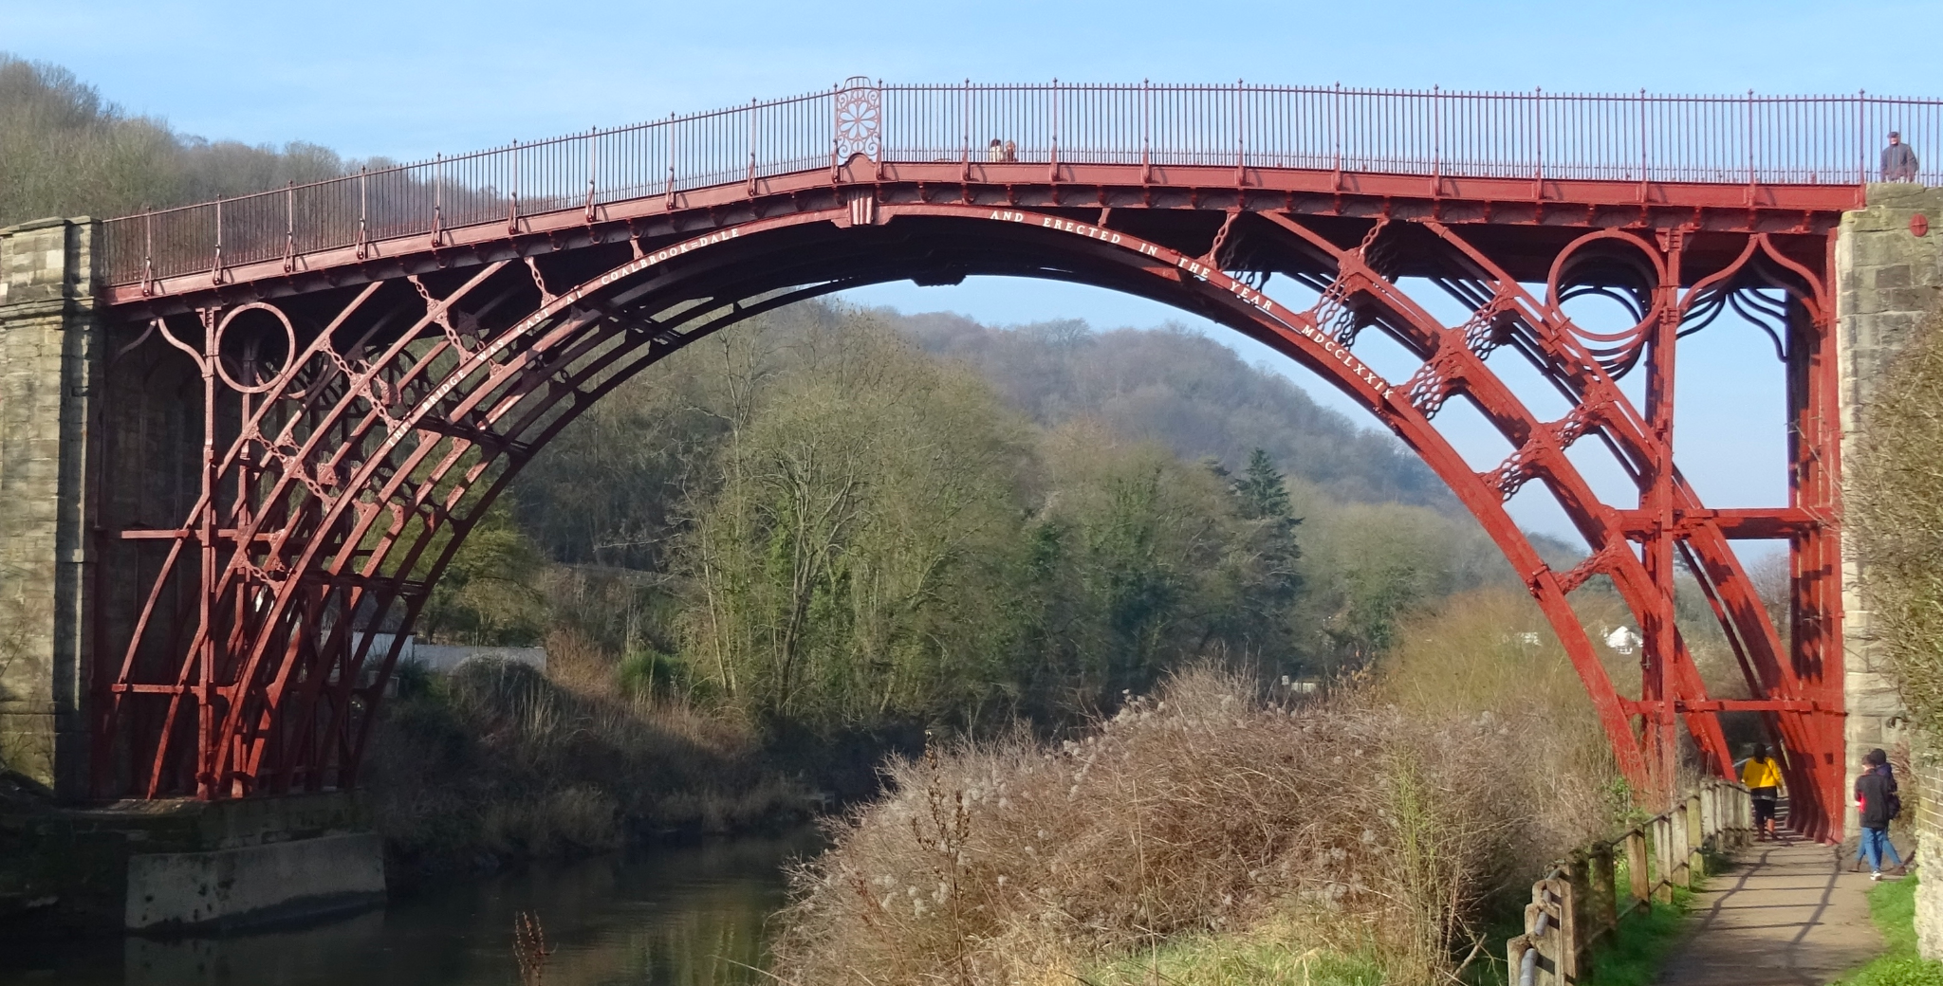
Arch Bridges
Ingenious Strength
The Iron Bridge in England is an early example of a wrought iron arch bridge. It was built in 1779 and is still in use today, proving that arch bridges can last for centuries.
Curvy Beauty
The Chengyang Wind and Rain Bridge in China is an ancient wooden arch bridge with multiple pagoda-like towers, intricate carvings, and covered walkways. It is a unique and artistic reflection of local culture.

Slide 7
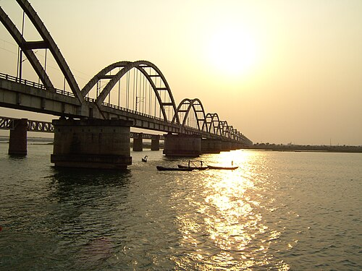
Arch Bridges
Graceful Symmetry
The Sydney Harbour Bridge in Australia is an iconic steel arch bridge that dominates the skyline of Sydney. Its elegant design and exacting construction required over 53,000 tons of steel and 8 years to complete.
The Godavari Arch Bridge
This a bowstring-girder bridge that spans the Godavari River in Rajahmundry, India. 2,745 . it is meters (9,006 ft) long,

Slide 8
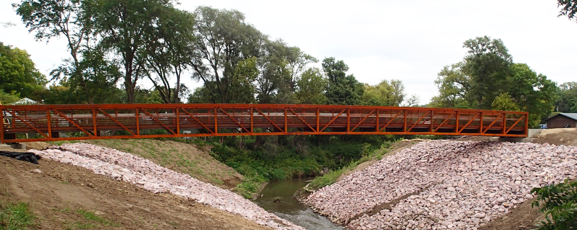
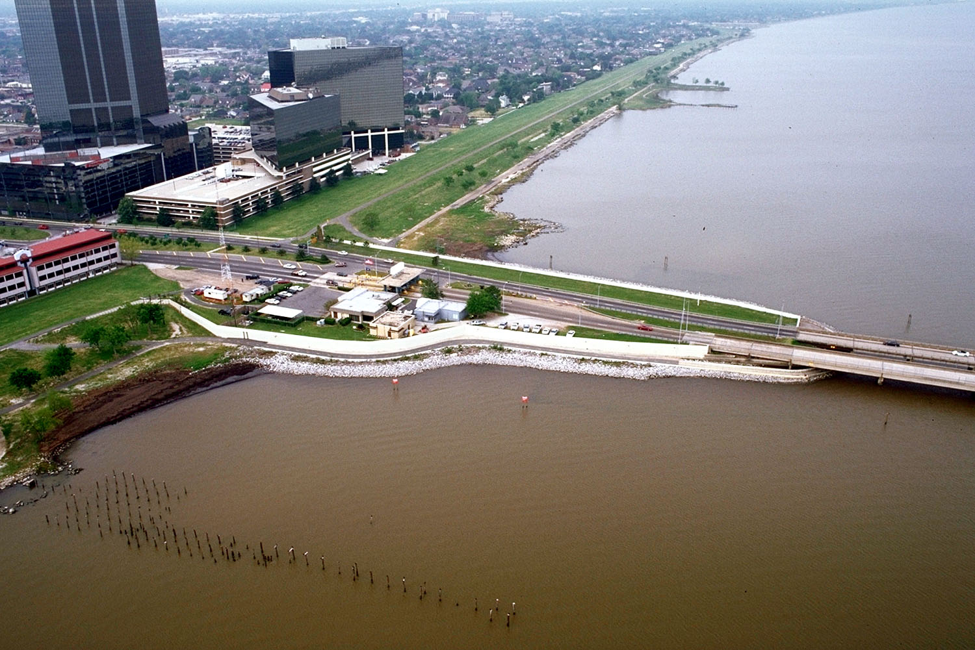
Beam Bridges
1
Simple Elegance
The Perry Creek bridge in Iowa is a beautiful example of a concrete beam bridge. It has a simple design and blends harmoniously into the surrounding landscape.
Modular Efficiency
2
The Hoan Bridge in Wisconsin is a cable-stayed beam bridge that consists of 28 prefabricated segments. Its modular construction made it easier to assemble and helped to reduce construction time and cost.
3
Amazing Length
The Lake Pontchartrain Causeway in Louisiana is the longest continuous beam bridge in the world. It stretches for almost 24 miles and connects the north and south shores of Lake Pontchartrain.

Slide 9
Choosing the Right Type of Bridge
When deciding what type of bridge to build, engineers consider a variety of factors, such as the span length, the terrain, the expected traffic volume, and the budget. They also evaluate the environmental impact, safety requirements, and maintenance needs of each design. By carefully weighing these factors, engineers can choose the best bridge type for each unique project.

Slide 10
Benefits of Different Bridge Types
1
Beam Bridges
2
Arch Bridges
Beam bridges are cost-effective and easy to construct, making them ideal for short to medium spans.
Arch bridges offer exceptional strength and aesthetic appeal, making them suitable for long spans and iconic structures.
3
Suspension Bridges
Suspension bridges can span great distances and provide flexibility in design, making them suitable for large water crossings.

Slide 11
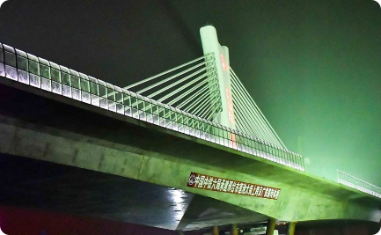
There are many types of bridges, each with its own unique features, strengths, and challenges. Whether they span rivers, valleys, or oceans, bridges bring people together and create new opportunities for growth, innovation, and exploration.
In Conclusion

