Slide 1
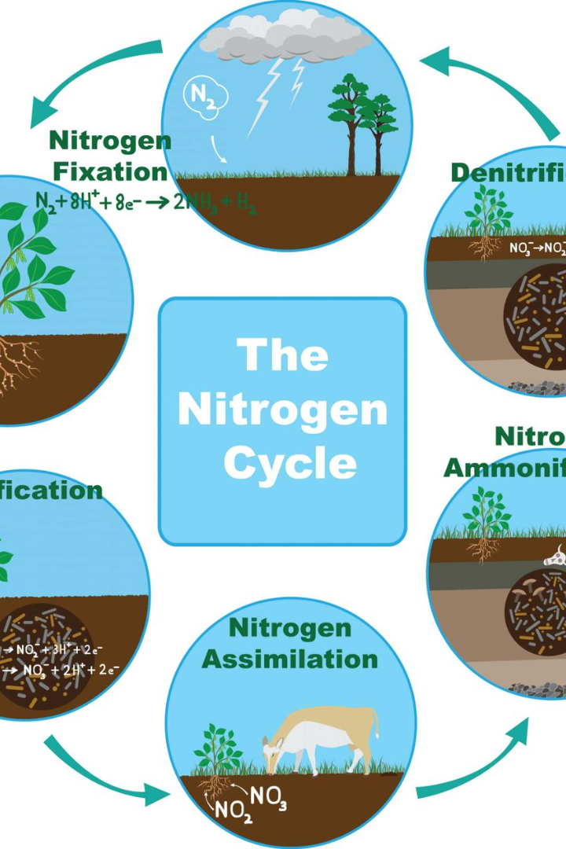
The Nitrogen Cycle: Exploring Life's Essential Journey
Discover the wonder of the nitrogen cycle and its impact on a classroom aquarium. Dive into the fascinating world of nitrogen transformations

Slide 2
Stage 1: Nitrogen Fixation
1
Certain bacteria convert atmospheric nitrogen into a usable form, such as ammonia.
Stage 2: Nitrification
2
Specialized bacteria transform ammonia into nitrite, and then into nitrate..
3
Stage 3: Denitrification
In oxygen-depleted environments, bacteria convert nitrate back into atmospheric nitrogen gas.

Slide 3
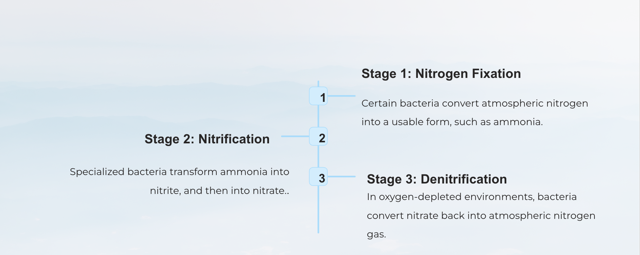
An Ocean of Transformation: Overview of the Nitrogen Cycle

Slide 4
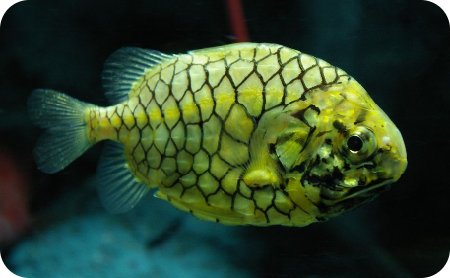
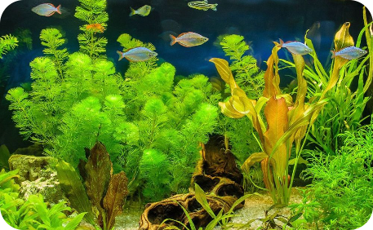
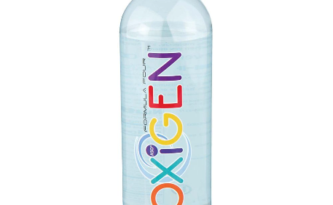
Impact on Aquatic Creatures
Balancing Act
Nature's Solution
Oxygen for Life
An imbalanced nitrogen cycle can lead to toxic ammonia and nitrite levels, harming fish and other aquatic organisms.
Plants help maintain water quality by utilizing nitrate as a nutrient source, reducing its concentration.
The nitrogen cycle promotes the availability of oxygen-rich water, critical for the survival of aquatic creatures.

Slide 5
Bacteria in the Transformation Process
Ammonia Oxidizers
Nitrite Oxidizers
Bacteria, such as Nitrosomonas, convert toxic ammonia into nitrite through oxidation.
Bacteria, like Nitrobacter, further oxidize nitrite into less harmful nitrate, completing the transformation process.
Denitrifying Bacteria
In the absence of oxygen, denitrifying bacteria convert nitrate back into atmospheric nitrogen.

Slide 6
Monitoring - Key to Healthy Aquariums
1
Ammonia Levels
2
Nitrite and Nitrate Levels
Regularly test ammonia levels using a reliable test kit to ensure they stay within safe limits.
Monitor nitrite and nitrate concentrations weekly to identify potential imbalances and take corrective action.
3
Water Changes
Frequent partial water changes help dilute harmful chemicals and maintain stable nitrogen levels.

Slide 7
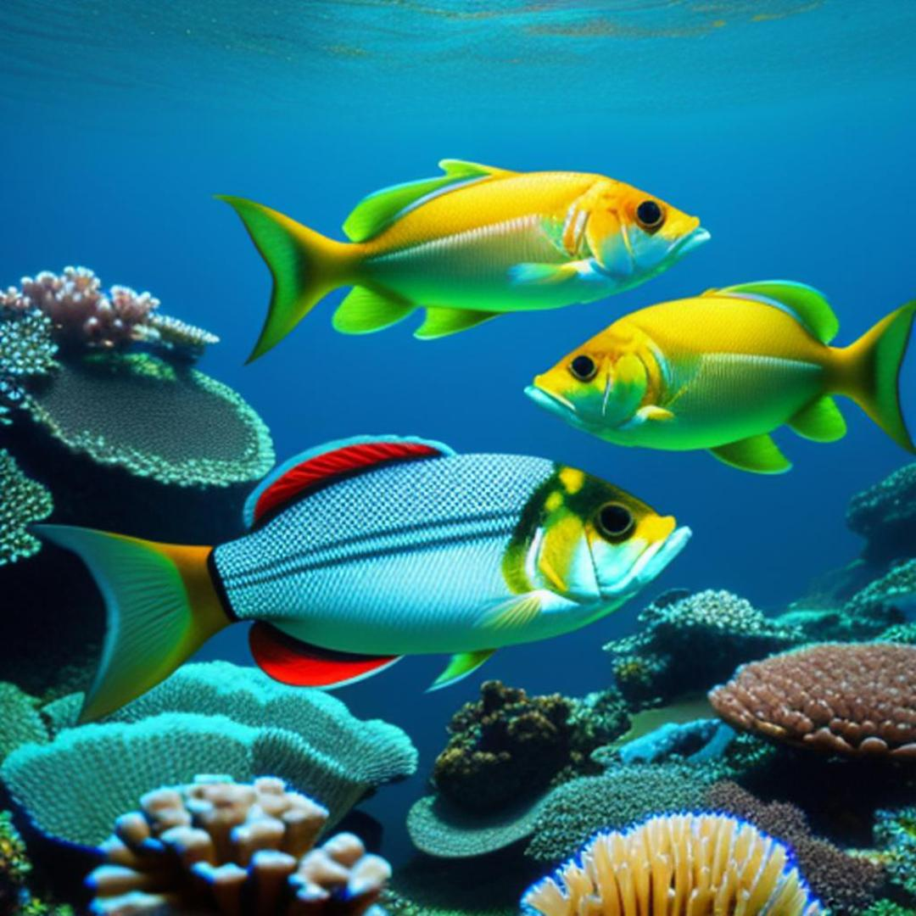
Feeding Techniques for Optimal Nutrition
Quality Over Quantity
Feed your aquatic creatures a balanced diet that meets their nutritional needs without overfeeding.
Avoid overfeeding to minimize excess organic waste that can disrupt the nitrogen cycle.
Variety Is Key
Rotate between different types of food to provide a diverse range of nutrients for your aquatic friends.

Slide 8
Managing Organic Waste
Remove excess food promptly to prevent its decomposition and the release of toxins.
Regularly clean the aquarium substrate and filter media to reduce the accumulation of organic waste.
Add beneficial bacteria supplements to aid in the breakdown of organic waste and maintain water quality.

Slide 9
Maintenance for a Harmonious Eco-Balance
1
Regular Water Testing
Stay vigilant by regularly testing water parameters to detect any changes and address them promptly.
2
Water Changes
Perform regular partial water changes to maintain stable conditions and remove accumulated toxins.
3
Equipment Maintenance
Clean and maintain aquarium equipment, such as filters and aerators, to ensure optimal performance.

