Slide 1
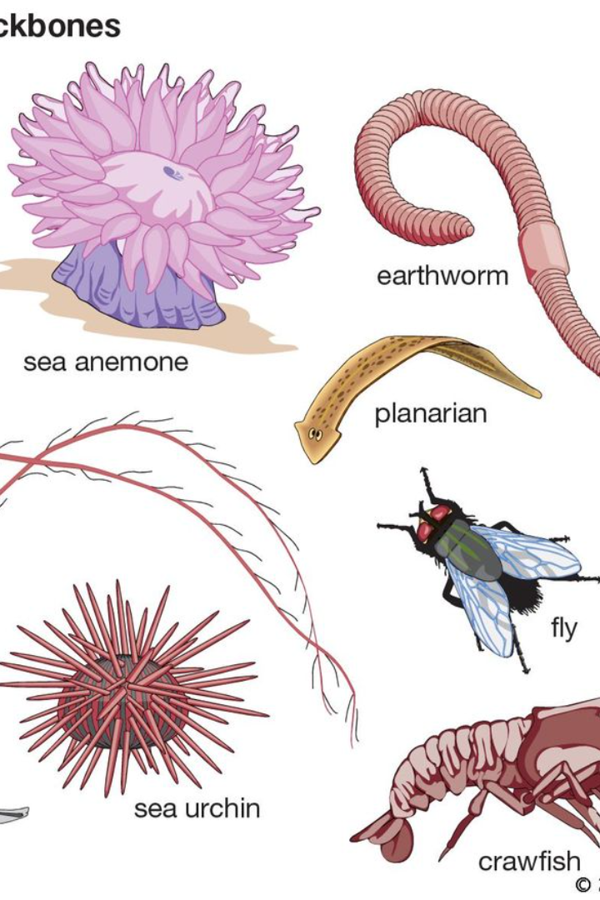
Introduction to Invertebrates
Invertebrates make up the vast majority of the animal kingdom, comprising a wide range of species without a backbone. They play crucial roles in ecosystems and exhibit fascinating diversity.

Slide 2
Characteristics of Invertebrates
1
Diversity of Forms
2
Adaptations for Survival
Incredible variety of shapes, sizes, and body structures, from the delicate wings of butterflies to the armored exoskeletons of beetles.
Evolved remarkable adaptations to thrive in diverse environments, including camouflage, stinging mechanisms, and various feeding strategies.
3
Reproduction Strategies
4
Ecological Niches
Reproduce in numerous ways, from simple asexual reproduction to complex courtship rituals and elaborate mating displays.
Occupy various ecological niches, fulfilling crucial roles as pollinators, decomposers, and primary producers in aquatic ecosystems.

Slide 3
Importance of Invertebrates in the Ecosystem
Provide essential ecosystem services, such as nutrient recycling, pest control, and soil aeration.
Fundamental links in food webs, serving as prey for numerous predators and helping regulate population dynamics.

Slide 4
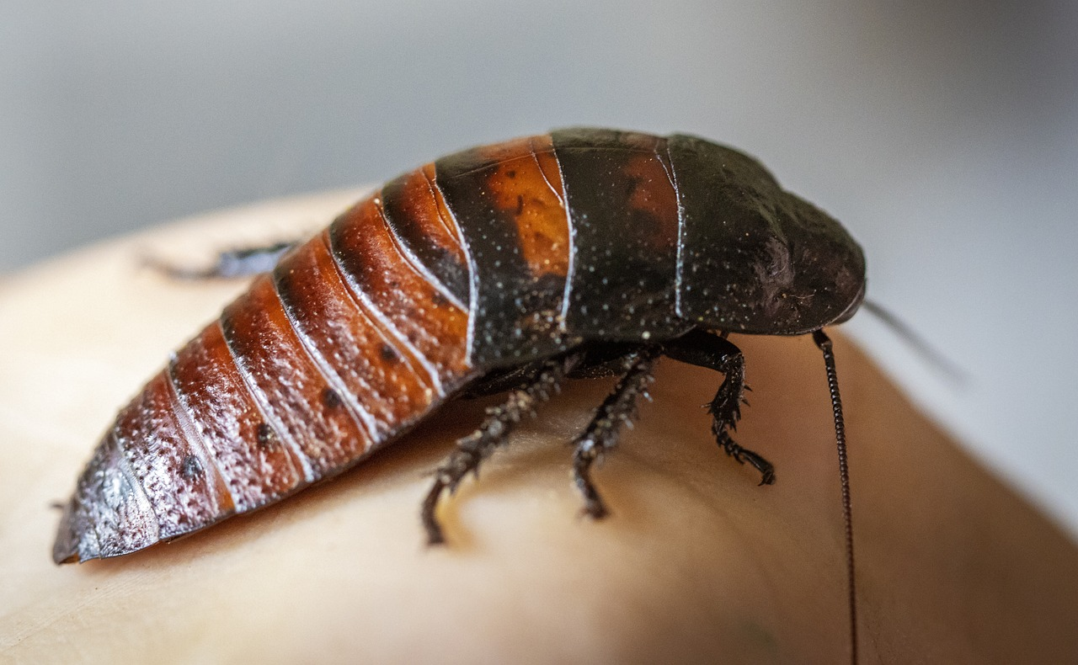
Is this an invertebrate?
https://cdn.pixabay.com/photo/2021/02/14/20/12/madagascar-hissing-cockroach-6015722_1280.jpg

Slide 5
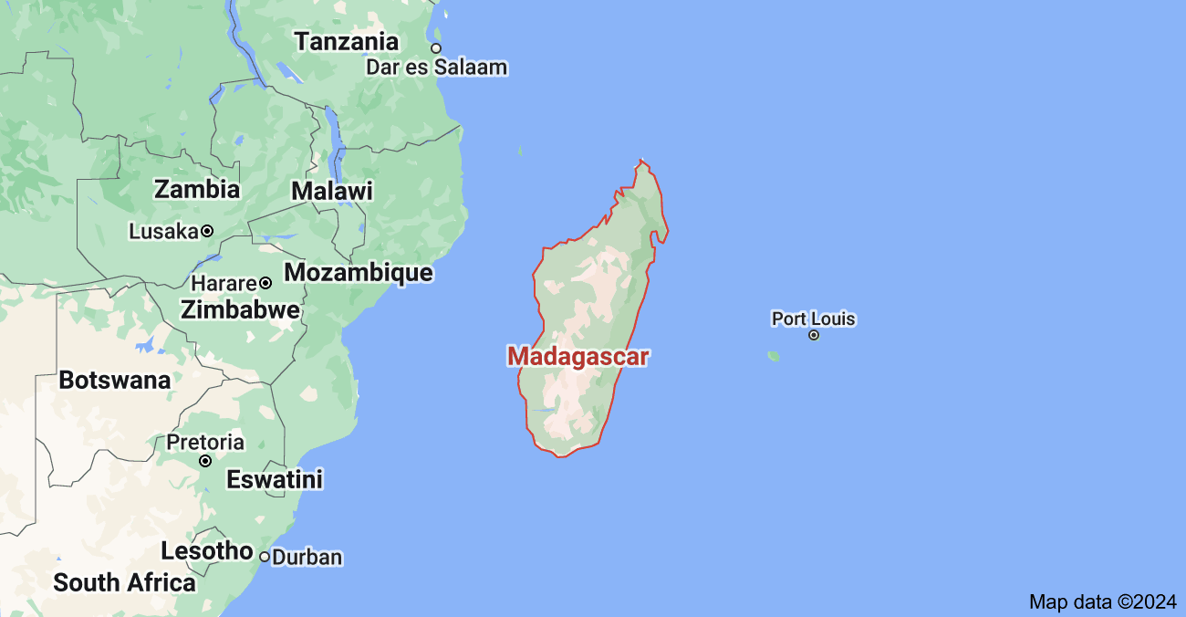
Overview of Madagascar Hissing Cockroaches
Large cockroaches (2-3 inches long and 1 inch wide)
Native to the island of Madagascar, off the coast of Africa.
https://www.google.com/maps/vt/data=tYiphr9GfcpGGAJlekRnl2gaWTUoJWdE6Nbr8jjos7-9OxkMJO6n0mj-2yjJN-fZJVLVCIx_c6W8hNm8sHlvq48_H-753xRBz1RGi-_r3OgyYxMYuZXXT7jeCWwVuy7n6wgx4QAMV50xkKD43lb9GGEY1JioDr6L975kLUe-UrdL0_yn1HqescvZJEAUE4xJCgSabnyvNcT6hpwgfczH_xH0spOey5SpwRdnb7Blm2DvoevhaOJJEJKF0KGimbKnPatfgiK3SG4DrduqUlZunpcB

Slide 6
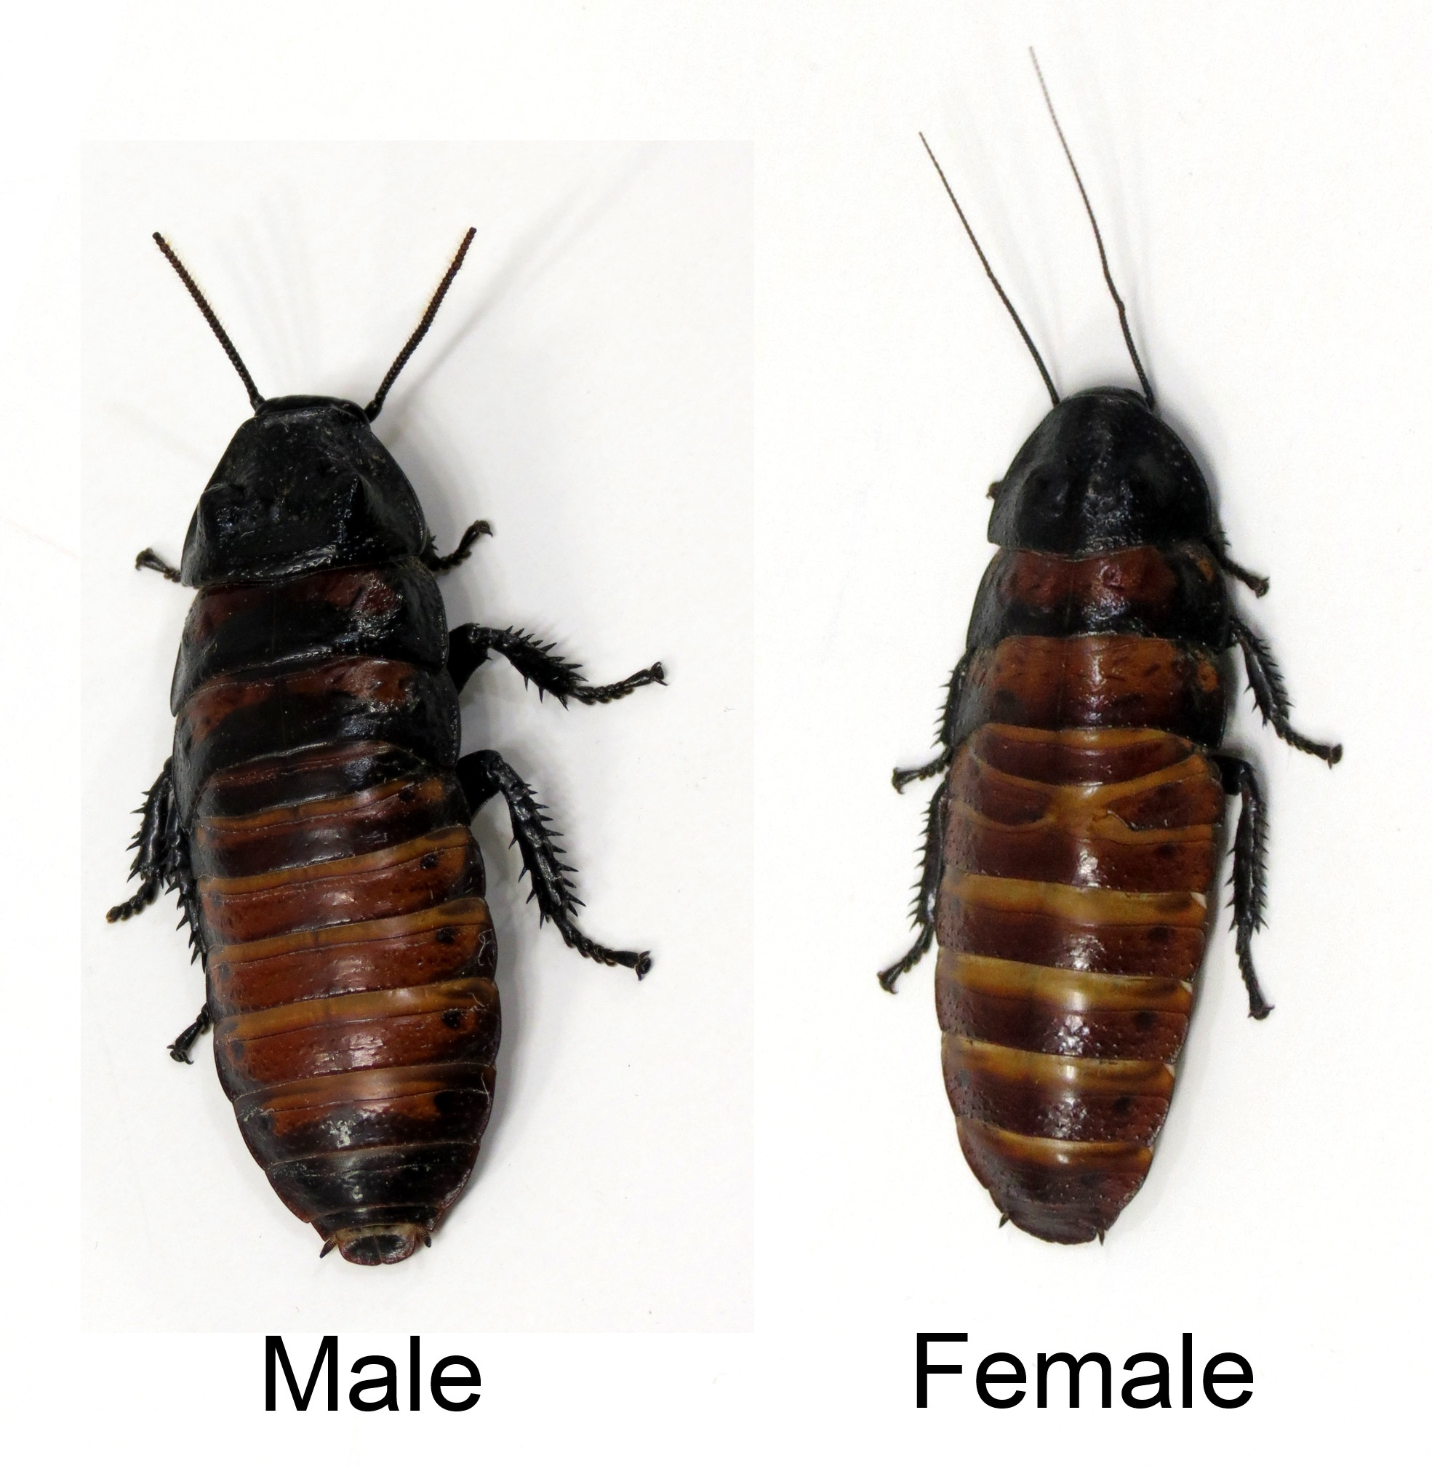
Overview of Madagascar Hissing Cockroaches
Males
prominent protrusions on the thorax, which are called pronotal humps.
brushier antennae.
Females
small bumps or none, with a much smoother thorax.
https://i.imgur.com/hShGs8q.jpg

Slide 7
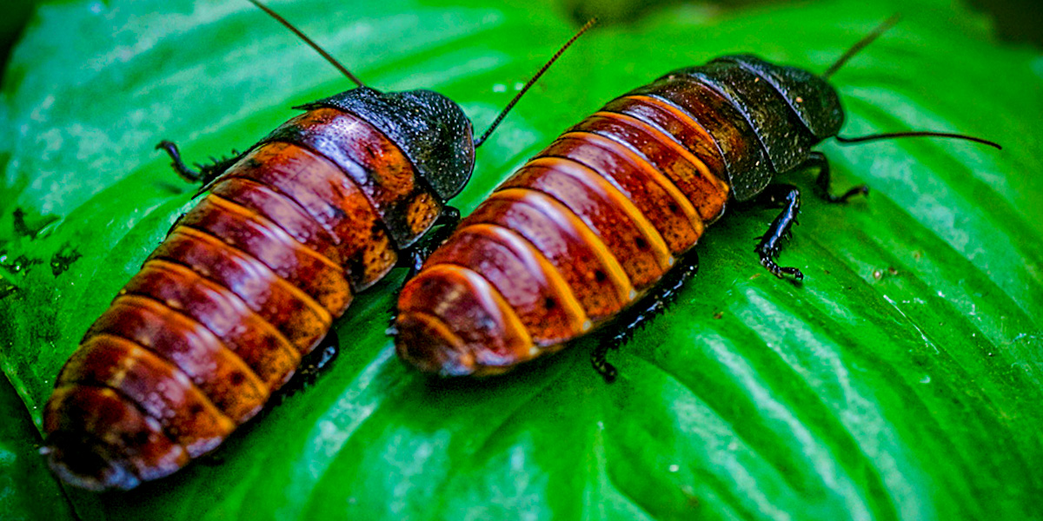
Overview of Madagascar Hissing Cockroaches
Average lifespan in the wild: 2 to 5 years
Size: 2 to 3 inches long
Weight: Up to 0.8 ounces
Color: shiny brown
Wingless
They are NOT pests and do not live in human dwellings
https://the-dro.com/wp-content/uploads/2017/03/hisser-roach-header-banner.jpg

Slide 8
Overview of Madagascar Hissing Cockroaches
How do they hiss?
Push air forcefully through small openings through which air is taken into the trachea.
Why do they hiss?
Males
Defense - to avoid predators and to defend territories
Communication - to signal danger, for example
Courtship and mating
Females and nymphs hiss only when disturbed.

Slide 9
Role of Madagascar Hissing Cockroaches in the Ecosystem
Live on forest floors, among leaf litter, logs, and other detritus.
At night, they become more active and scavenge for meals, feeding primarily on fruit or plant materials.
Play a vital role as detritivores, aiding in the decomposition of organic matter and nutrient cycling in their natural habitats.
Contribute to approximately 92% of the decomposition process in their ecosystems, ensuring the breakdown of decaying plant and animal material.

Slide 10
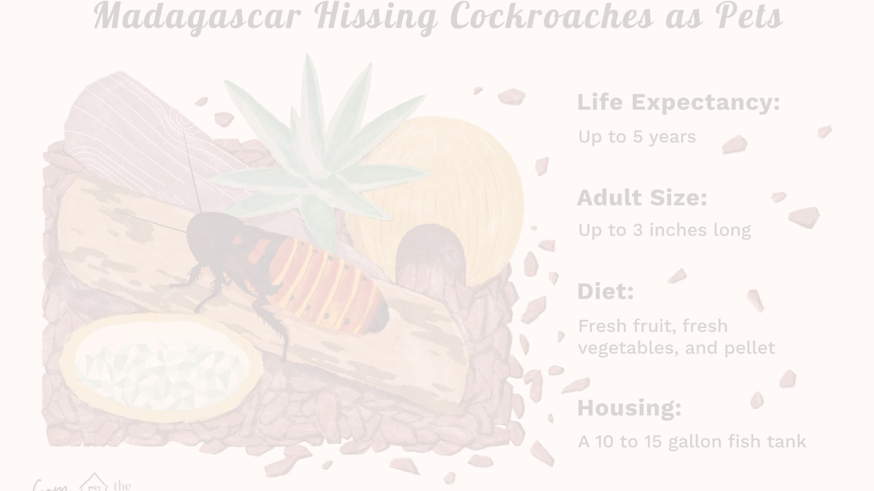
Keeping Madagascar Hissing Cockroaches as Pets
Enclosure
Diet and Hydration
Environmental Conditions
Provide a spacious, well-ventilated enclosure with a substrate for burrowing and climbing opportunities.
Offer a varied diet of fruits, vegetables, and protein sources while ensuring access to clean water and maintaining proper humidity levels.
Maintain a warm and relatively humid environment, mimicking their natural habitat, and ensure a secure lid to prevent escapes.

