Slide 1
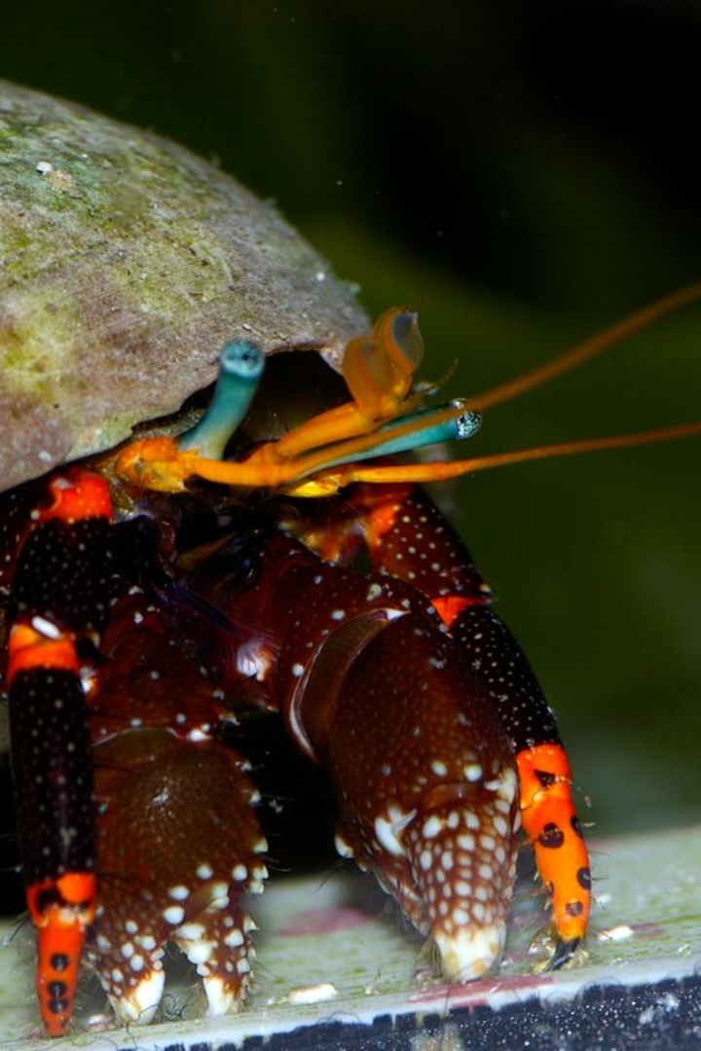
Introduction to Hermit Crab Shells
Hermit crab shells are the protective exoskeletons that provide shelter for these fascinating crustaceans. They are essential for the hermit crab's survival, acting as a portable home that offers safety and security.

Slide 2
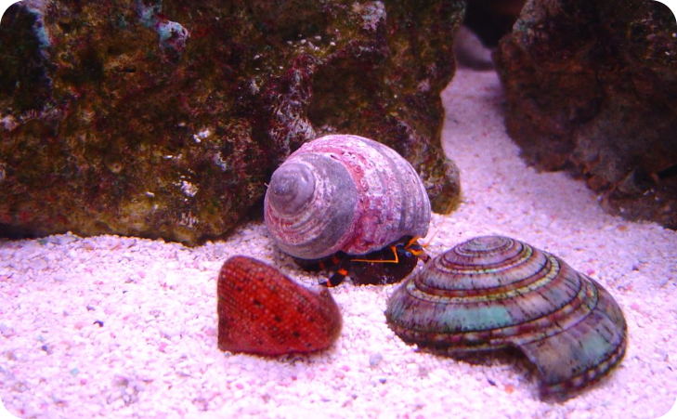
What Are Hermit Crab Shells?
Diverse Shell Types
Hermit crab shells come in various shapes, sizes, and colors. Hermit crabs cannot create their own shells so they use the empty shells of gastropods/\.

Slide 3
Composition and Structure of Hermit Crab Shells
Protective Material
The shells are primarily made of calcium carbonate, providing durability and protection against predators and environmental factors.
Modifiable Structure
The shell's shape and size can be modified to accommodate the hermit crab's growing body through a process called molting.

Slide 4
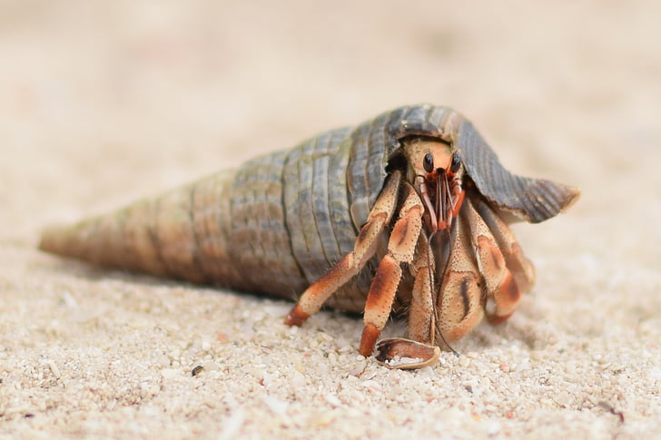
Function of Hermit Crab Shells
Portable Home
Protection
The shells serve as protective coverings, shielding the hermit crabs from potential threats and dangers in their environment.
They provide a safe and cozy home that the hermit crabs can carry around as they scuttle across the seafloor.

Slide 5
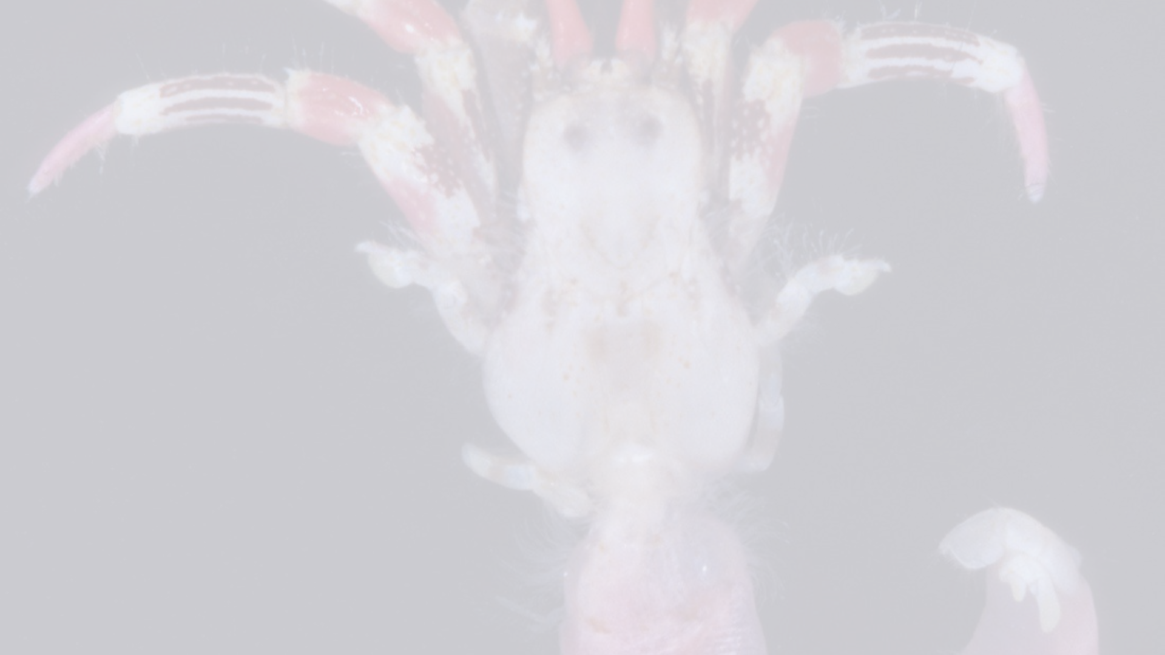
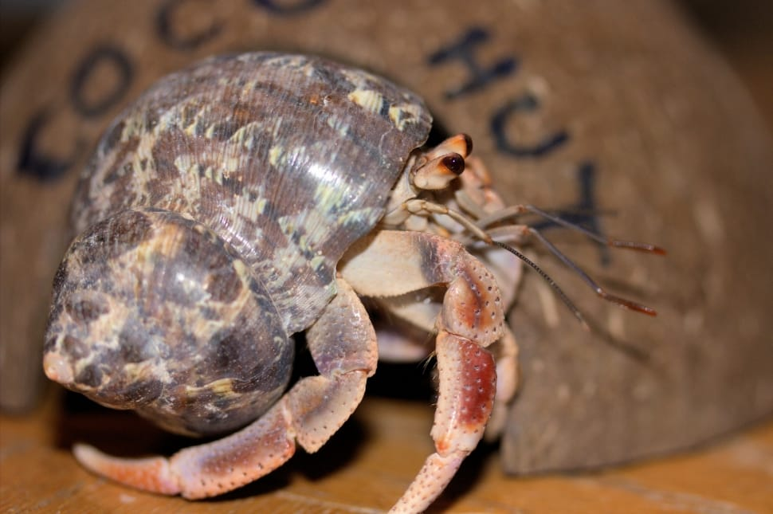
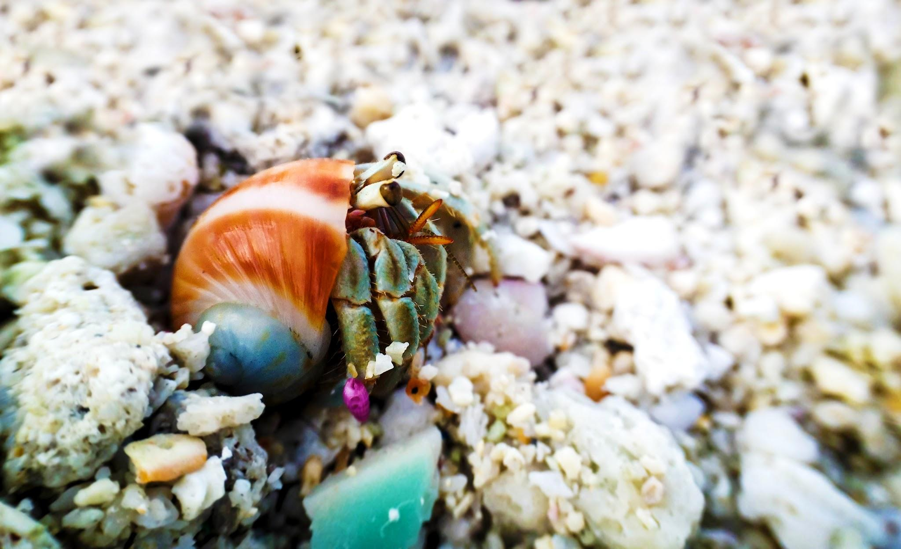
The Process of Changing Shells
Exploring
They search for a suitable-sized empty shell, often engaging in "shell swapping" where multiple individuals exchange shells to find the best fit.
Molting
Hermit crabs undergo molting, shedding their exoskeleton to allow for growth and the potential adoption of a larger shell.

Slide 6
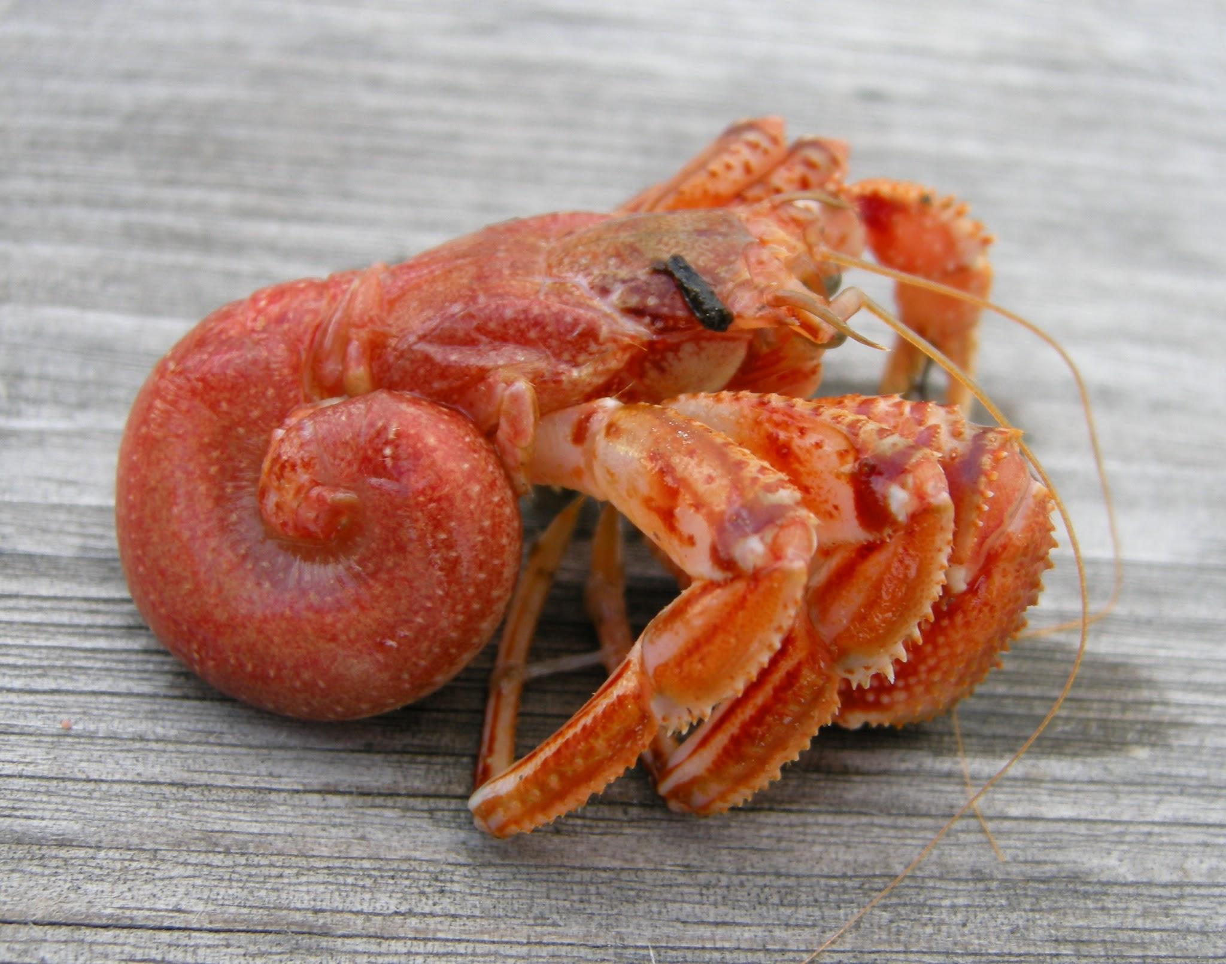
Reasons Why Hermit Crabs Change Shells
Growth
As hermit crabs grow, they require larger shells to accommodate their increasing body size.
Protection
Older shells become worn-out and may no longer provide adequate protection, prompting the hermit crabs to seek new ones.
Environmental Suitability
Changes in the environment or habitat conditions may necessitate a switch to shells that are better suited for survival.

Slide 7
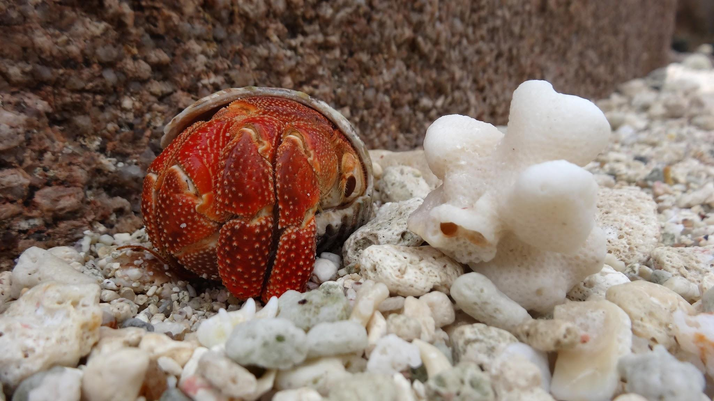
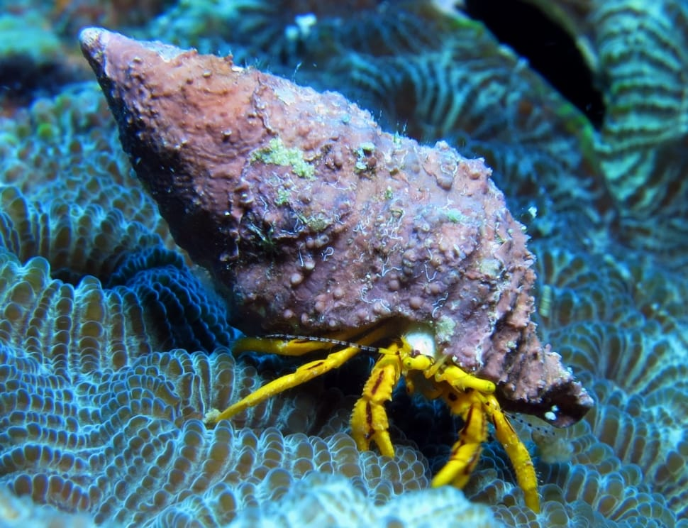
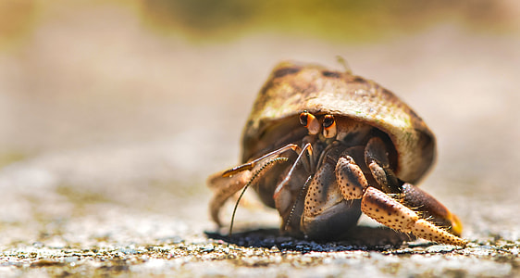
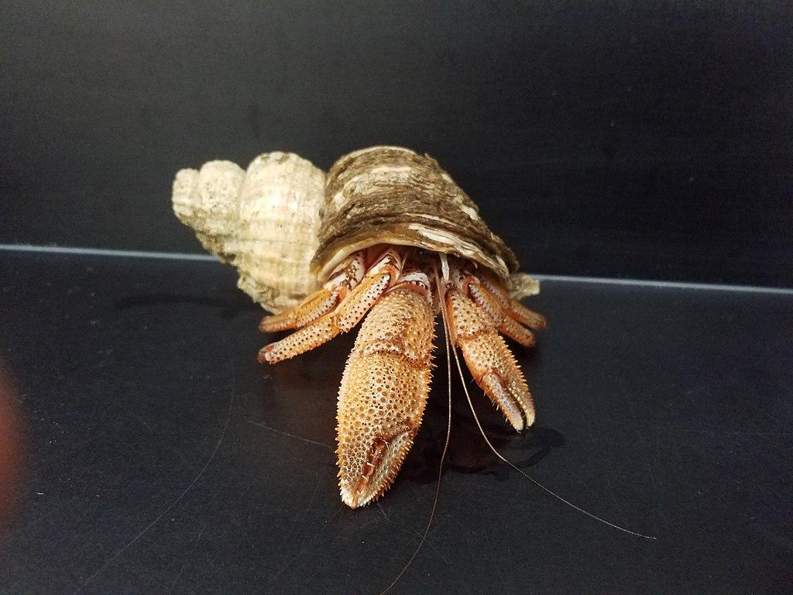
How Can Understanding Hermit Crab Shells Help Us?
Conservation
Understanding the significance of suitable shells can lead to conservation efforts aimed at preserving natural habitats for hermit crabs.
Bioinspiration
Studying shell adaptation may inspire biomimicry for engineering designs that can provide innovative solutions in various industries.

Slide 8
Conclusion
The ability of hermit crabs to change shells showcases their remarkable adaptation and survival strategies in dynamic marine environments.

