Slide 1
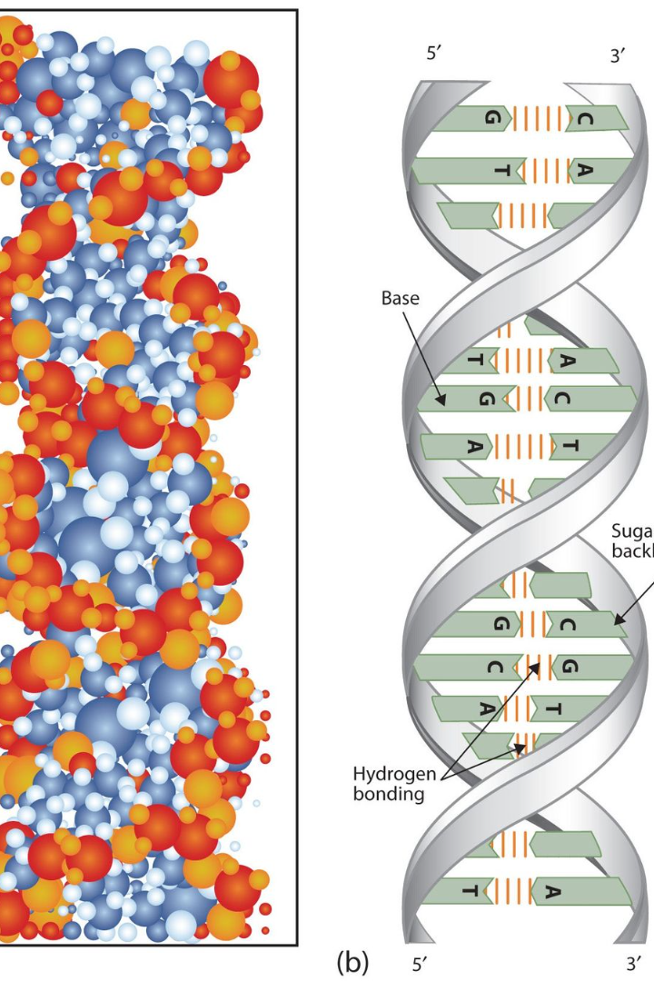
Introduction to Genes and Heredity…
using our class guinea pig!

Slide 2
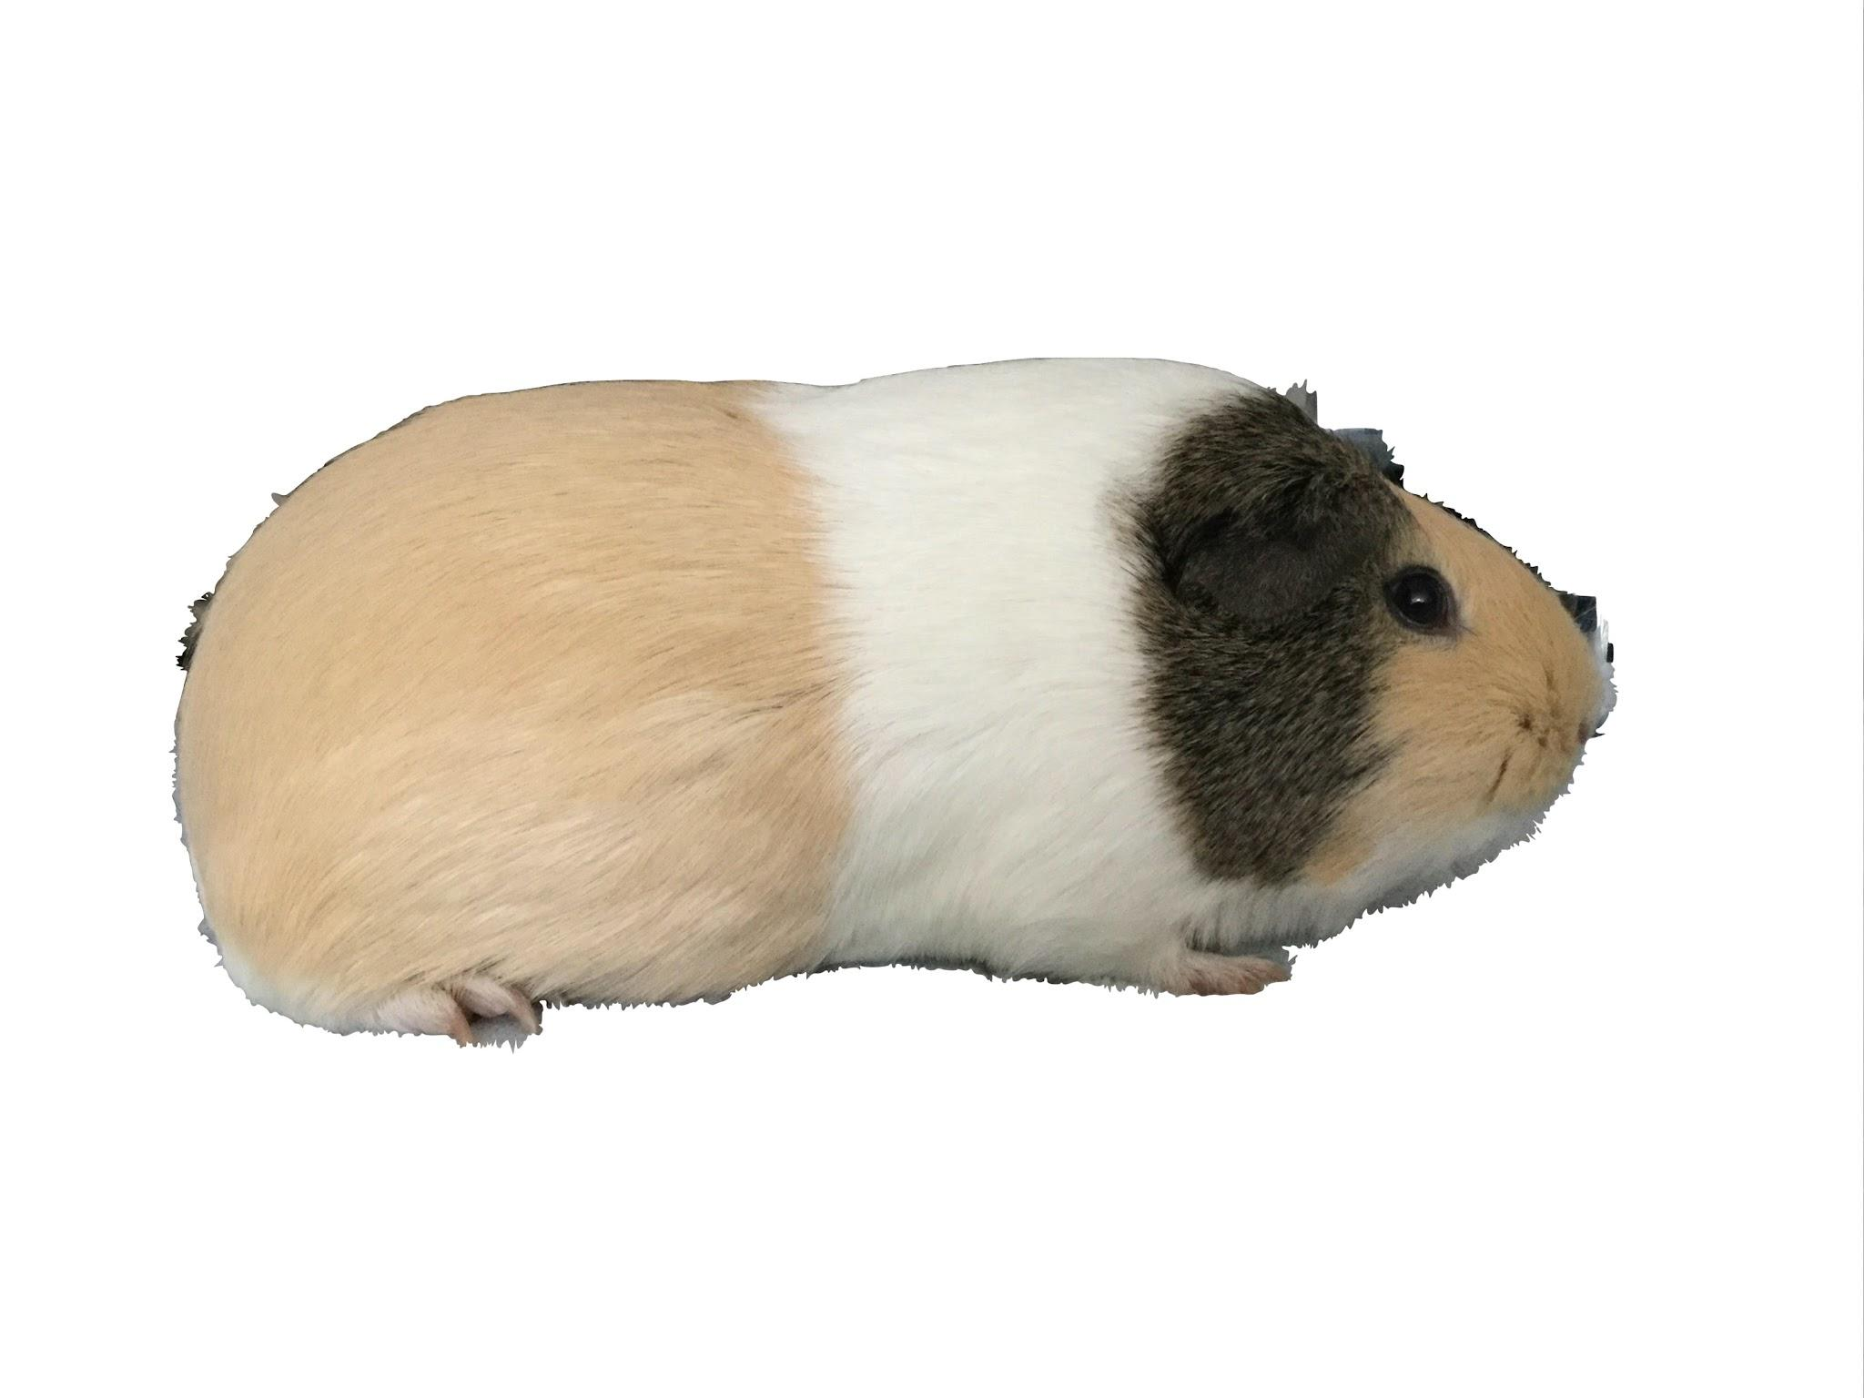
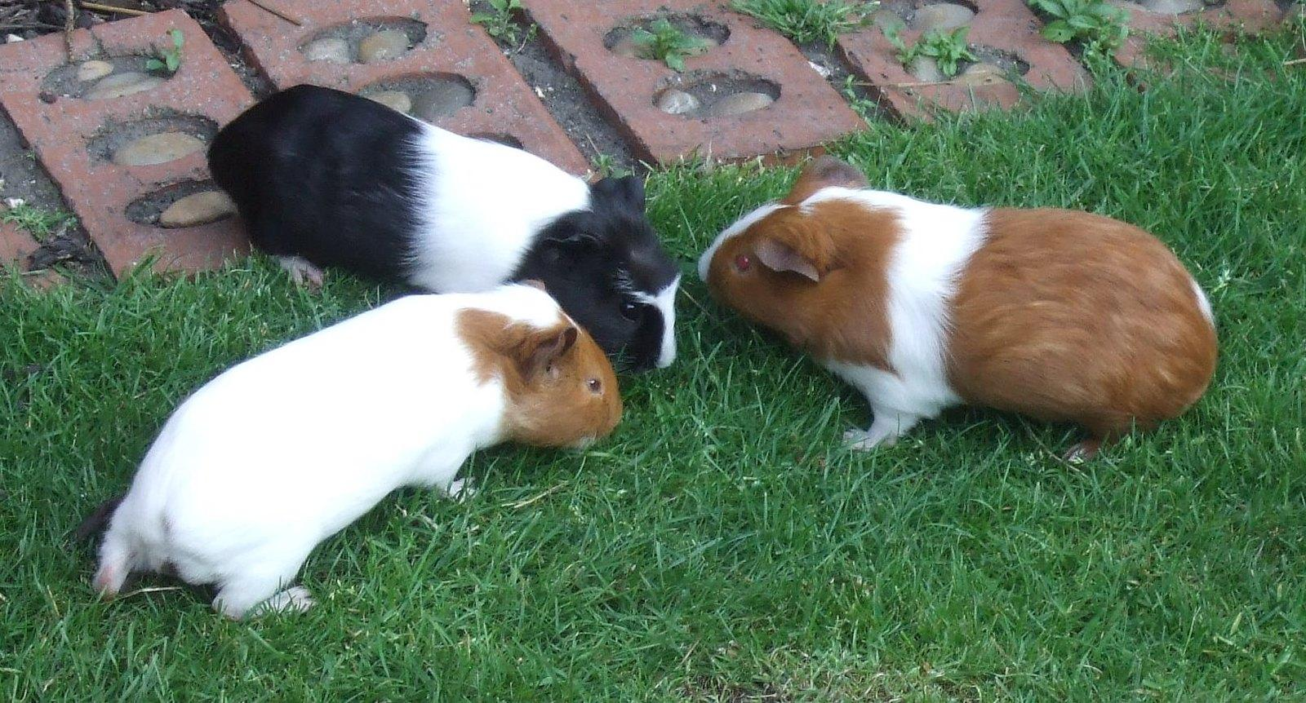
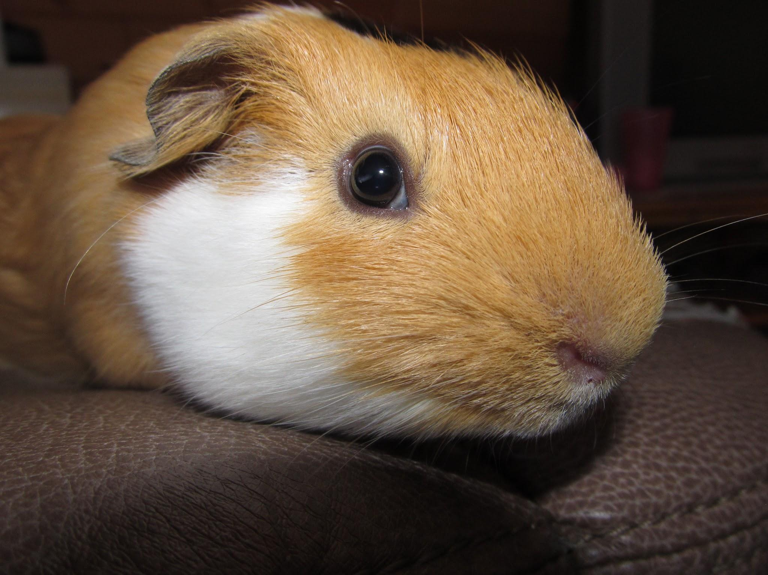
The Guinea Pig as a Model Organism
Diverse Genetics
The guinea pig exhibits a broad range of genetic traits, making it an ideal model for studying heredity and genetic diversity.

Slide 3
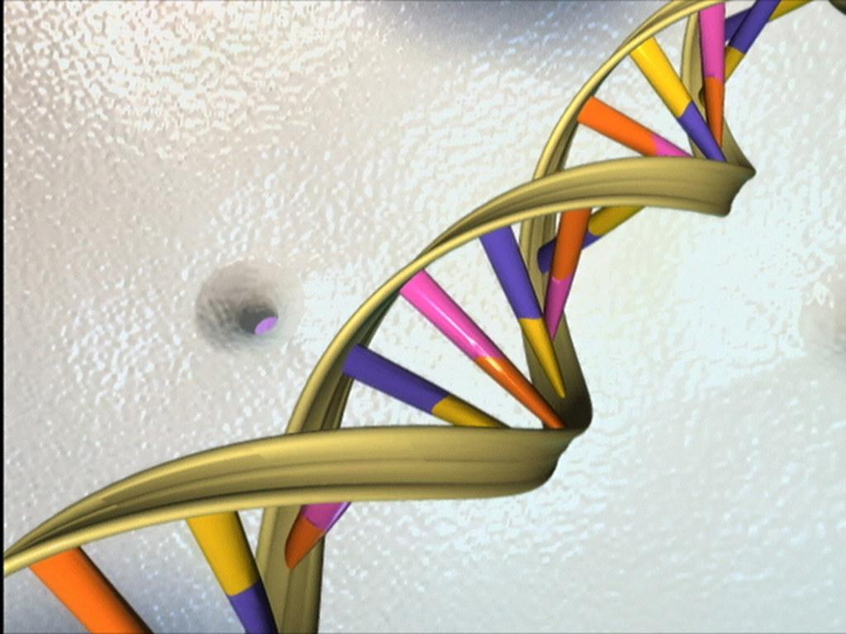
Basic Building Blocks of Inheritance
Deoxyribonucleic acid (DNA) is a molecule that carries most of the genetic instructions used in the development, functioning, and reproduction of all living things. It is a double-stranded helix shape, resembling a twisted ladder.
DNA Structure
Each "rung" of the ladder is made up of a pair of nitrogenous bases, which can be either adenine (A), thymine (T), cytosine (C), or guanine (G). These bases are held together by hydrogen bonds, with A always pairing with T, and C always pairing with G. The order of these base pairs along the DNA strand determines the genetic code.

Slide 4
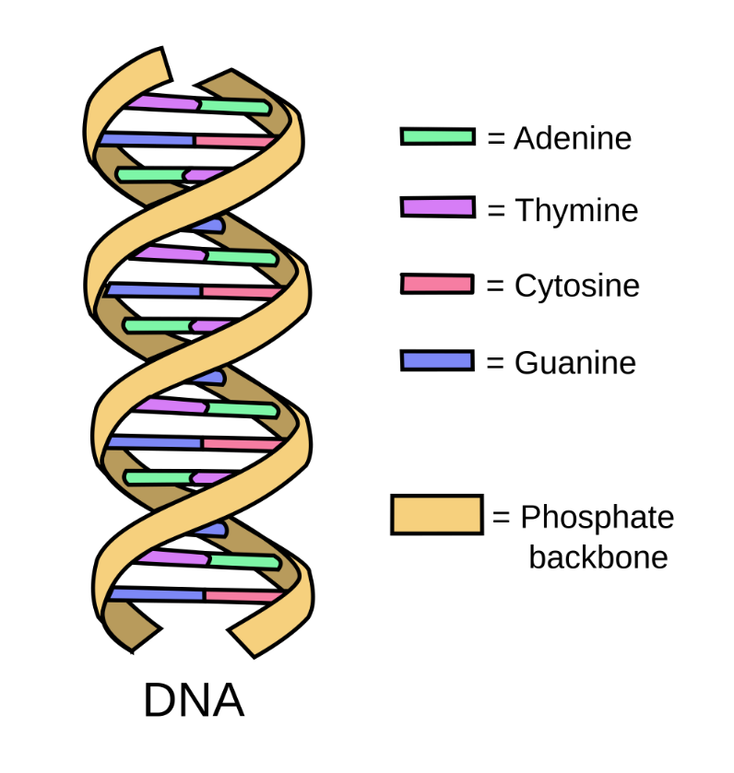
Basic Building Blocks of Inheritance
DNA Structure
Each "rung" of the ladder is made up of a pair of nitrogenous bases, which can be either adenine (A), thymine (T), cytosine (C), or guanine (G). These bases are held together by hydrogen bonds, with A always pairing with T, and C always pairing with G. The order of these base pairs along the DNA strand determines the genetic code.

Slide 5
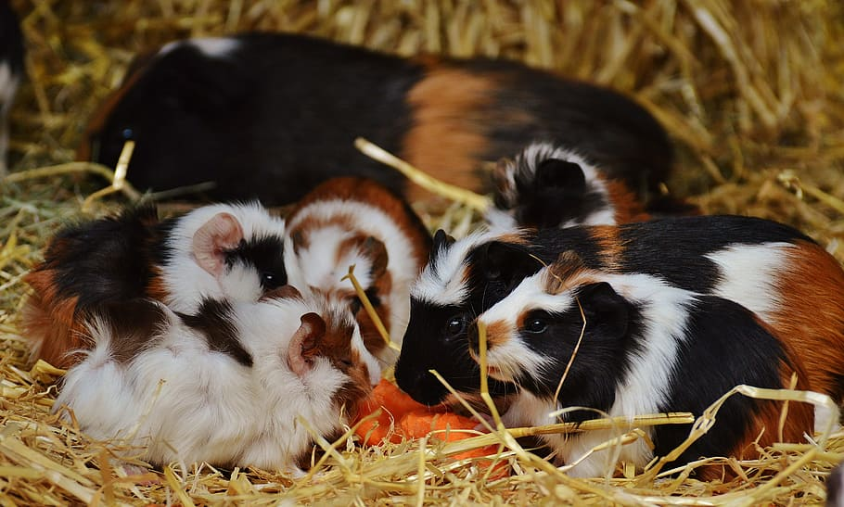
Understanding Genetics: Inheritance
Traits are passed down from parents to their offspring through the inheritance of genes. The specific combination of genes inherited from both parents determines the unique traits of an individual.

Slide 6
Understanding Genetics: Physical Traits
Genes play a crucial role in determining our physical traits. These traits can include things like hair color, eye color, height, and even certain predispositions to diseases.
Each gene is made up of specific DNA sequences that code for different traits. For example, a gene may determine whether a person has blue or brown eyes.
Some traits are controlled by a single gene, while others are influenced by multiple genes and environmental factors.

Slide 7
Inherited Traits: Genotypes and Phenotypes
the observable characteristics or traits of an organism, such as its physical appearance, behavior, or other measurable traits. It is the result of the interaction between an organism's genetic makeup and the environment.
Phenotype
the genetic makeup or the set of genes an organism carries. It determines the potential range of phenotypic traits that an organism can exhibit. Genotype is inherited from the organism's parents.
Genotype
Codominant Inheritance
In codominant inheritance, both alleles contribute to the phenotype, and neither allele is dominant or recessive over the other. The resulting phenotype shows a combination or expression of both alleles.
Example: In guinea pigs, if one parent has a black coat color allele (B) and the other parent has a white coat color allele (W), the offspring may have a coat color that shows both black and white patches.
X-Linked Inheritance
X-linked inheritance refers to the inheritance of genes located on the X chromosome. It often shows different inheritance patterns in males and females due to the presence of one X chromosome in males and two X chromosomes in females.
Example: Hemophilia is an X-linked recessive disorder, meaning that males are more commonly affected because they only have one X chromosome. Females can be carriers of the disorder if they inherit one affected X chromosome and one normal X chromosome.

Slide 8
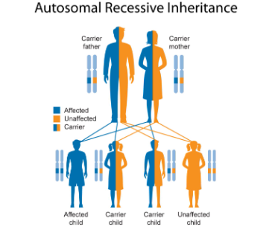
Inheritance Patterns
Dominant Inheritance
a single copy of a dominant allele is sufficient to produce the associated phenotype. The dominant allele masks the effect of the recessive allele.
Example: If a guinea pig inherits a dominant allele for a black coat color (B) from one parent and a recessive allele for a white coat color (b) from the other parent, the guinea pig will have a black coat.
Example: If both parents of a guinea pig carry a recessive allele for a white coat color (b), the guinea pig will have a white coat only if it inherits two copies of the recessive allele (bb).
Codominant Inheritance
In codominant inheritance, both alleles contribute to the phenotype, and neither allele is dominant or recessive over the other. The resulting phenotype shows a combination or expression of both alleles.
Example: In guinea pigs, if one parent has a black coat color allele (B) and the other parent has a white coat color allele (W), the offspring may have a coat color that shows both black and white patches.
X-Linked Inheritance
X-linked inheritance refers to the inheritance of genes located on the X chromosome. It often shows different inheritance patterns in males and females due to the presence of one X chromosome in males and two X chromosomes in females.
Example: Hemophilia is an X-linked recessive disorder, meaning that males are more commonly affected because they only have one X chromosome. Females can be carriers of the disorder if they inherit one affected X chromosome and one normal X chromosome.

Slide 9
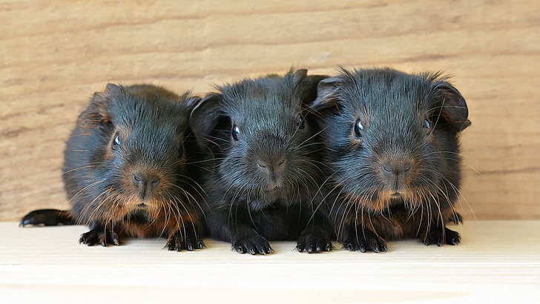
Inheritance Patterns
Dominant Inheritance
Example: If a guinea pig inherits a dominant allele for a black coat color (B) from one parent and a recessive allele for a white coat color (b) from the other parent, the guinea pig will have a black coat.
a single copy of a dominant allele is sufficient to produce the associated phenotype. The dominant allele masks the effect of the recessive allele.
Codominant Inheritance
In codominant inheritance, both alleles contribute to the phenotype, and neither allele is dominant or recessive over the other. The resulting phenotype shows a combination or expression of both alleles.
Example: In guinea pigs, if one parent has a black coat color allele (B) and the other parent has a white coat color allele (W), the offspring may have a coat color that shows both black and white patches.
X-Linked Inheritance
X-linked inheritance refers to the inheritance of genes located on the X chromosome. It often shows different inheritance patterns in males and females due to the presence of one X chromosome in males and two X chromosomes in females.
Example: Hemophilia is an X-linked recessive disorder, meaning that males are more commonly affected because they only have one X chromosome. Females can be carriers of the disorder if they inherit one affected X chromosome and one normal X chromosome.

Slide 10
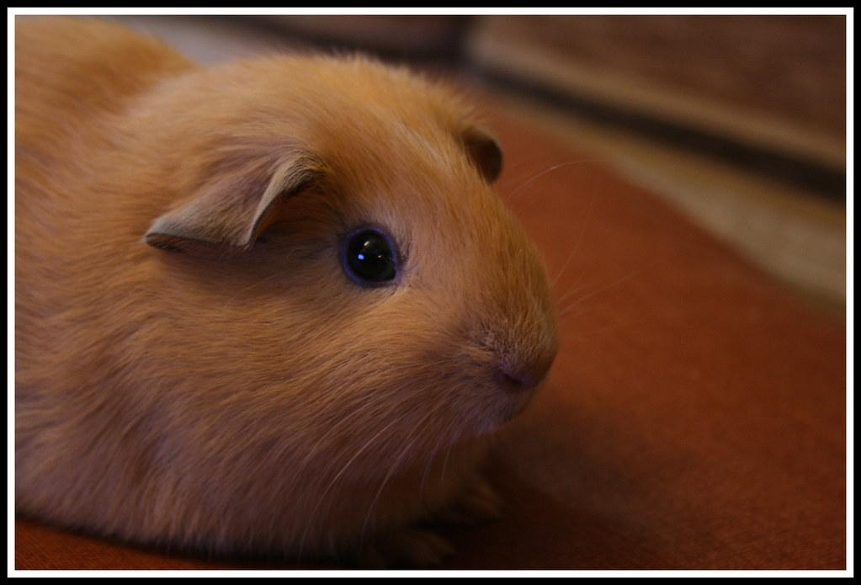
Inheritance Patterns
Recessive Inheritance
An individual must inherit two copies of the recessive allele to be able to exhibit the phenotype.
Example: If both parents of a guinea pig are brown, a recessive trait,the baby will be brown
BUT…the parents might have a phenotype of black fur and yet carry the brown allele. If they both contribute the brown allele, then the baby will be brown.

Slide 11
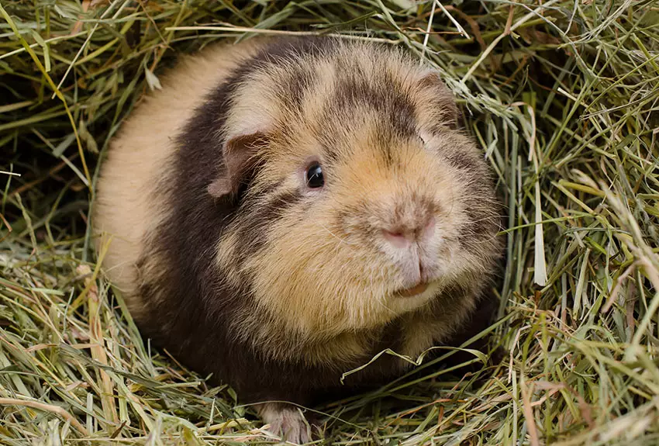
Inheritance Patterns
Incomplete Dominance
Both alleles contribute to the phenotype - neither is dominant or recessive. The resulting phenotype shows a combination of the trait.
For example, in guinea pigs, a Roan Coat occurs when both the agouti and solid coat alleles are present. It results in a coat with a mixture of agouti and solid hairs, creating a speckled or brindled appearance.
https://www.omlet.co.uk/images/cache/850/575/Brindle-guinea-pig.webp

Slide 12
Inheritance Patterns
Coat Color in Males: Guinea pigs have a sex chromosome system similar to humans (XX females, XY males). Genes located on the X chromosome can exhibit X-linked inheritance, where males only have one copy of the X chromosome and express any alleles present on it.
Females can be homozygous for orange fur, or can carry the gene without expressing it.Males can only be orange (Oo) if they inherit the orange allele from their mother.
X Linked Inheritance--
the inheritance of genes located on the X chromosome. It usually shows different inheritance patterns in males and females due to the presence of one X chromosome and two X chromosomes in the female.
https://www.omlet.us/images/originals/Self-guinea-pig.jpg

Slide 13
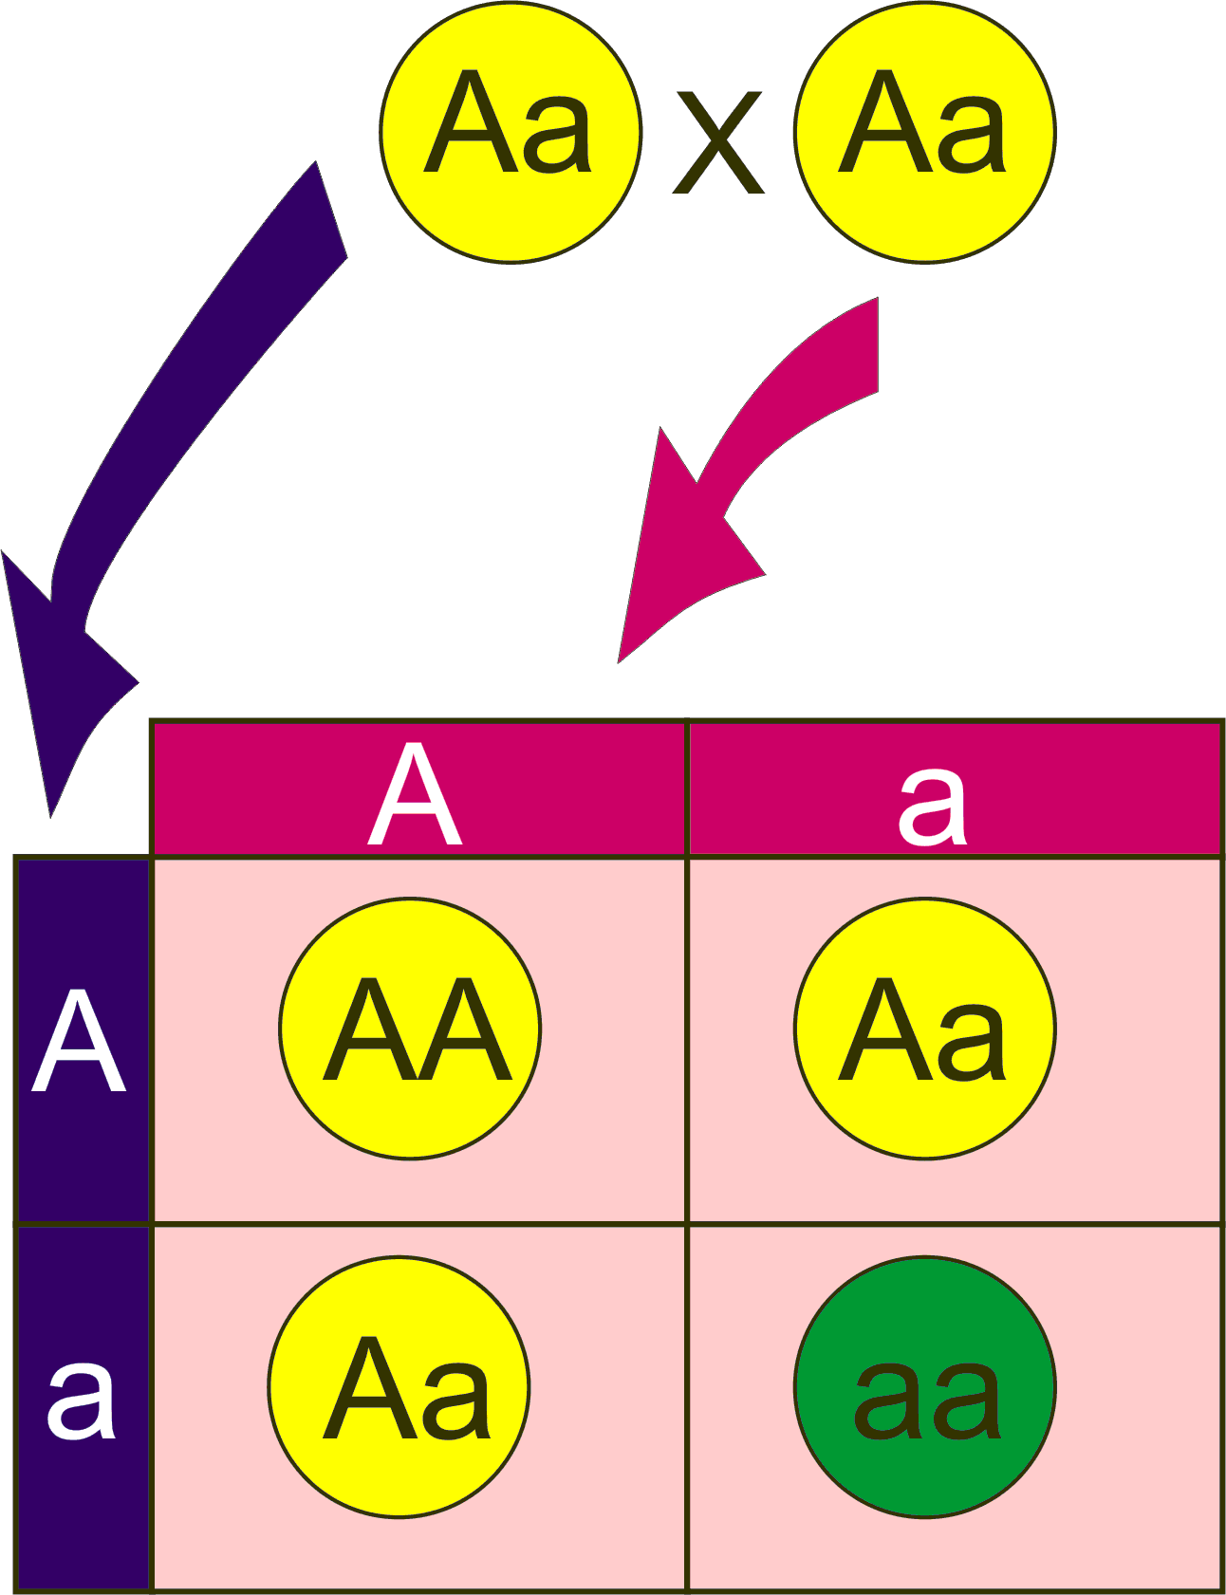
Punnett Squares
In a Punnett square, the alleles of the parents are represented in a grid, and by combining the alleles from the parents, we can determine the possible combinations of alleles in the offspring.
Punnett squares are a visual tool used to predict the possible genetic outcomes of a cross between two individuals. They allow us to determine the probability of different genotypes and phenotypes in the offspring.

Slide 14
Please go to:
Guinea Pig Genes:
to practice Punnett Squares with Guinea Pigs

