Slide 1
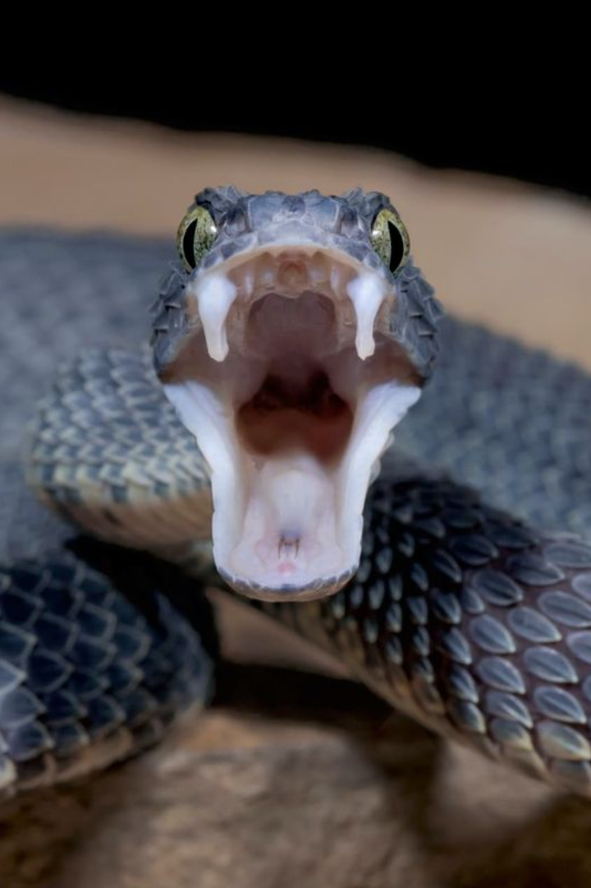
Exploring the World of Snake Fangs
Today we'll learn about the different types of fangs found in snakes and how venom is ejected from them.

Slide 2
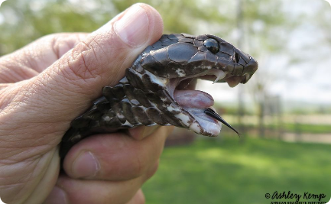
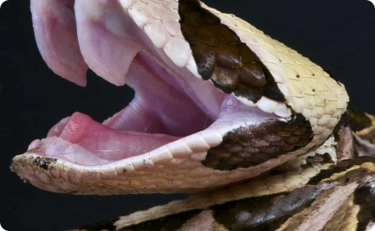
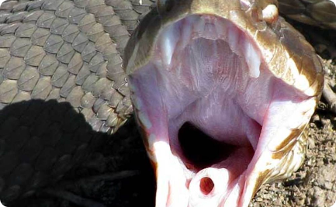
Only venomous snakes have fangs, which are different from the snake's "normal" teeth, therefore fangs are considered specialized teeth.
Types of Snake Fangs
Characteristics of Fangs
Fixed Fangs
Hinged Fangs
These fangs are short and permanently erect. They are found in non-venomous snakes.
These fangs fold against the roof of the snake's mouth when not in use. They are found in venomous snakes.
Fangs are modified teeth that are longer, sharper and more hollow. They are used to inject venom into the prey, while the snake holds it in its mouth.

Slide 3
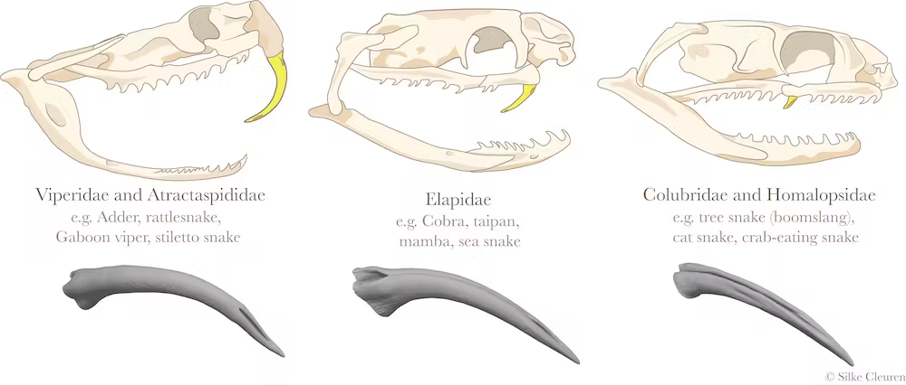
https://images.theconversation.com/files/397640/original/file-20210428-19-jvnlor.png?ixlib=rb-1.1.0&q=45&auto=format&w=1000&fit=clip
Mouse munchers, fish fanatics, and reptile wrestlers - venomous snakes tailor their venom and hunting skills to specific prey. Their fangs have evolved- snakes that have blunt fangs are more likely to prey on lizards and crabs and those with slender, sharp fangs prey on mice.

Slide 4
Opisthoglyph
fangs at the back of the mouth
fangs have backward groovesthe venom groove or channel is located on the back (posterior) side of the fang, closer to the base.
https://allyouneedisbiology.files.wordpress.com/2015/01/68nigrifutand1.jpg
Types of Snake Fangs
Aglyphous
lacking grooves or channels for venom transport
long, thin, conical, and sharp
not considered fangs
During a bite, the venom, secreted from modified salivary glands, flows along the grooves in the jaw and onto the teeth

Slide 5
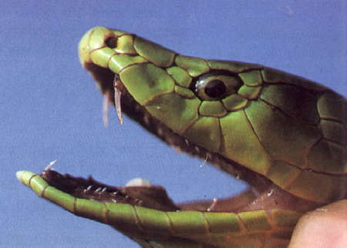
Types of Snake Fangs
Solenoglyphous
long, hollow fangs
the snake can fold the fangs against the roof of their mouth until they are needed
Venom travels from a venom gland at the base of the fang through the hollow channel and exits through an opening near the tip.
https://blog.wcs.org/photo/wp-content/uploads/2015/01/%C2%A9AMNHC.-Chesek-CC_DB_Skull-736x650.jpg
Proteroglyph
Fangs have forward grooves
Small, hollow fangs
Hollow fang with front-facing hole – this fang has a hole on the front of the tooth instead of the bottom, so it can “spit” the venom forward https://www.nps.gov/cabr/blogs/images/Proteroglyphous-Dentition.png

Slide 6
Can you identify which is which?
https://i2.wp.com/reptileapartment.com/wp-content/uploads/Intro_Figure3.jpg

Slide 7
Can you identify which is which?
A, aglyphous or non-venomous python skull.
B, opisthoglyph, or rear-fanged venomous snake skull.
C, proteroglyph, or elapid skull.
D, solenoglyph, or viperid skull.
https://i2.wp.com/reptileapartment.com/wp-content/uploads/Intro_Figure3.jpg

Slide 8
Venom Glands and Sacs
Venom Glands
Sacs
Venom glands are located beneath the eyes and contain the venom. There are two kinds of glands: Duvernoy's and the Maxillary glands.
Sacs are structures below the venom glands that store the venom. They form part of the snake's dental system.
Venom Composition
Fun Fact
Venoms vary by species, but they contain toxins that help in hunting and defense.
Some snake venom is being studied for its potential medicinal use in treating diseases such as cancer, heart disease, and stroke.

Slide 9
Mechanisms for Venom Ejection
1
Solitary Fangs
These snakes use muscles to force venom from the gland through the duct to the fang.
Multi-Fanged Snakes
2
These snakes have a valve in the venom duct that controls venom flow to all the fangs at once.
3
Rear-Fanged Snakes
They have venom-delivery systems different from front-fanged snakes. Their fangs point backward, and venom is ejected through a groove in the fang.

Slide 10
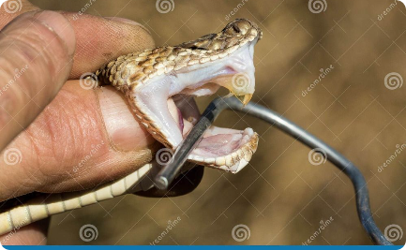
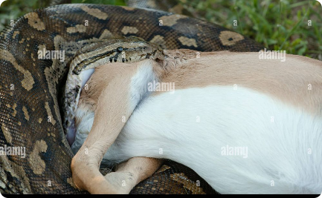
Venom Delivery Methods
Dry Bite
Prey Envenomation
Defensive Bite
Snake doesn't inject venom into its prey or attacker.
Snakes inject venom directly into their prey. They then swallow the prey whole.
Snakes bite to protect themselves from predators or when they feel threatened.

Slide 11
Fun Facts and Examples
1
Biggest Snake Fangs
2
Smallest Snake Fangs
The Gaboon Viper (the world's heaviest viper) has fangs that can reach up to 2in in length.
The Thread Snake has the smallest fangs of any snake (0.3mm).
3
Controversial Snake Venom
4
Deadly Snakes
The venom of the Black Mamba snake is sometimes used as a painkiller by traditional healers, but it is not approved by Western medicine.
The most venomous snakes in the world are the Inland Taipan also known as the Fierce Snake and the Belcher's Sea Snake.

