Slide 1
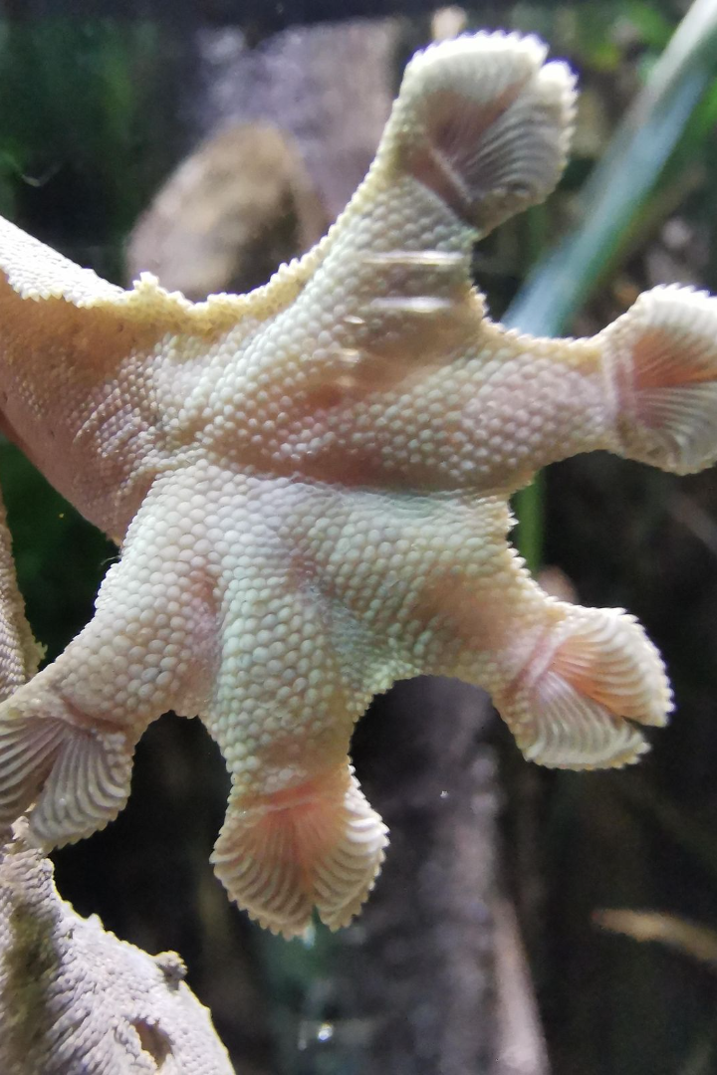
Discovering the Marvels of Gecko Feet
Gecko feet possess incredible adhesion properties due to their microscopic structures. Join us as we delve into the fascinating world of gecko adhesion.

Slide 2
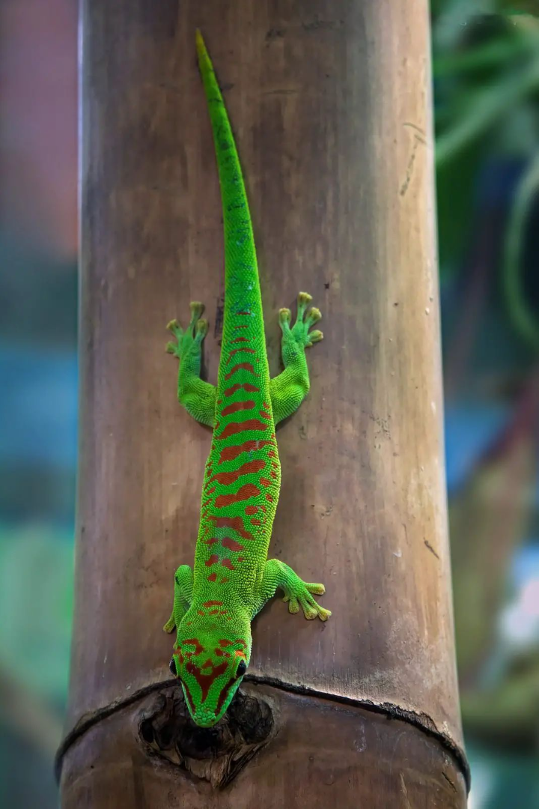
Witness the Graceful Climbing Skills of Geckos
With their unique setae and electrostatic forces, geckos showcase unparalleled agility and precision.

Slide 3
Unveiling the Secrets of Gecko Feet
Gecko feet are equipped with tiny hair-like structures called setae, which allow them to stick to surfaces with remarkable grip. These microscopic wonders enable geckos to effortlessly scale walls and ceilings, defying gravity with ease.

Slide 4
Exploring the Microscopic World of Geckos
Take a closer look at the incredible setae of geckos under a microscope.
These tiny hair-like structures play a crucial role in creating the electrostatic forces that allow geckos to effortlessly scale walls and hang from ceilings.
But how?

Slide 5
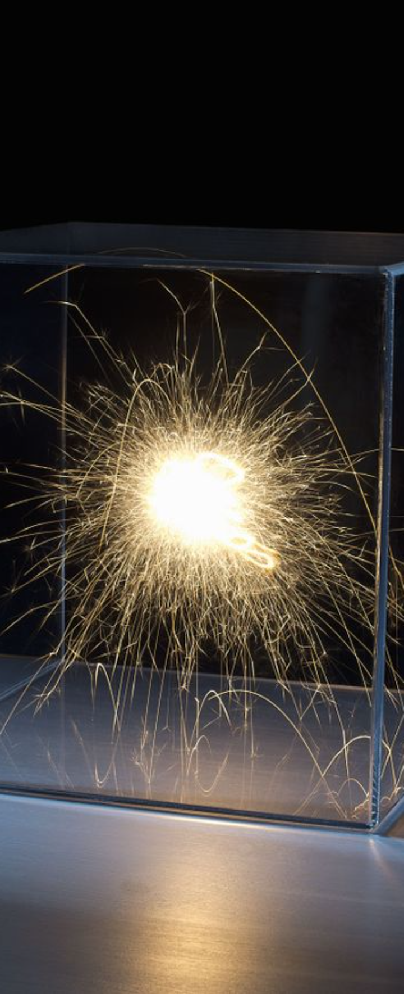
The Wonders of Electrostatics
Let’s take a look at electrostatics.
Electrostatics is the branch of physics that explores the fascinating world of electric charge and its behavior. From the attraction of opposite charges to the repulsion of like charges, electrostatics governs the forces that shape our everyday lives and help a gecko climb!

Slide 6
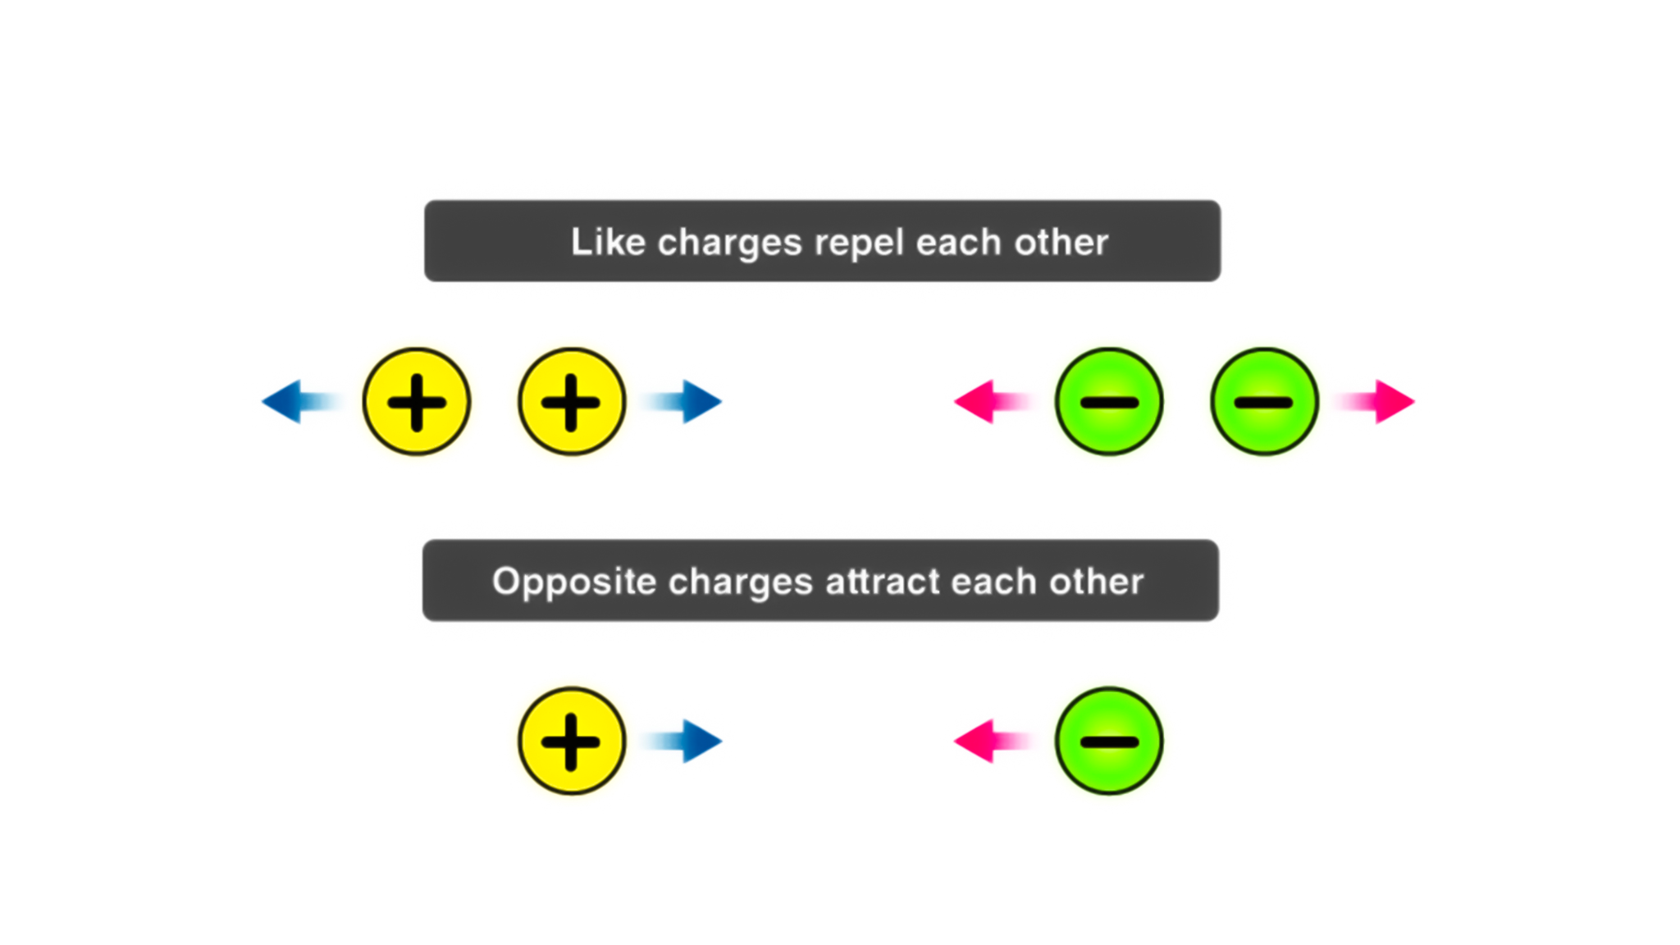
The Science Behind Electrostatic Charges
Positive and Negative Charges
Electrostatic charges can be classified into two types: positive and negative charges. These charges are associated with the presence or absence of electrons in an atom or object.
Positive charges occur when an object has lost electrons, resulting in an excess of positively charged protons. Examples of objects with positive charges include glass rubbed with silk and the positively charged terminal of a battery.
Negative charges, on the other hand, occur when an object has gained electrons, resulting in an excess of negatively charged electrons. Examples of objects with negative charges include rubber rubbed with fur and the negatively charged terminal of a battery.
Positive and negative charges can attract or repel each other. Opposite charges, such as a positive and a negative charge, attract each other, while like charges, such as two positive or two negative charges, repel each other.
https://byjus-answer-creation.s3.amazonaws.com/uploads/2890Physics_6294b5d604bda0ac3a859f1c.jpg_img_upload_solution_2022-07-02%2011:01:20.934972.png

Slide 7
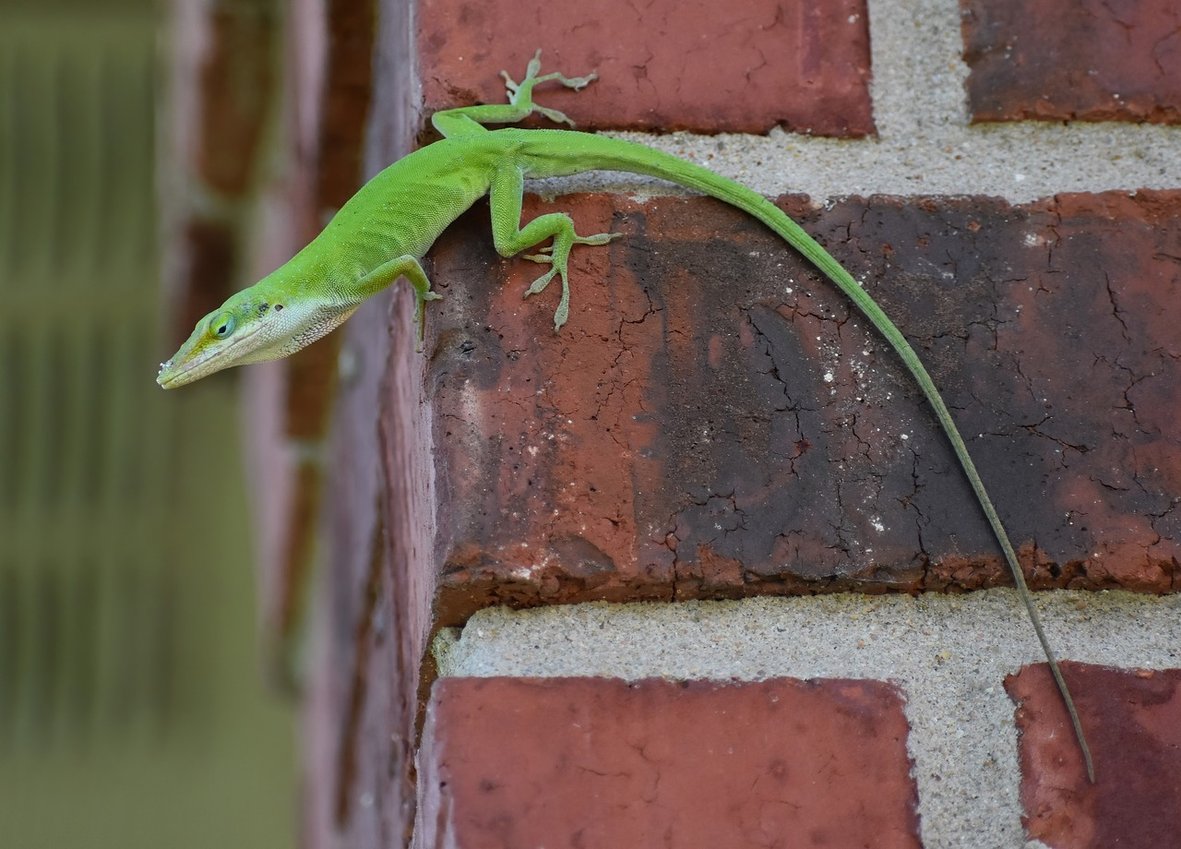
Electrostatic Adhesion in Geckos
Geckos have specialized setae on their feet that generate weak electrostatic forces, enabling them to stick to various surfaces.
These setae, combined with the van der Waals forces, allow geckos to create a strong adhesive bond with surfaces. The electrostatic interactions between the charged setae and the surface result in a phenomenon called "electrostatic adhesion." This unique mechanism allows geckos to traverse challenging terrains with ease.
https://cdn.pixabay.com/photo/2023/08/30/14/15/gecko-8223406_1280.jpg

