Slide 1
Can You Spot the Hidden Animal?
Thanks to: Can You Spot the Camouflaged Animals in These Photos?

Slide 2
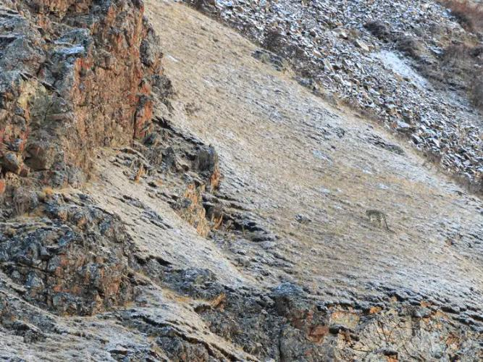
https://i.insider.com/5d1112e19c51011e936b4334?width=1300&format=jpeg&auto=webp
Where is the snow leopard?

Slide 3
https://i.insider.com/5d1112e19c51011e936b4334?width=1300&format=jpeg&auto=webp

Slide 4
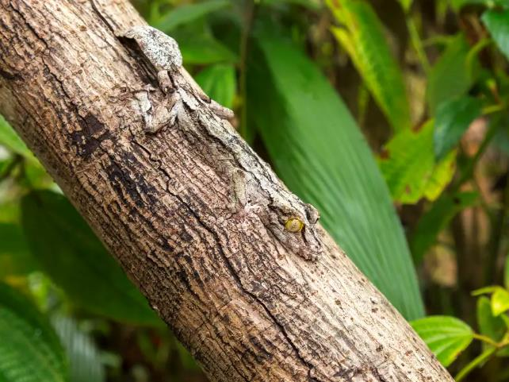
https://i.insider.com/5d1114aa9c51011a45357da3?width=1300&format=jpeg&auto=webp
I see a gecko.
Do you?

Slide 5
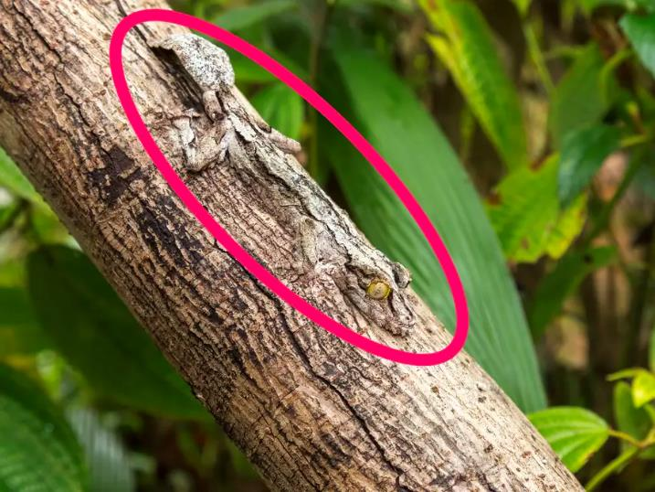
https://i.insider.com/5d1138839c510120533196c4?width=1300&format=jpeg&auto=webp

Slide 6
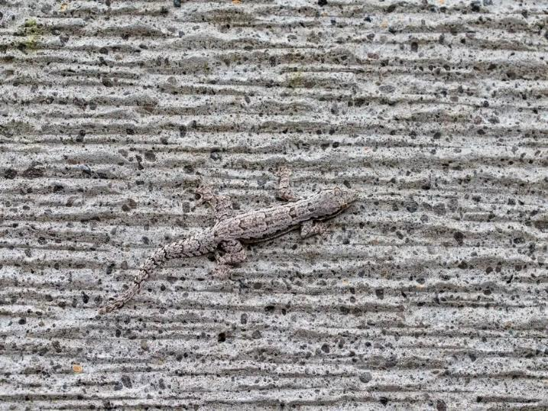
https://i.insider.com/5d1115199c51011a464e6034?width=1300&format=jpeg&auto=webp
There is a lizard there!

Slide 7
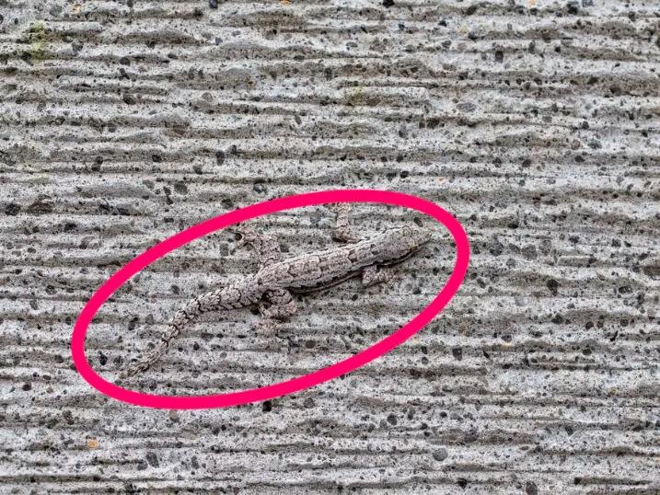
https://i.insider.com/5d1139c09c51010d884ce424?width=1300&format=jpeg&auto=webp

Slide 8
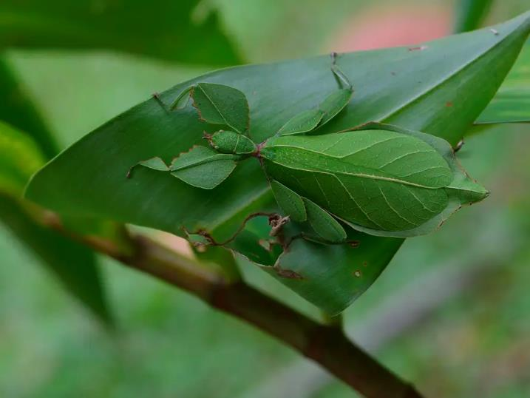
https://i.insider.com/5d11156a9c51011a5a720253?width=1300&format=jpeg&auto=webp
I see a leaf, but I also see a leaf mantis.

Slide 9
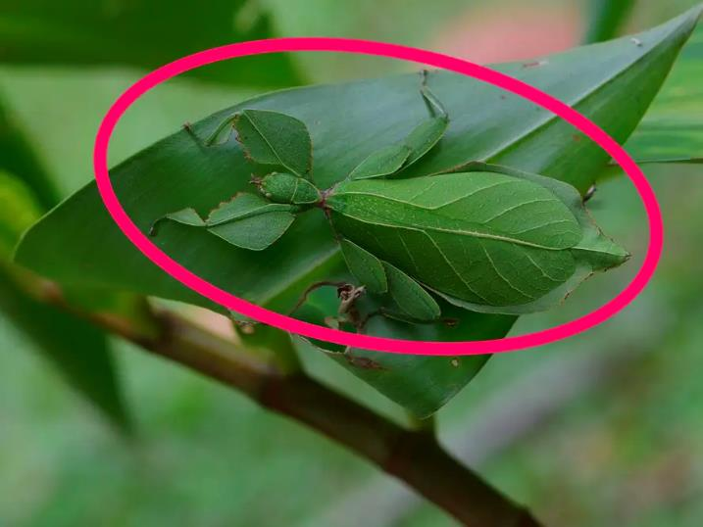
https://i.insider.com/5d113aeb9c51010da35ffb2f?width=1300&format=jpeg&auto=webp

Slide 10
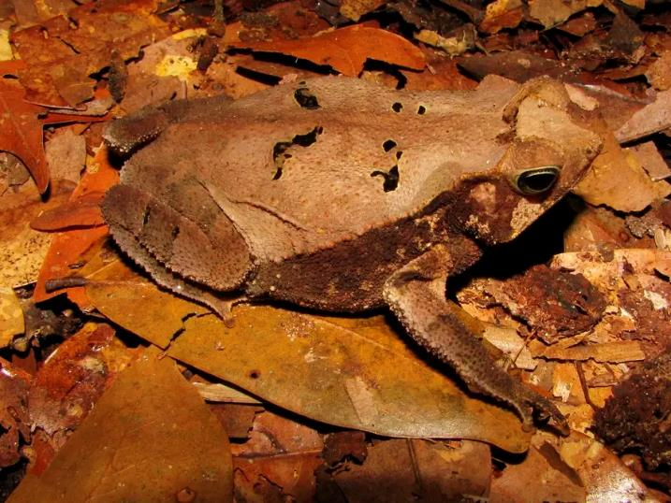
https://i.insider.com/5d1117e29c51011ad87127d7?width=1300&format=jpeg&auto=webp
This toad looks like a leaf!

Slide 11
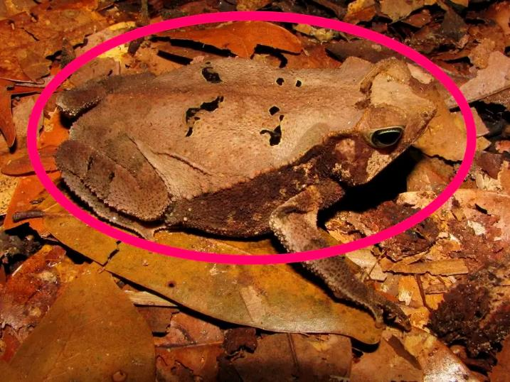
https://i.insider.com/5d1235f49c51010029521425?width=1300&format=jpeg&auto=webp

Slide 12
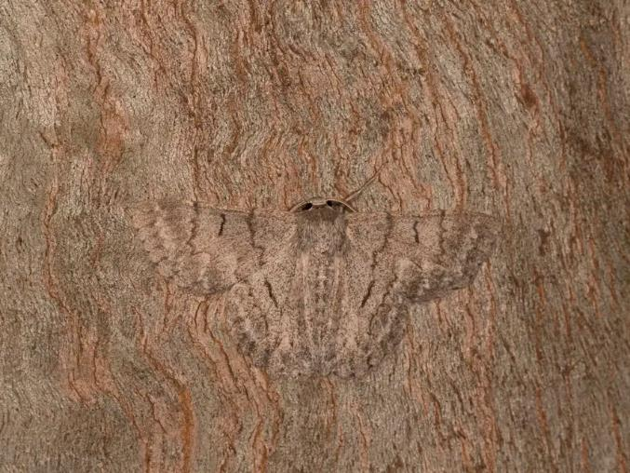
https://i.insider.com/5d1115c09c51011f0b72fc92?width=1300&format=jpeg&auto=webp
Where is the moth?

Slide 13
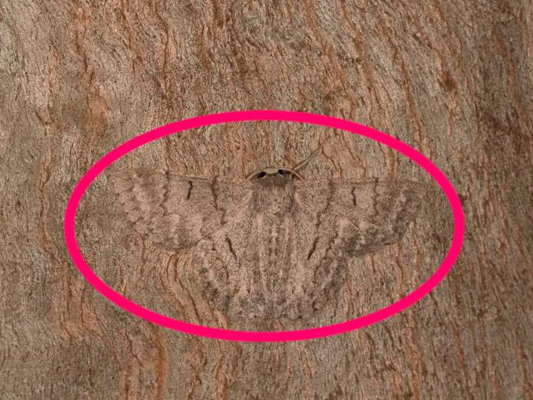
https://i.insider.com/5d1140909c5101007e615814?width=1300&format=jpeg&auto=webp

Slide 14
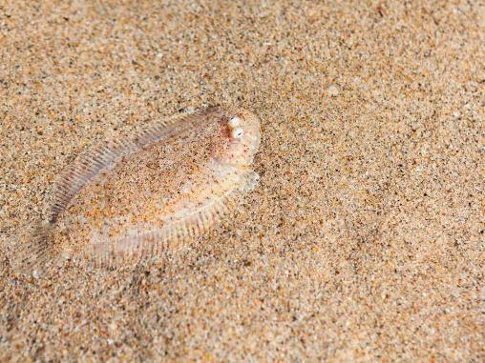
https://i.insider.com/5d1116139c51011a775d2056?width=1300&format=jpeg&auto=webp
There is a fish in there!

Slide 15
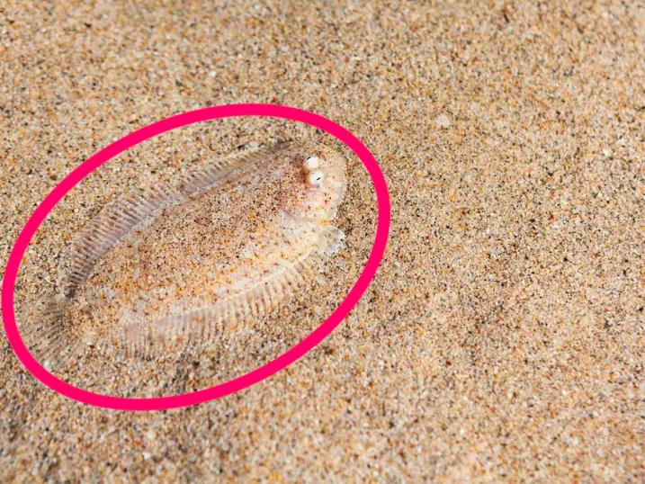
https://i.insider.com/5d1141d99c510126731d24e4?width=1300&format=jpeg&auto=webp

Slide 16
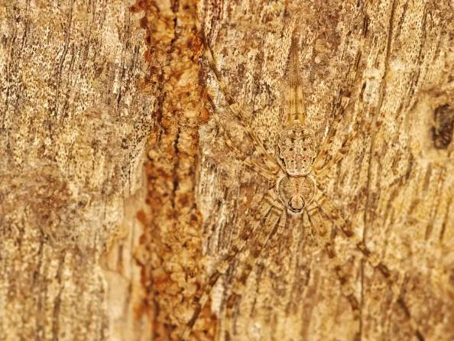
https://i.insider.com/5d11168b9c51011f66527db2?width=1300&format=jpeg&auto=webp
Is there really a spider in there?

Slide 17
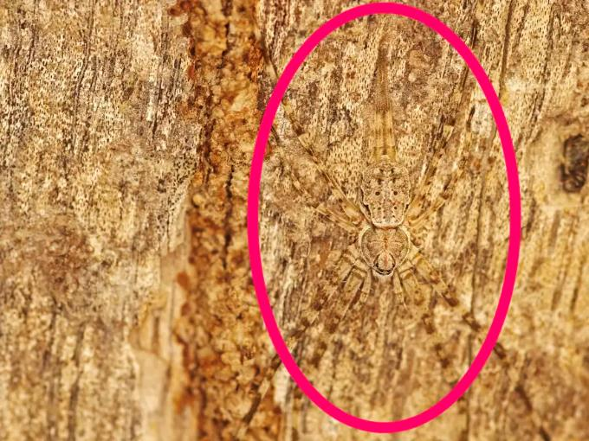
https://i.insider.com/5d1142879c510128a8114925?width=1300&format=jpeg&auto=webp

Slide 18
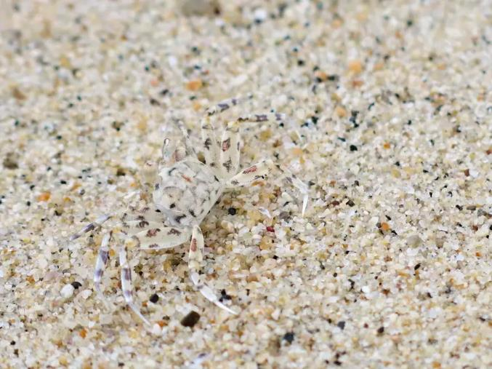
https://i.insider.com/5d1116c79c51011b701fefda?width=1300&format=jpeg&auto=webp
Another really hard one - where is the sand spider?

Slide 19
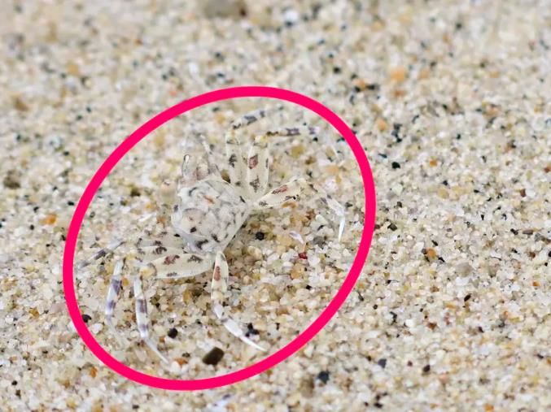
https://i.insider.com/5d1143cd9c5101213f75efa4?width=1300&format=jpeg&auto=webp

Slide 20
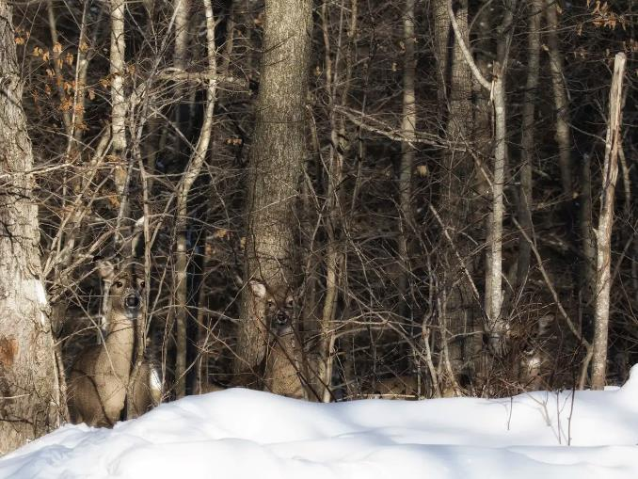
https://i.insider.com/5d1118d79c51011b0e6787ba?width=1300&format=jpeg&auto=webp
Count how many deer you can see!

Slide 21
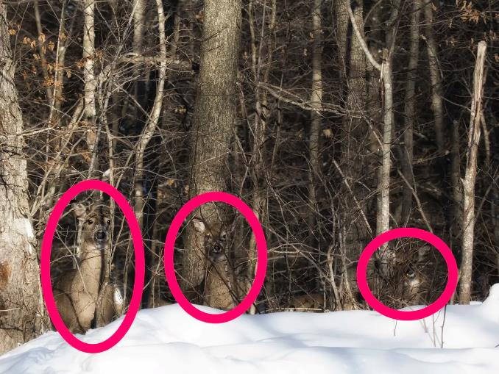
https://i.insider.com/5d1236a39c510127007ad35a?width=1300&format=jpeg&auto=webp

Slide 22
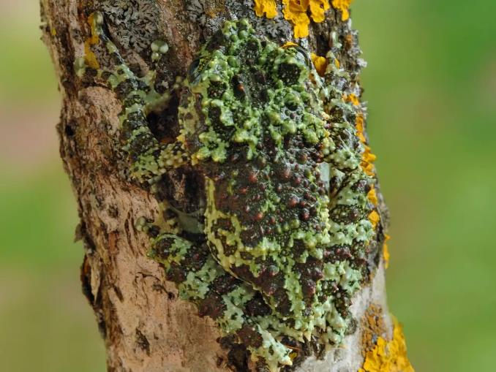
https://i.insider.com/5d111aba9c510122114aae02?width=1300&format=jpeg&auto=webp
Is there an animal there?

Slide 23
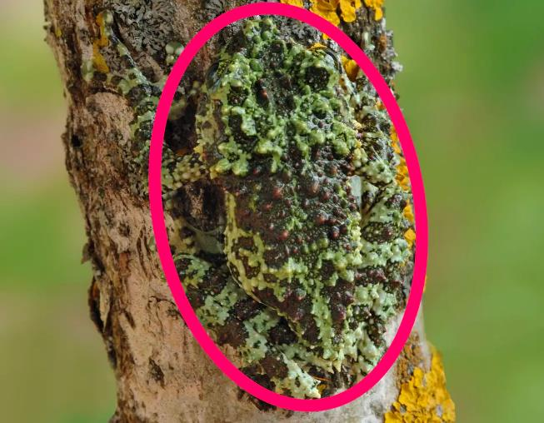
https://i.insider.com/5d12371d9c510114a603b553?width=1300&format=jpeg&auto=webp
It’s a moss frog!

Slide 24
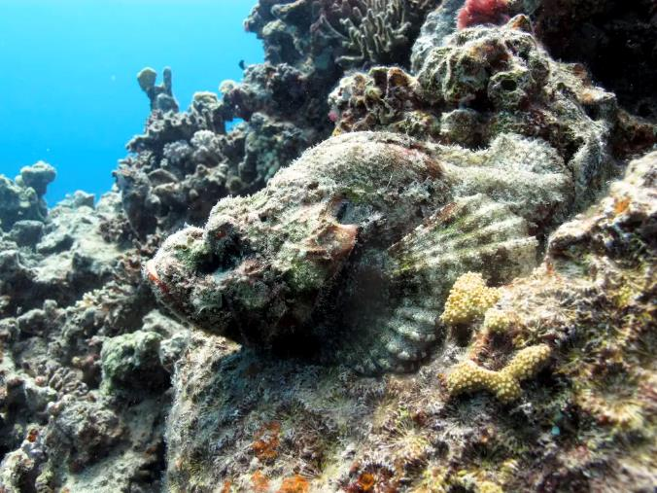
https://i.insider.com/5d111b859c51011b2d51f431?width=1300&format=jpeg&auto=webp
What is hiding here?

Slide 25
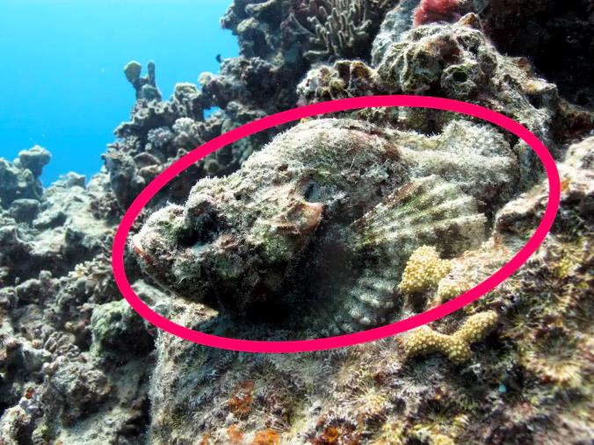
https://i.insider.com/5d12379a9c51012778568075?width=1300&format=jpeg&auto=webp
This is a devil scorpionfish.

Slide 26
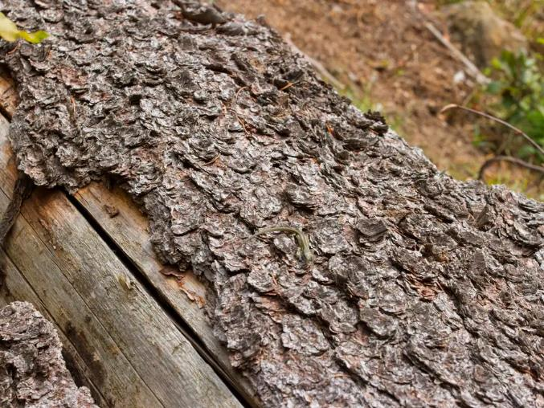
https://i.insider.com/5d111cfe9c510120740d0ec3?width=1300&format=jpeg&auto=webp
Is this a trick?

Slide 27
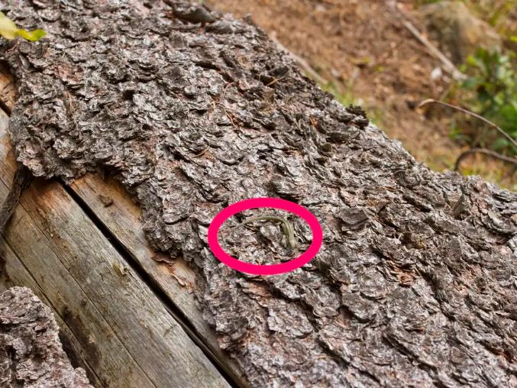
https://i.insider.com/5d12397b9c510100fd20b480?width=1300&format=jpeg&auto=webp
It is a tiny little lizard!

Slide 28
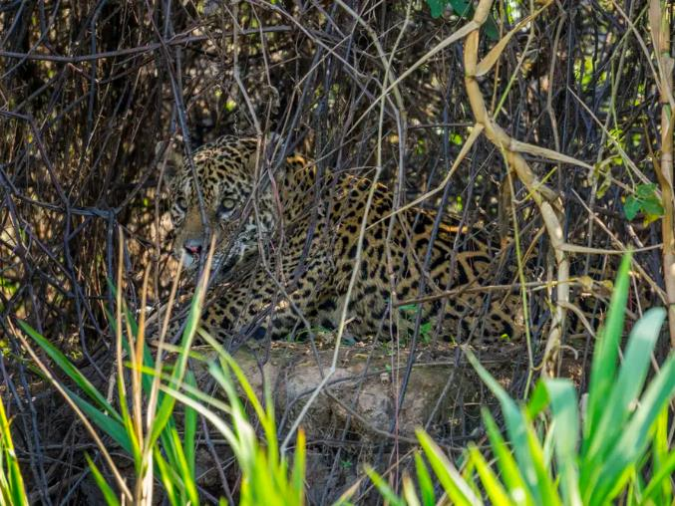
https://i.insider.com/5d1120dc9c51011cff6ad7b3?width=1300&format=jpeg&auto=webp
Where is the jaguar?

Slide 29
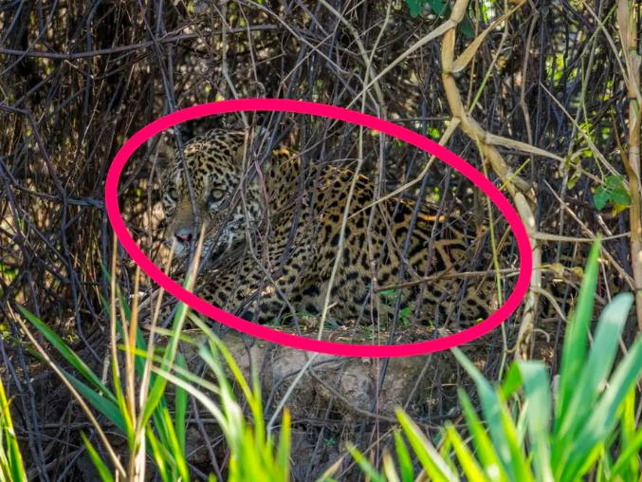
https://i.insider.com/5d123fa09c51013f806728f5?width=1300&format=jpeg&auto=webp

Slide 30
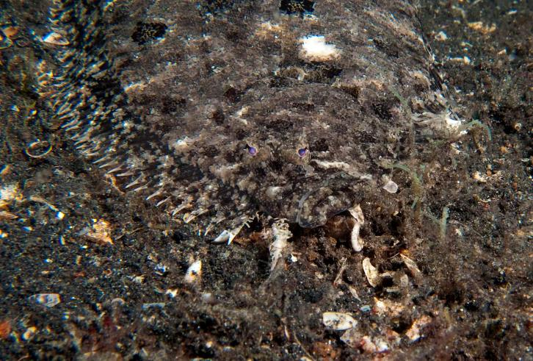
https://i.insider.com/5ebec83a4dca687d1e00f228?width=1300&format=jpeg&auto=webp
There is a fish in there!

Slide 31
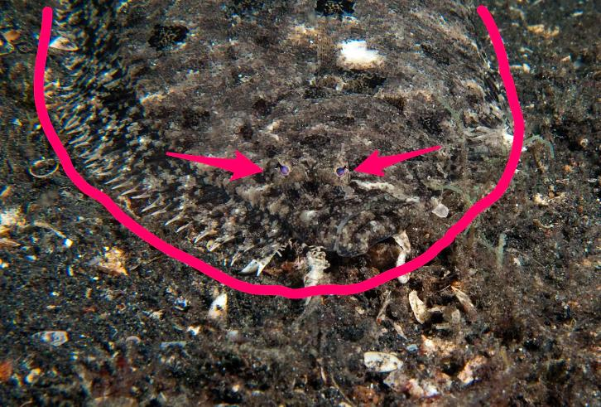
https://i.insider.com/5ebec87a4dca687d5d45d666?width=1300&format=jpeg&auto=webp
The arrows are pointing to the eyes of the angler flatfish.

Slide 32
You have just observed many animals who have the ability to blend in with their environment. This is called camouflage.
Look at YOUR class pet. How does it use camouflage?

