Slide 1
Birds of a Feather

Slide 2
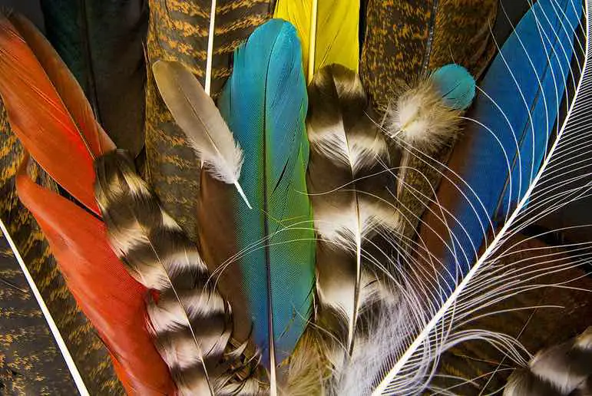
What are feathers?
Feathers distinguish birds from all other animals.
All birds molt yearly (sometimes twice a year) which means the bird has all new feathers every year.
The feathers are made of keratin. Keratin is a protein that is in the hair and nails of humans.
Bird feathers are many different colors. This may be due to pigments in the keratin layers of the feather, from the bird’s diet or due to the refractive nature of light.
https://rsscience.com/wp-content/uploads/2023/01/collection-different-feathers.jpg?ezimgfmt=ng:webp/ngcb1

Slide 3
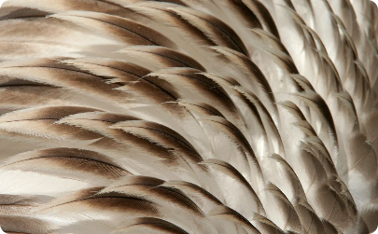
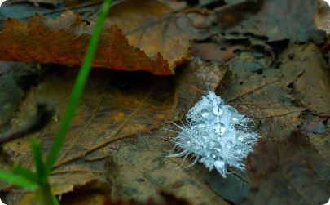
The Versatility of Feathers
Insulation
Water Repellent
Feathers provide excellent insulation, keeping birds warm in cold weather. The fluffy down feathers trap air, creating a layer of insulation that helps regulate body temperature. This is similar to what hair does for mammals
Feathers have a special coating that repels water, keeping birds dry even when it's raining. This helps maintain their body temperature and prevents their feathers from getting waterlogged. For ducks and seabirds, their feathers are lifesavers, repelling water and keeping the birds warm and dry. But when there is an oil spill, the oil clogs the spaces between feathers, turning the protective shield into a soggy sponge, leaving the bird vulnerable and chilled.

Slide 4
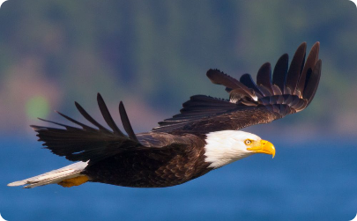
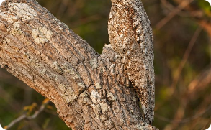
The Versatility of Feathers
Flight Assistance
Feathers are essential for flight. They provide lift and help birds maneuver in the air. The shape and arrangement of feathers enable birds to generate the necessary lift and control their movements during flight.
Camouflage
Bird feathers can adapt to blend in with their surroundings, providing them with effective camouflage to hide from predators or prey.

Slide 5
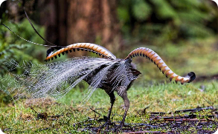
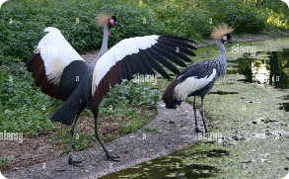
The Versatility of Feathers
Displaying
Protection
Feathers serve as a protective barrier, shielding birds from harsh weather conditions and offering some defense against potential threats.
Some bird species use their vibrant feathers to attract mates or establish dominance within their social hierarchy.

Slide 6
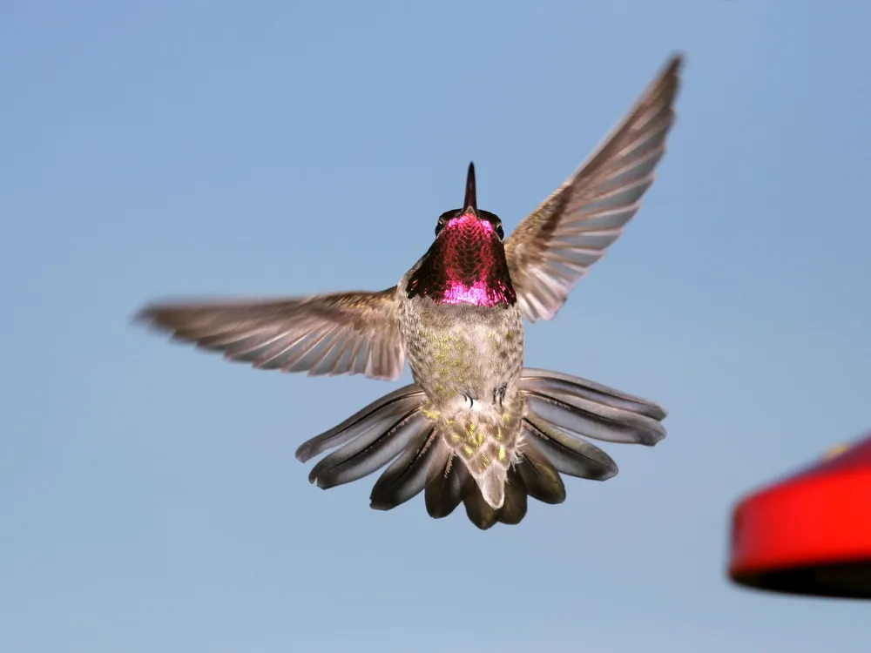
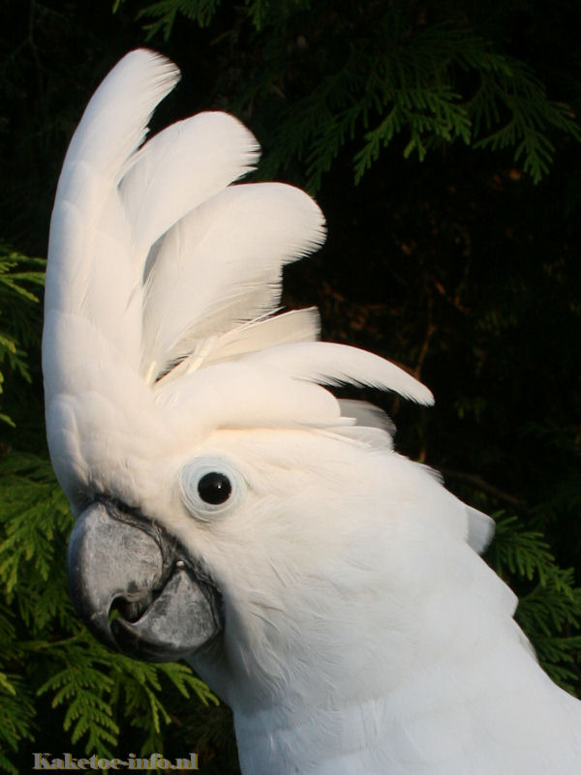
The Versatility of Feathers
Intimidation
Some birds raise their crests when they want to scare away a predator or competitor. It makes them look larger and impressive.
https://th-thumbnailer.cdn-si-edu.com/rIXqBJaXFHbLI3PZGtJQbYI2Ysk=/1000x750/filters:no_upscale()/https://tf-cmsv2-smithsonianmag-media.s3.amazonaws.com/filer/a9/c6/a9c64ab0-5cab-434e-ba35-093fa2ec6f03/istock_000003372950_large.jpg
Sound Production
Certain feathers are specially adapted to produce unique sounds, allowing birds to communicate with others of their species. When air is at the right speed and at the right angle, it makes the feathers vibrate and create sound. It is called wing-song.
http://www.cockatoo-info.com/photo/witkuifkaketoe6.jpg

Slide 7
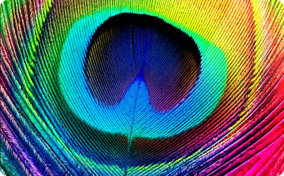
Examples of Feathers From Different Bird Species and Habitats
Peacock feathers aren't painted, but rather shimmer with iridescent hues thanks to flat, light-bending barbules and a hidden architecture of layered, tiny plates called micro-lamellae that work together like a prism.
Peacock Feathers
A mesmerizing display of vibrant colors and distinctive eye-shaped patterns found on the peacock's train feathers.

Slide 8
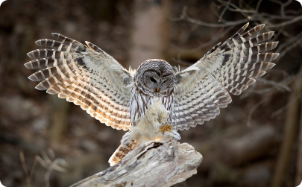
Examples of Feathers From Different Bird Species and Habitats
Owl Feathers
The unique, fringed edges of owl flight feathers help reduce noise, allowing for silent flight.
Some owl have feathered feet. These protect their feet from cold weather, but also help them to know when they have made contact with their prey..

Slide 9
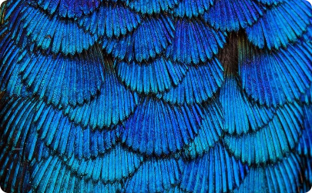
Examples of Feathers From Different Bird Species and Habitats
Hummingbird Feathers
Specialized feathers with iridescent colors, allowing hummingbirds to shimmer in the sunlight.
A ruby-throated hummingbird’s throat is a beautiful iridescent red. Or is it? Actually, the feather itself is dark but it is covered with clear cells that work like a prism to reflect the light. The brilliant colors help to attract mates and also to scare away competitors. And boy are those feathers tiny!

Slide 10
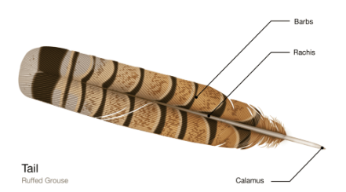
Feather Structure and Function
Feathers are composed of a central shaft called a rachis, attached barbs, and intricate barbules that interlock to create a sturdy and flexible structure.

Slide 11
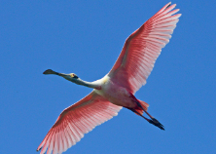
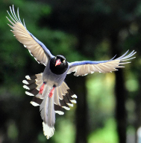
Types of Feathers
Flight Feathers
Large, sturdy feathers present on the wings and tail that enable birds to achieve flight with precision and agility
Asymmetrical shape and rigid structure optimize lift and control during flight.
Long and narrow
Also called wing feathers

Slide 12
Types of Feathers
Down Feathers
Soft, fluffy feathers that provide exceptional insulation and keep birds warm in cold environments.
Also assists with buoyancy for aquatic birds.
https://rsscience.com/wp-content/uploads/2023/01/Canada-goose-down-feather.jpg?ezimgfmt=ng:webp/ngcb1

Slide 13
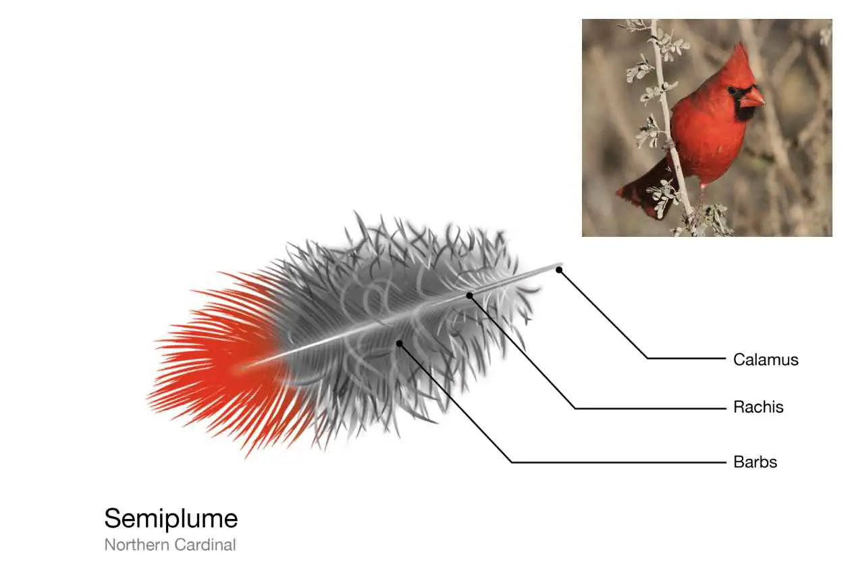
Types of Feathers
Semiplume Feathers
Feathers with a combination of down-like barbs and fluffy tips and contour properties that provide both insulation and flight support.
Mostly hidden under other festhers
https://rsscience.com/wp-content/uploads/2023/01/Northern-cardinal-semiplume-feather.jpg?ezimgfmt=ng:webp/ngcb1

Slide 14
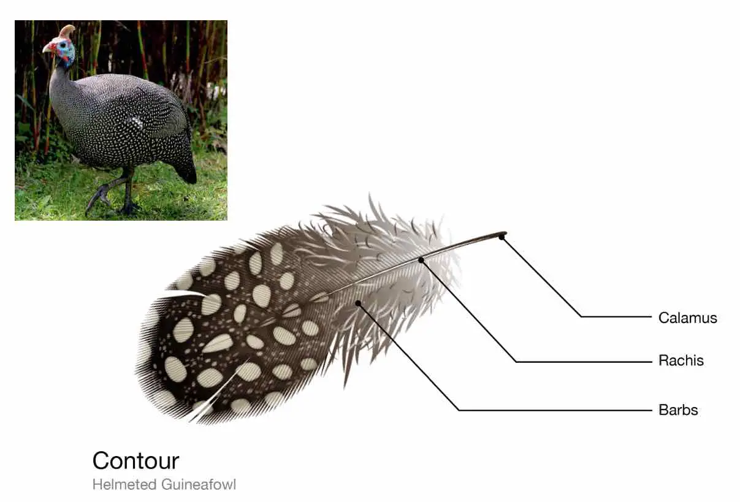
Types of Feathers
Contour Feathers
Streamlined feathers covering a bird's body, providing shape, protection, and control during flight.
Interlocking barbules enables smooth and efficient air flow, reducing turbulence
Also known as body feathers
https://rsscience.com/wp-content/uploads/2023/01/helmeted-guineafowl-contour-feather-.jpg?ezimgfmt=ng:webp/ngcb1

Slide 15
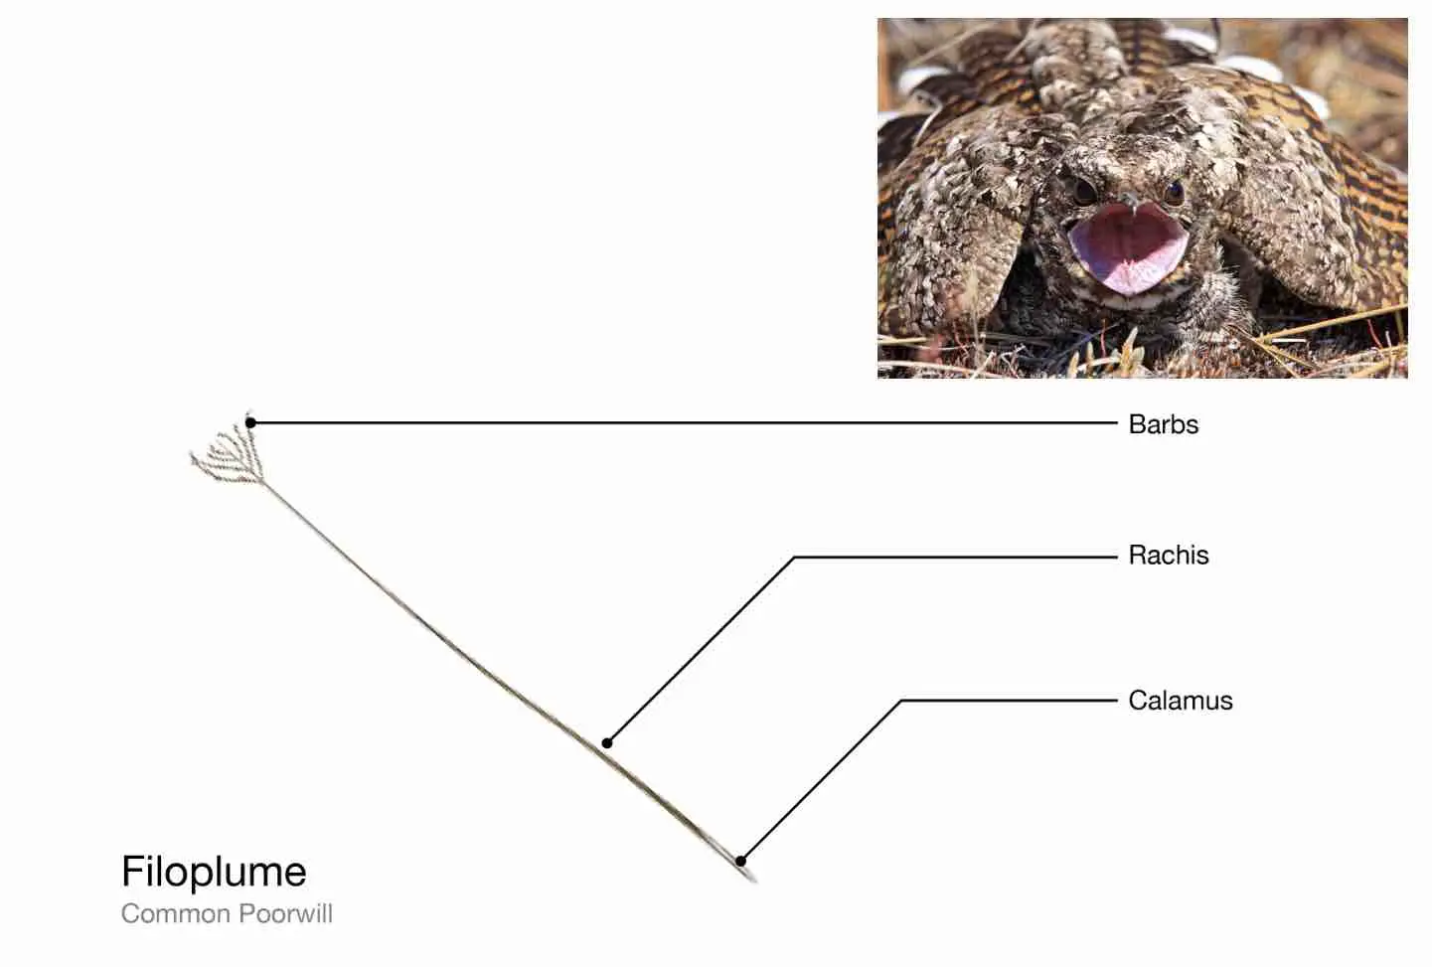
Types of Feathers
Filoplume Feathers
Delicate, hair-like feathers scattered among other feather types, acting as sensory receptors, providing feedback on feather positioning.
Act like whiskers of mammals
https://rsscience.com/wp-content/uploads/2023/01/Common-poorwill-filoplume-feather.jpg?ezimgfmt=ng:webp/ngcb1

Slide 16
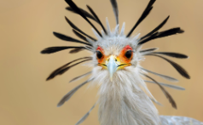
Types of Feathers
Bristle Feathers
Stiff feathers found near a bird's face, help protect sensitive facial regions amd acting as specialized sensors for detecting movement

Slide 17
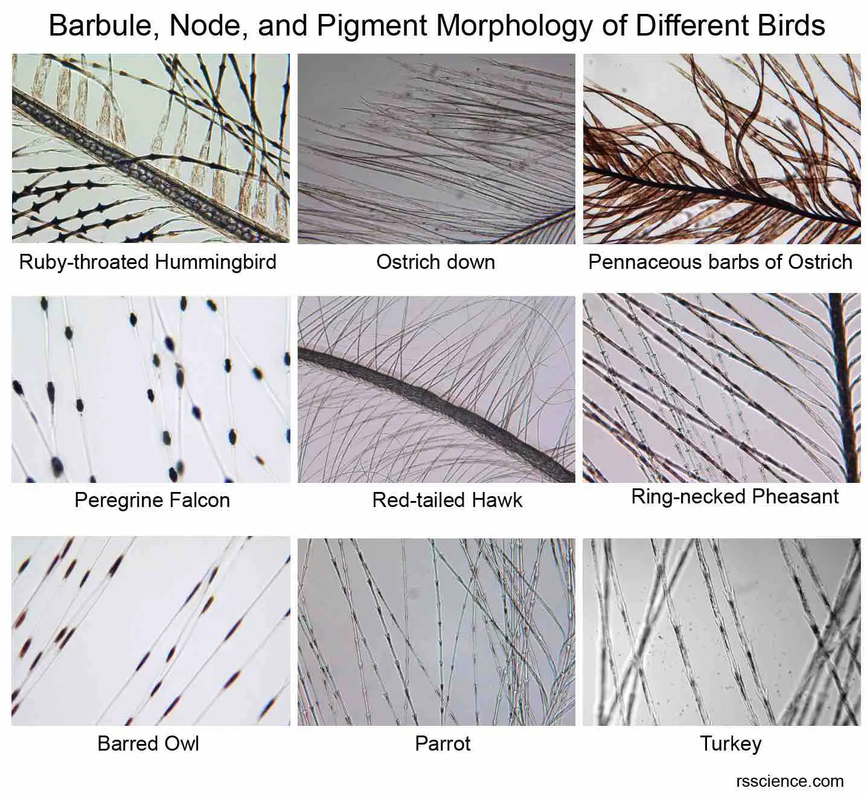
Under the microscope
https://rsscience.com/wp-content/uploads/2023/01/collection-microscopic-images-of-bird-feather-turkey-parrot.jpg?ezimgfmt=ng:webp/ngcb1

