Slide 1
The Rhythm of Life: Unveiling the Mysteries of Circadian Rhythms
An Exploration of Human and Mouse Sleep-Wake Cycles

Slide 2
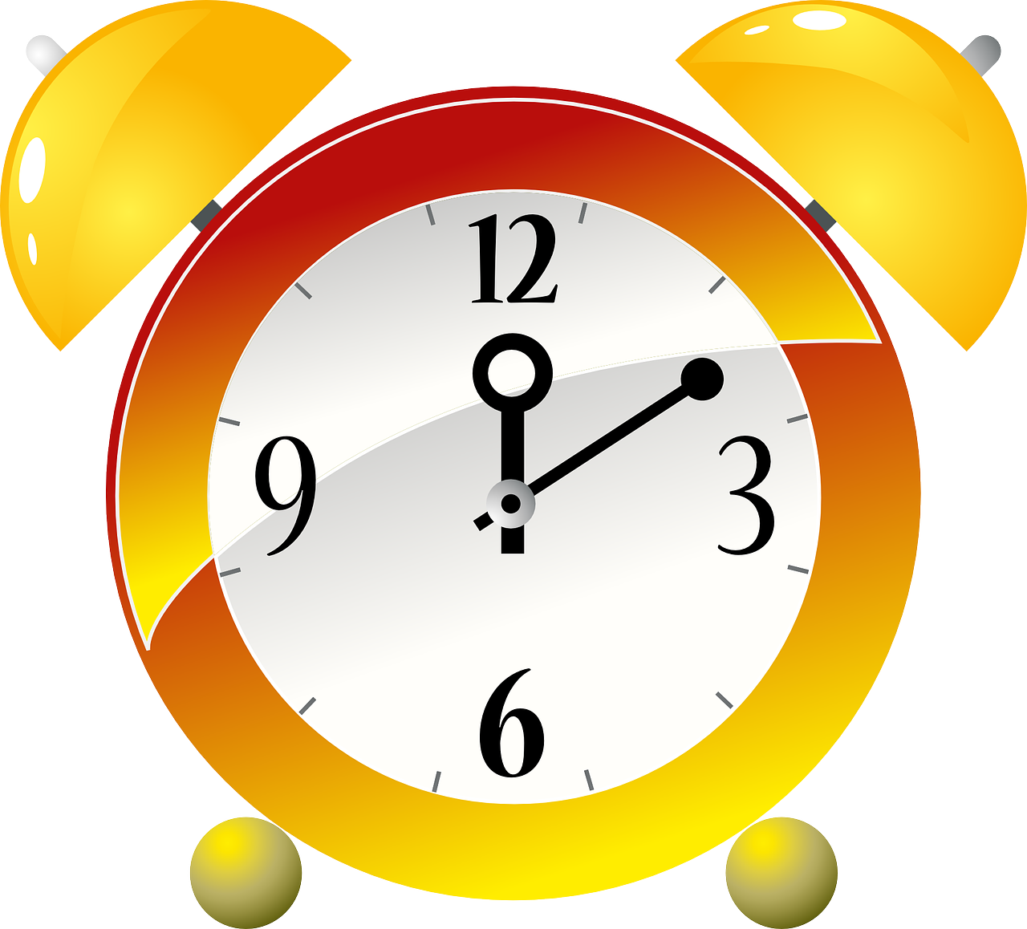
Imagine an internal clock that guides your daily routines, dictating when you feel alert and energized, and when you crave rest and rejuvenation. This intricate mechanism is known as the circadian rhythm, an innate biological process that orchestrates our sleep-wake cycles, hormone production, and other physiological functions.
https://cdn.pixabay.com/photo/2013/07/13/01/09/alarm-clock-155187_1280.png

Slide 3
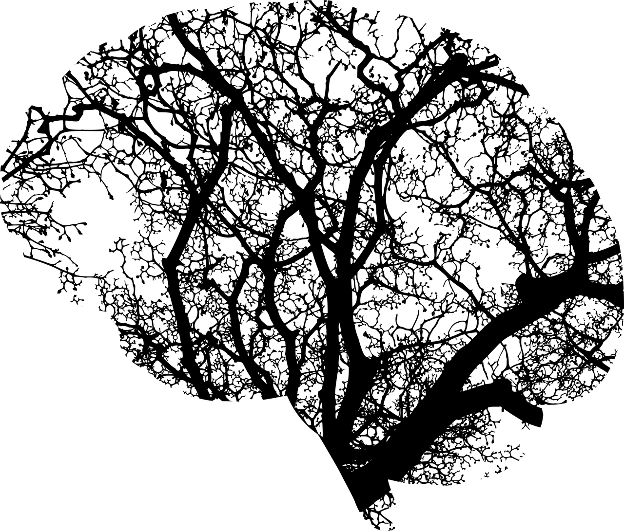
The Master Conductor: The Suprachiasmatic Nucleus (SCN)
Deep within the brain lies the Suprachiasmatic Nucleus (SCN), the maestro of our circadian rhythm. This tiny cluster of neurons acts as our internal timekeeper, constantly monitoring light signals from our eyes.
https://cdn.pixabay.com/photo/2017/03/15/17/22/brain-2146817_1280.png

Slide 4
Circadian Rhythm
Light plays an important role in synchronizing our circadian rhythm with the external environment.
Circa, which means approximately,
and dia, which means day
An internal biological clock known as the circadian rhythm, which regulates various physiological processes.
https://cdn.pixabay.com/photo/2017/01/27/19/45/sunrise-2014052_1280.jpg

Slide 5
Light's Influence: The Dance of Darkness and Dawn
https://cdn.pixabay.com/photo/2017/01/27/19/45/sunrise-2014052_1280.jpg
Exposure to sunlight during the day suppresses melatonin secretion, a hormone that promotes sleepiness.
As darkness falls, melatonin production surges, signaling the body's preparation for rest.
In fact, production of melatonin peaks at about 9pm.
https://cdn.pixabay.com/photo/2016/12/09/17/16/yawning-1895561_1280.jpg

Slide 6
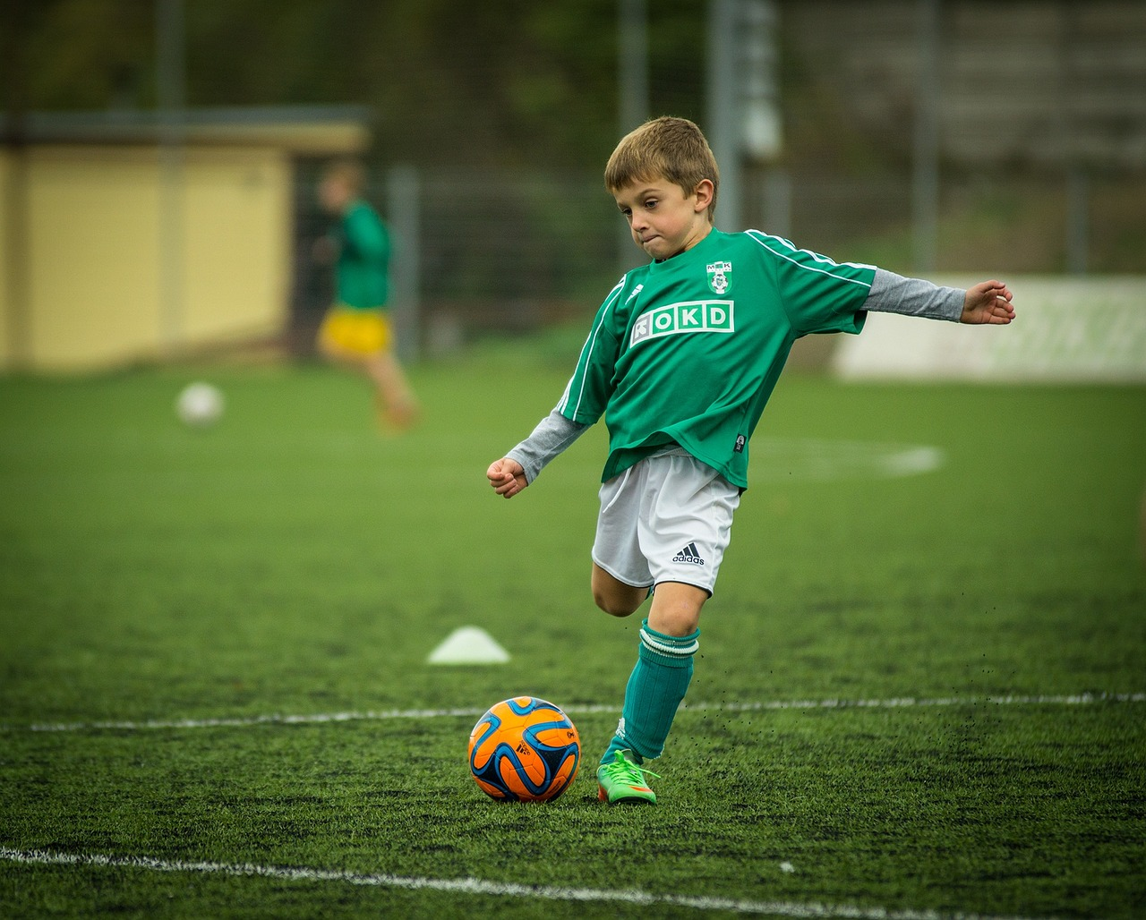
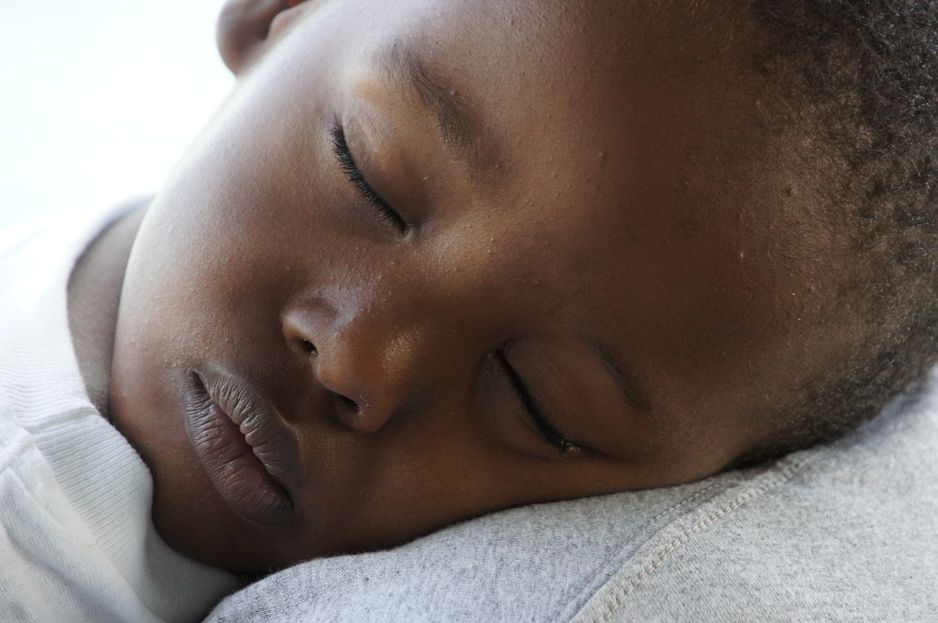
Humans: Creatures of the Day
https://cdn.pixabay.com/photo/2015/01/26/22/40/child-613199_1280.jpg
Humans are diurnal organisms, meaning our circadian rhythm aligns with the day-night cycle.
Our activity levels peak during the day, allowing us to engage in various activities under optimal lighting conditions.
As night approaches, our internal clock signals the need for rest and rejuvenation. Darkness triggers melatonin release, signaling the onset of sleep.
https://cdn.pixabay.com/photo/2018/09/28/18/56/boy-3709975_1280.jpg

Slide 7
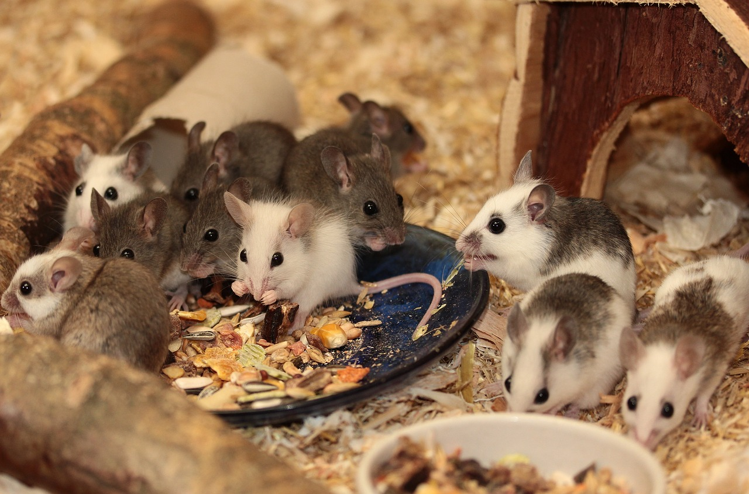
Mice: Creatures of the Night
Mice, on the other hand, are nocturnal creatures, meaning their circadian rhythm is adapted for activity under low-light conditions.
Their peak activity occurs during the night, enabling them to forage for food, avoid predators, and stay cool in warm climates.
https://cdn.pixabay.com/photo/2015/01/21/23/18/mouse-607240_1280.jpg

Slide 8
Mice: Creatures of the Night
Their peak activity occurs during the night, enabling them to forage for food, avoid predators, and stay cool in warm climates.
https://cdn.pixabay.com/photo/2015/01/21/23/18/mouse-607240_1280.jpg

Slide 9
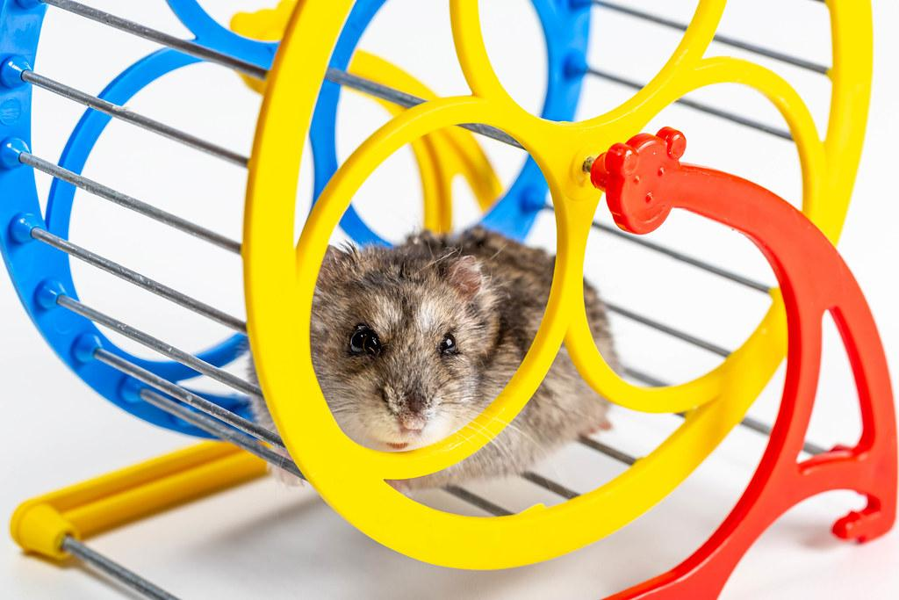
Our experiment
In this experiment, we will investigate the relationship between light and dark cycles and mouse activity, gaining a deeper appreciation for the intricate interplay between organisms and their environment.

