Slide 1
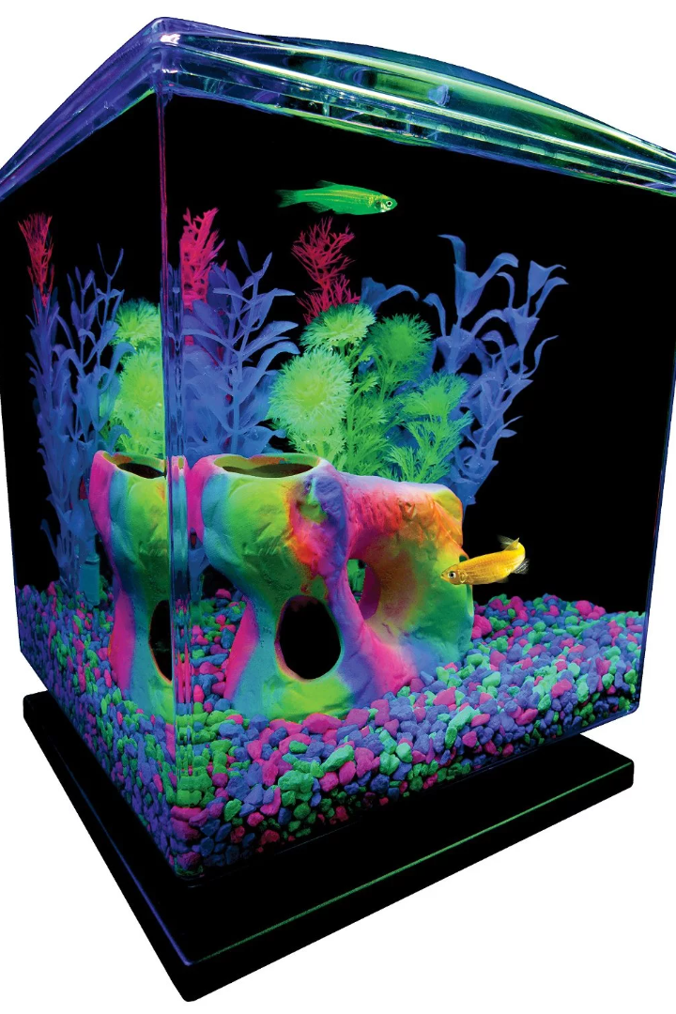
GloFish, GMO and DNA Technologies
Discover the fascinating world of GloFish, genetically modified organisms (GMOs), and cutting-edge DNA technologies.

Slide 2
Introduction to GloFish
The First Genetically Modified Pet 🐟
Colorful and Eye-Catching 🌈
fluorescent tropical fish that have been modified using genetic engineering techniques.
Electric Green, Starfire Red, and Sunburst Orange.
Safe for the Environment and Humans ✅
Popular in the Aquarium Hobby 🐠
rigorous scientific testing to ensure they pose no risk to the ecosystem or human health.
popular pets worldwide and are widely available in pet stores.

Slide 3
Genetically Modified Organisms (GMO) and DNA Technologies
1
Advancing Scientific Frontiers 🧬
2
Precision Engineering ⚙️
GMOs and DNA technologies revolutionize fields like agriculture, medicine, and environmental conservation.
Scientists can modify an organism's genes by adding, removing, or altering DNA sequences with remarkable precision.
3
Unleashing New Possibilities 🌍
These technologies have the potential to enhance crop yield, treat genetic diseases, and conserve endangered species.

Slide 4
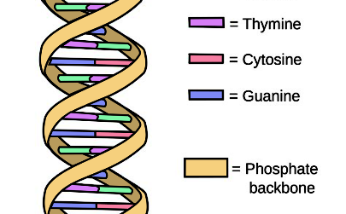
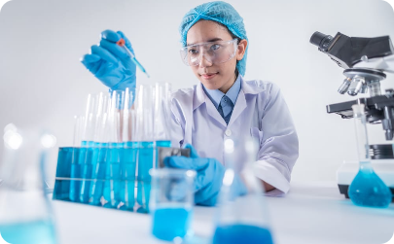
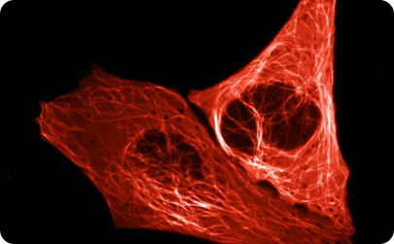
How GloFish are Genetically Engineered
DNA Modification Process
Complex Laboratory Techniques
Scientists introduce foreign genes into GloFish embryos, enabling them to produce fluorescent proteins...
Advanced laboratory methods, including gene splicing and DNA sequencing, are used to create GloFish.
Fluorescent Protein Expression
The inserted genes encode proteins that emit fluorescence, resulting in the stunning colors of GloFish.

Slide 5
Uses and Benefits of GloFish
1
Public Engagement and Education
GloFish serve as captivating teaching tools to educate the public about biology, genetics, and biotechnology.
2
Scientific Research
These genetically modified fish are invaluable in studying genetic disorders, environmental impacts, and physiological processes.
3
Aesthetically Pleasing Aquarium Pets
GloFish bring unique beauty and vibrancy to home aquariums, captivating both adults and children alike.

Slide 6
Controversies and Ethical Considerations Surrounding GloFish
Ecological Concerns 🌍
Animal Welfare
Ethical Debate 💭
Some argue that genetically modifying animals for aesthetic purposes may compromise their welfare and autonomy.
Questions arise regarding the morality of altering an organism's genes solely for human entertainment.
Critics worry about the environmental impact and potential interbreeding of GloFish with wild fish populations.

Slide 7
Regulations and Restrictions on GloFish
Educational and Research Exemptions
Limited Availability ⚖️
Strict Guidelines 📜
Specially licensed institutions or educational programs may be permitted to work with GloFish for scientific or educational purposes.
GloFish are subject to stringent regulations enforced by various governmental agencies and international treaties.
Some countries or states may impose restrictions on the sale, possession, or transportation of GloFish.

Slide 8
Future Developments and Potential Applications for GMO and DNA Technologies
1
Improved Crop Yield and Nutrition 🌽
GMOs present the opportunity to develop drought-resistant crops and enhance nutritional content to address global food security challenges.
2
Human Health Advancements
Future applications may include personalized medicine, gene therapies, and potential cures for genetic disorders.
3
Environmental Conservation
GMO technologies can help conserve endangered species and restore damaged ecosystems.

Slide 9
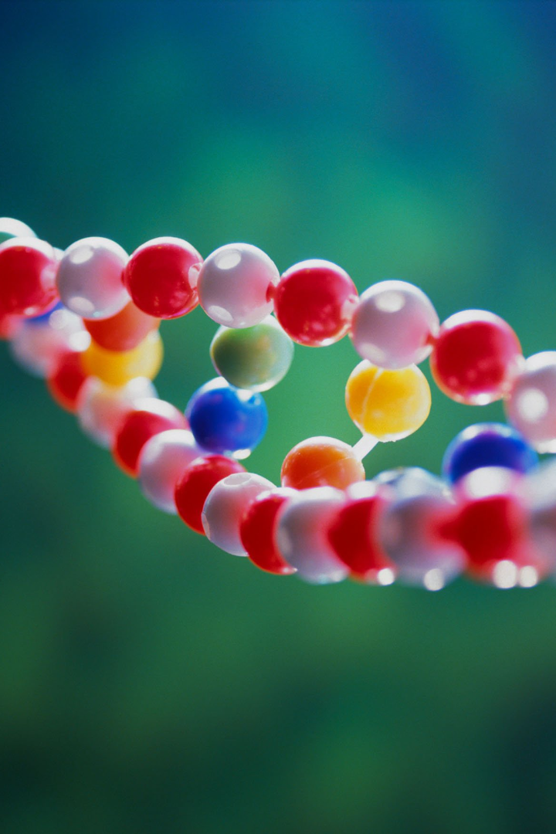
Types of Genetic Modification
Genetic modification is a powerful tool that revolutionizes fields like agriculture, medicine, and environmental conservation. Let's explore its different techniques, applications, and ethical considerations.

Slide 10
Types of Genetic Modification Techniques
1
Selective Breeding
2
Gene Editing (CRISPR)
3
Transgenic Technology
Traditional method of breeding plants or animals based on desired traits.
Revolutionary technique to precisely edit an organism's DNA and introduce beneficial changes.
Introducing genes from one species into another to enhance desired characteristics.

Slide 11
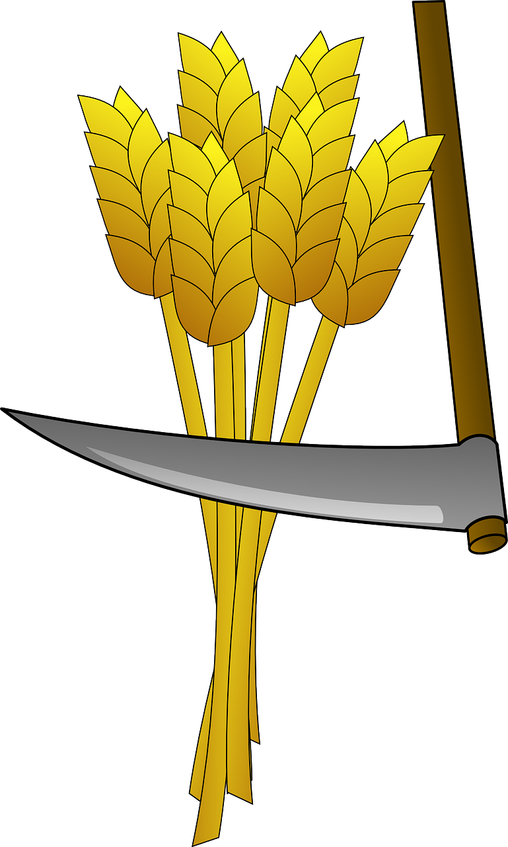
Applications of Genetic Modification
Agriculture and Crop Improvement
Enhancing yields, pest resistance, and nutritional content to address global food security.
Medicine and Healthcare
Developing genetically modified organisms for drug production and disease research.
Environmental Conservation
Genetically modifying species to restore ecosystems or combat invasive species.
https://cdn.pixabay.com/photo/2013/07/12/13/47/wheat-147293_1280.png

Slide 12
Ethical and Social Considerations
1
Safety Concerns and Potential Risks
2
Impact on Biodiversity
3
Public Perception and Acceptance
Evaluating the effects of introducing modified organisms on natural ecosystems.
Addressing public concerns, promoting transparency, and fostering responsible use.
Ensuring proper regulation and risk assessment to avoid unintended consequences.

Slide 13
Regulation and Governance
International Regulations and Guidelines
Ethical Committees and Oversight Bodies
Establishing standards and protocols to ensure safe and ethical use of genetic modification.
Monitoring and reviewing research, policies, and applications related to genetic modification.

Slide 14
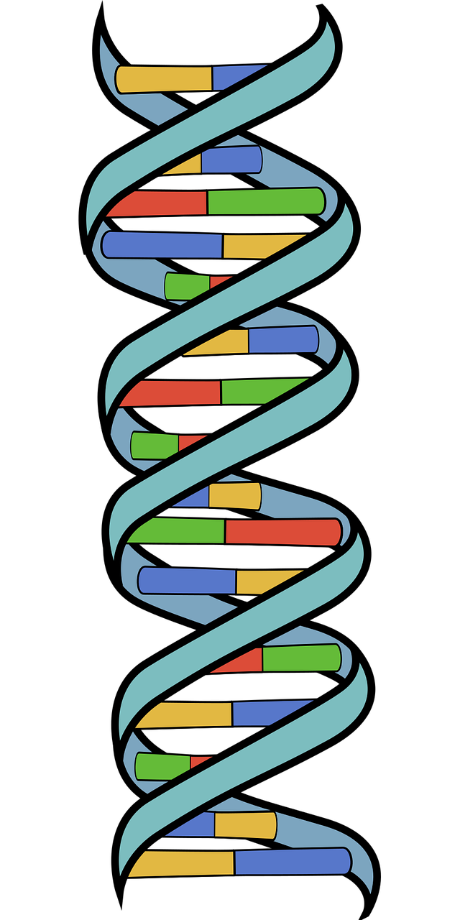
Exploring Different Types of DNA Technologies
In this presentation, we'll dive into the world of DNA technologies and discover how they work, their applications, and their possibilities.
https://cdn.pixabay.com/photo/2023/08/03/00/49/dna-8166111_1280.png

Slide 15
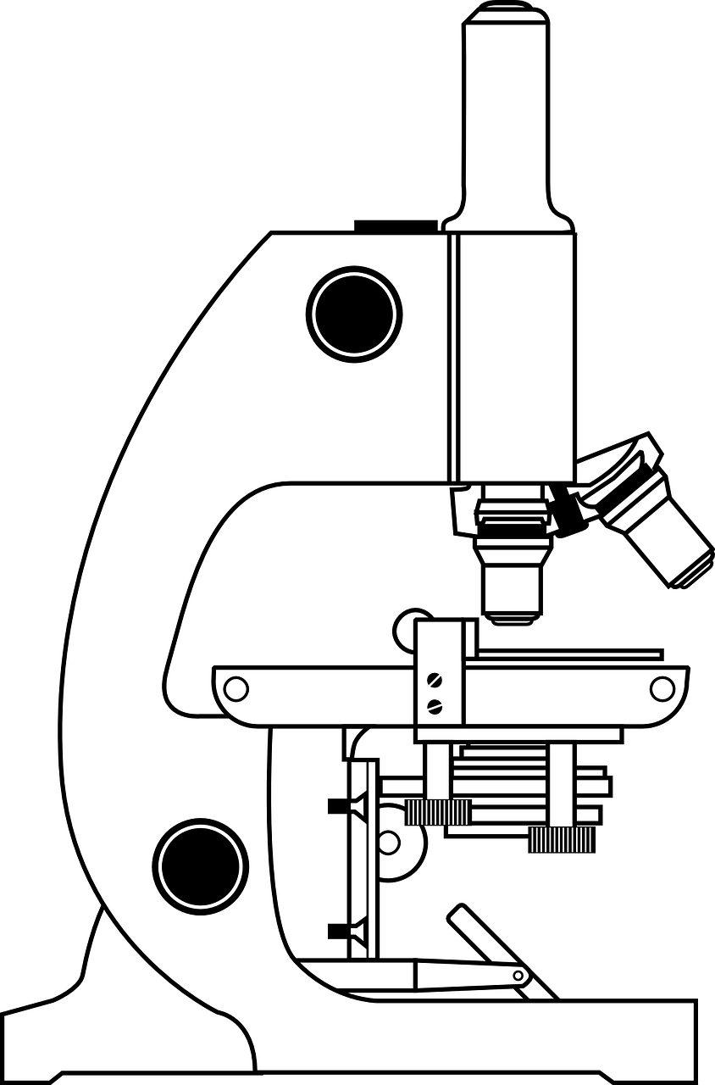
PCR (Polymerase Chain Reaction)
1
The Process
PCR is a technique that amplifies a specific segment of DNA into millions of copies using a thermal cycling method.
2
Applications
PCR has various applications such as genetic analysis, DNA sequencing, and detecting infectious agents in diseases.
https://cdn.pixabay.com/photo/2012/04/12/13/36/microscope-30064_1280.png
3
Advancements
Recent advancements in PCR technology have expanded its applications, such as CRISPR-based diagnostics, point-of-care diagnosis, and gene editing.

Slide 16
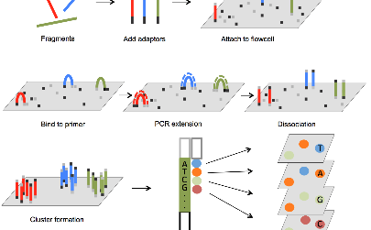
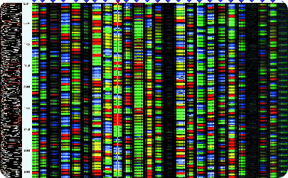
DNA Sequencing
The Process
Applications
Progress
DNA sequencing is a technique used to determine the order of nucleotides in a DNA molecule. This information can be used to diagnose diseases or to understand evolutionary relationships.
DNA sequencing has various applications, such as genome sequencing, personalized medicine, drug discovery, and forensic analysis.
Recent developments in DNA sequencing technology have led to faster, cheaper, and more accurate results. Novel sequencing technologies, such as nanopore sequencing, are pushing the boundaries of what's possible.

Slide 17
CRISPR-Cas9
1
The Discovery
CRISPR-Cas9 is a gene-editing tool derived from a bacterial defense system that can cut DNA at specific locations and modify genomes.
Applications
2
CRISPR-Cas9 has a wide range of applications such as correcting genetic mutations, designing disease-resistant crops, curing genetic diseases, and creating new biofuels.
3
The Debate
CRISPR-Cas9 raises ethical, social, and legal concerns about who decides how to use this technology, particularly concerning germline editing.

Slide 18
DNA Microarray
Technology
Applications
Future
A DNA microarray is a tool that can measure the expression of thousands of genes simultaneously. It is used to study gene expression, genetic variation, and drug discovery.
Microarray technology is being replaced by next-generation sequencing, but it is still a valuable tool for gene expression analysis and remains an important part of the scientist's toolkit.
DNA microarrays have various applications such as diagnosing diseases, predicting drug response, and studying complex diseases like cancer.

Slide 19
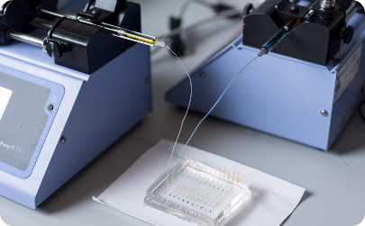
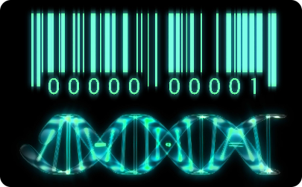
DNA Barcoding
The Technology
The Applications
The Potential
DNA barcoding is a molecular technique that uses a short DNA sequence to identify species. It aims to create a standardized library of sequences for all known species on Earth.
DNA barcoding is a rapidly evolving field with many new applications and possibilities, such as environmental DNA monitoring and taxonomic discovery.
DNA barcoding has various applications such as species identification, biodiversity monitoring, and conservation biology.

