Slide 1
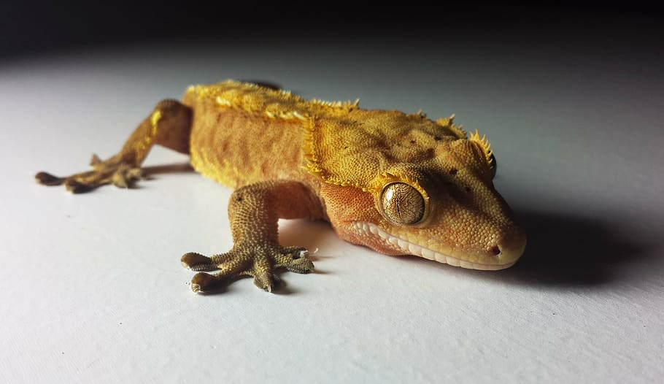
Crested Geckos

Slide 2
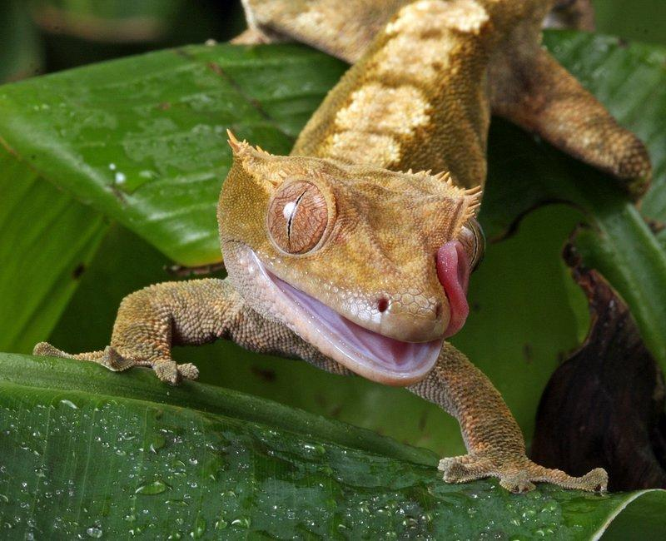
What are crested geckos?
Crested geckos are small, arboreal lizards.
They are known for their distinctive crests, which are small, raised bumps on their heads, and their vibrant coloration.
They typically range in size from 3 to 8 inches in length and have a lifespan of 10 to 20 years.

Slide 3
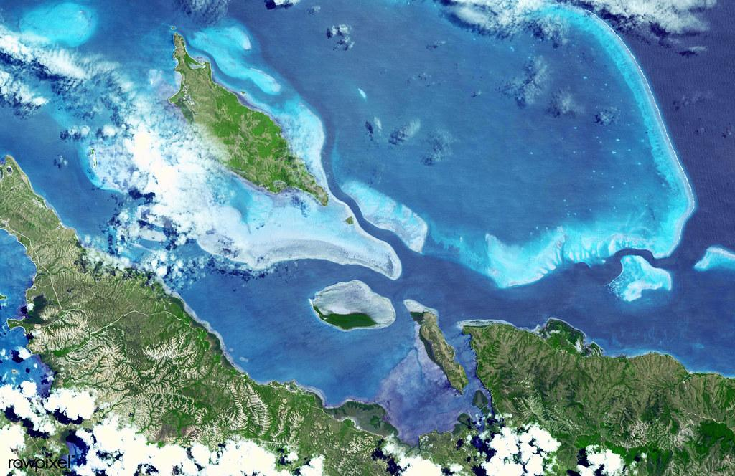
Where are they from?
They are native to New Caledonia, a group of islands between Fiji and Australia.

Slide 4
Caring for Your Crested Gecko
It is important to provide them with the proper environment and care to ensure their health and well-being.
Enclosures should be escape-proof and provide ample space for climbing and hiding.
Temperature and humidity in the enclosure should be carefully regulated to mimic their natural habitat.
Crested geckos are crepuscular, meaning they are most active at dawn and dusk, so it is important to provide them with a light-dark cycle that mimics their natural environment.

Slide 5
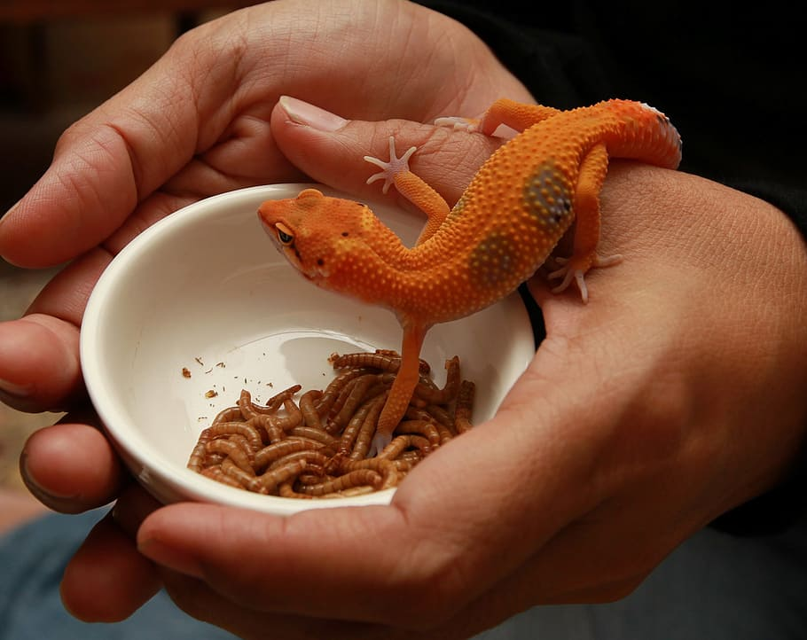
Diet
They are insectivores, meaning they eat insects.
A commercially prepared crested gecko diet is a convenient and nutritious option.
Typically contain a variety of insects, such as crickets, mealworms, and waxworms, as well as vitamins and minerals.

Slide 6
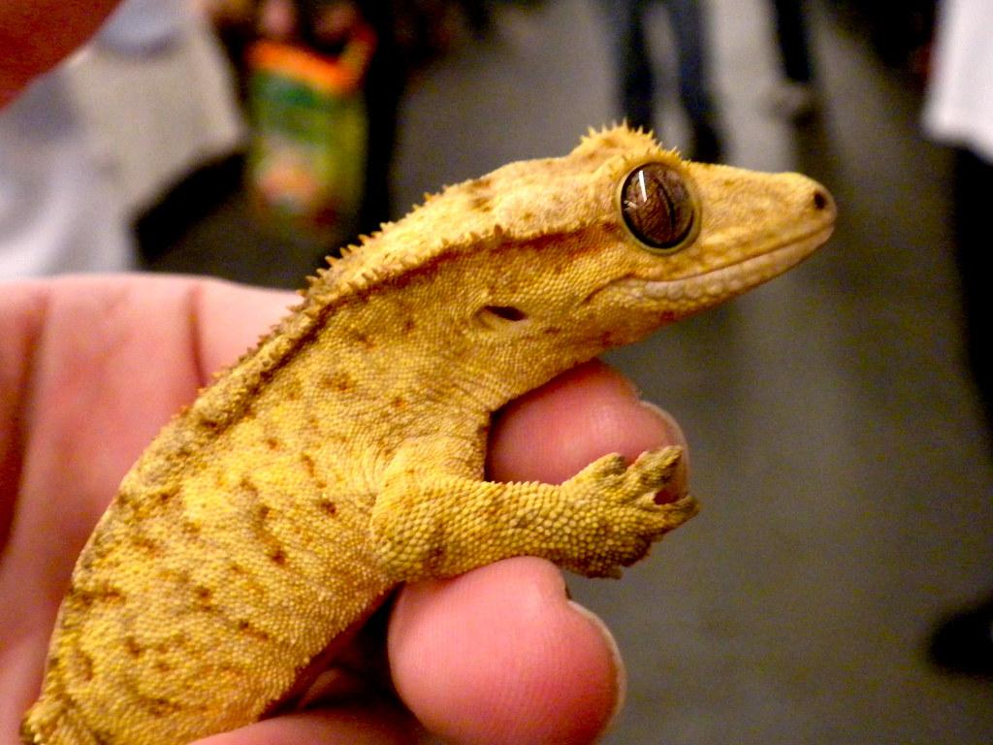
Temperature/ Humidity
Crested geckos are cold blooded,which means they cannot regulate their own temperature and musts rely on their environment to keep them at 72* - 78* F.
Humidity should be between 60 and 80%

Slide 7
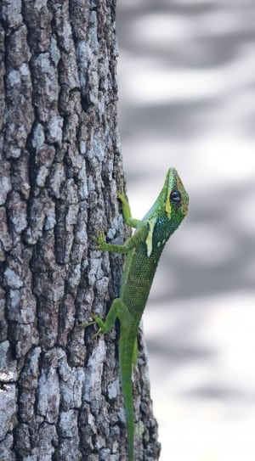
Housing
Crested geckos are arboreal, which means they live in trees. They are active, and need lots of vertical space for climbing, so a tall tank is preferred. Add branches and other decor that allows them to climb.

Slide 8
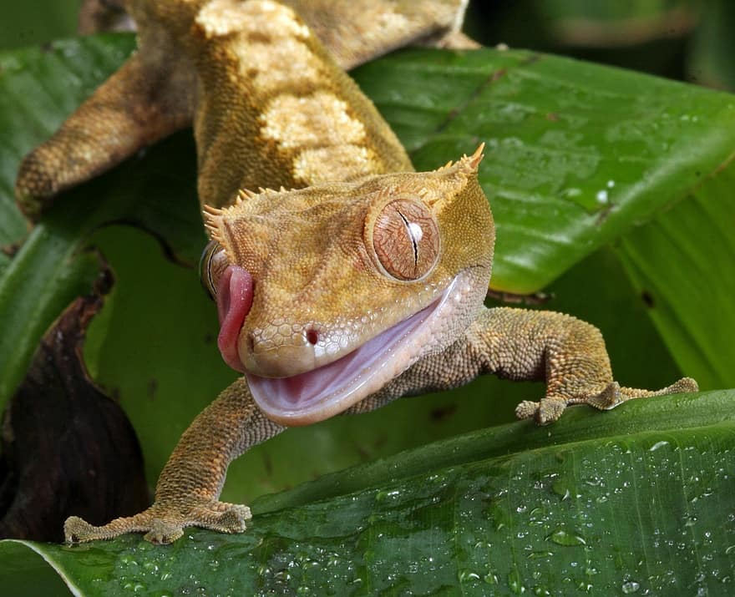
Importance to ecosystem
They help to pollinate plants, disperse seeds, and control insect populations. They are also a source of food for other animals, such as hawks, eagles, and snakes.
The loss of arboreal habitat is a major threat to many species of animals. Deforestation, logging, and the clearing of land for agriculture are all destroying the homes of arboreal animals. This can lead to population declines and even extinction.

Slide 9
Caring for your Crested Gecko
Weekly
Scrub habitat and decor with 10% bleach and 90% hot water solution or a 50% vinegar and 50% hot water solution
Rinse the habitat 203 times to remove any residue
Wipe and dry
Daily:
Clean water bowl
Mist habitat
Check thermometers
Clean up any debris

Slide 10
Types of Illnesses
Impaction occurs when a crested gecko swallows a non-food item that gets stuck in its digestive system.
Nutritional imbalances can occur if the gecko's diet is not properly balanced.
Respiratory infections can be caused by a variety of factors, including poor ventilation in the enclosure.

Slide 11
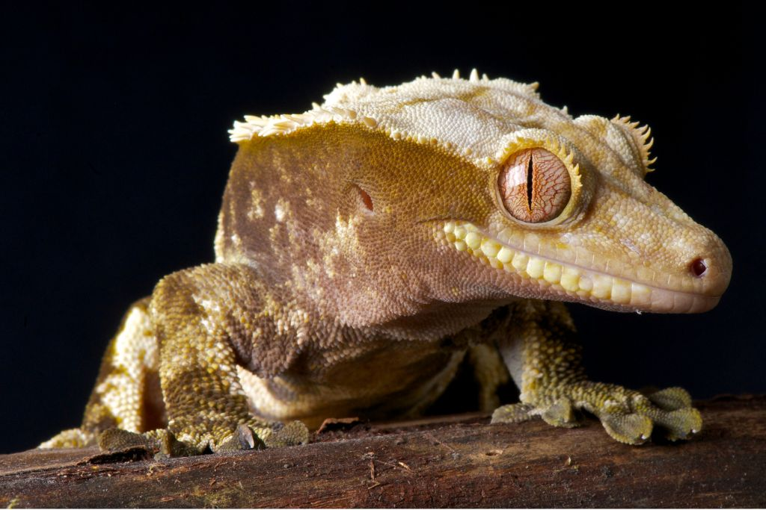
Signs of Illness
Loss of appetite
Weight loss
Lethargy
Changes in skin color or texture
Difficulty breathing
Swollen or closed eyes
Discharge from the nose or mouth
https://www.allgecko.com/wp-content/uploads/2023/10/crested-gecko-health-x-no-credit-needed.jpg

