Slide 1
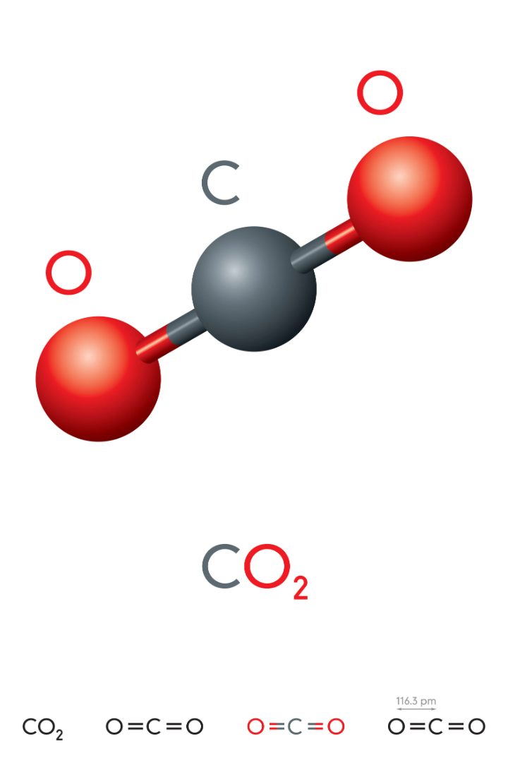
Carbon Dioxide:
Exploring its Impact on the Environment and Aquariums

Slide 2
What is Carbon Dioxide?
Carbon dioxide is a colorless, odorless gas that is naturally present in Earth's atmosphere. It plays a crucial role in the Earth's carbon cycle, regulating temperature and supporting plant life through photosynthesis.

Slide 3
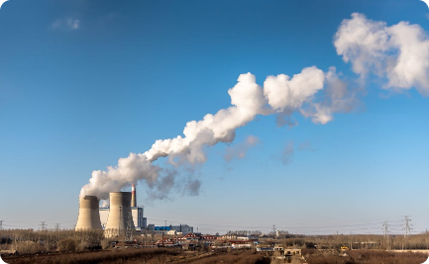
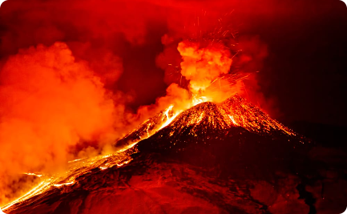
Sources of CO₂
Industrial Emissions
Factories and power plants release significant amounts of CO_{2,} contributing to climate change.
Natural Sources
Human Activities
Natural processes like volcanic eruptions release CO₂ into the atmosphere, contributing to its levels.
Activities such as burning fossil fuels and deforestation also generate CO₂, impacting its balance.

Slide 4
The Positive Effects on the Environment
1
Sustaining Life
2
Regulating Temperature
Essential for photosynthesis, the process by which plants convert sunlight into energy, helping to sustain life on Earth.
Supporting Acid-Base Balance
3
Acts as a greenhouse gas, trapping heat in the atmosphere and preventing drastic temperature fluctuations.
In oceans, dissolves to form carbonic acid, which maintains the pH balance necessary for the survival of marine organisms.

Slide 5
Photosynthesis: Nature's CO₂ Converter
1
Step 1: Absorption
Plants absorb CO₂ from the air through tiny pores called stomata in their leaves.
2
Step 2: Conversion
Using the energy from sunlight, plants convert CO2 and water into oxygen and glucose through photosynthesis.
3
Step 3: Oxygen Release
As a byproduct of photosynthesis, plants release oxygen back into the atmosphere, benefiting organisms that rely on it.

Slide 6
The Role of CO₂ in the Food Chain
Primary Producers
Primary Consumers
Plants use CO₂ to produce glucose, the building block of all other organic compounds.
Herbivores consume plants, obtaining energy-rich molecules created from CO₂ during photosynthesis.
Secondary Consumers
Decomposers
Microorganisms decompose organic matter, releasing CO2 back into the atmosphere, closing the loop.
Carnivores derive energy by consuming herbivores, indirectly relying on CO2 for their survival.

Slide 7
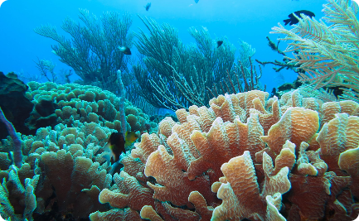
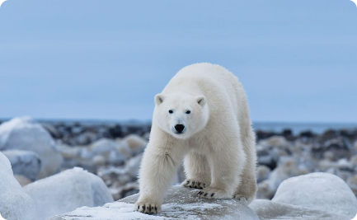
Effects of CO₂ on Ecosystems
Ocean Acidification
Excessive carbon dioxide emissions contribute to global warming, causing climate change and disrupting ecosystems around the world.
Deforestation
Ecosystem Disruptions
Loss of trees reduces CO₂ absorption, leading to increased atmospheric CO2 levels and climate change.
Altered CO₂ levels disrupt ecosystems, impacting the survival and migration patterns of various species.

Slide 8
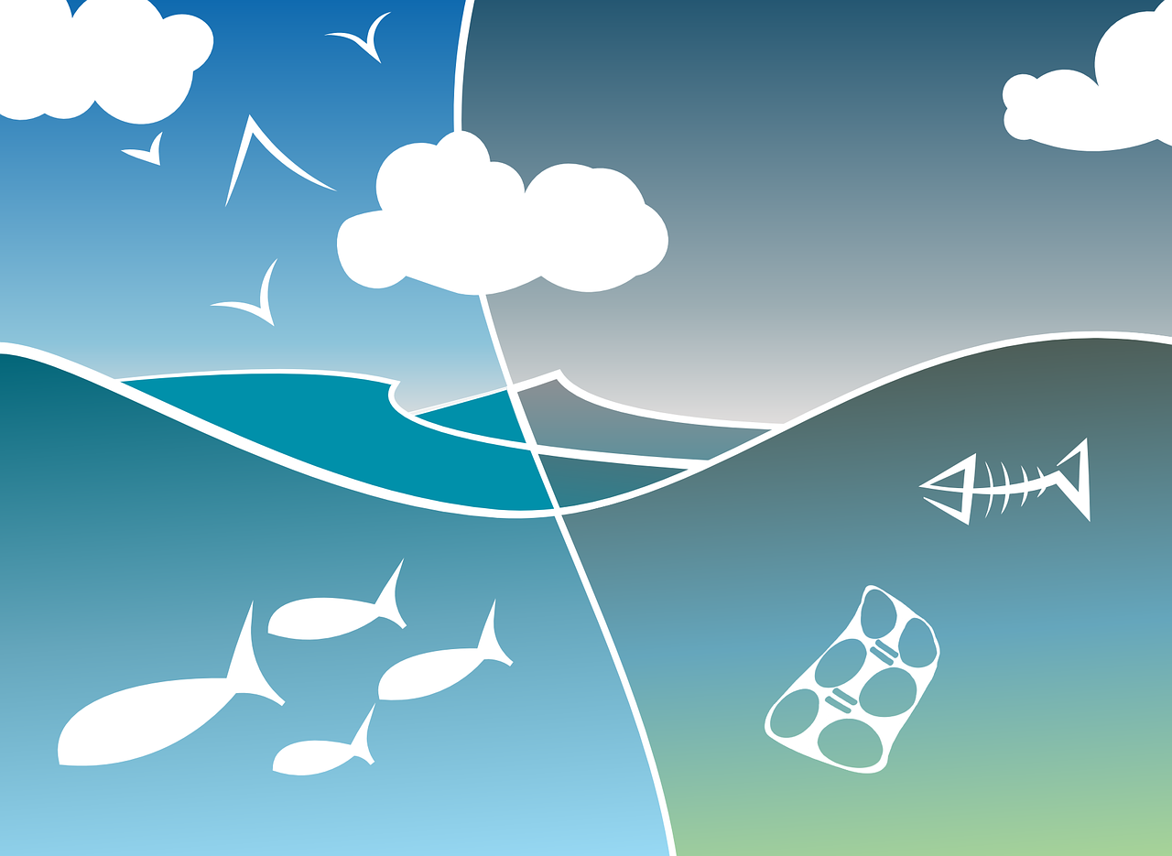
Effects of CO₂ on Ecosystems
What about in an aquarium?
Climate Change
Air Pollution
Rising CO₂ levels contribute to ocean acidification, threatening coral reefs and marine life.
Carbon dioxide is one of the primary greenhouse gases responsible for air pollution and smog formation in urban areas.
https://cdn.pixabay.com/photo/2014/12/21/23/47/aquarium-576059_1280.png

Slide 9
How Carbon Dioxide Affects Aquariums
pH Balance
Plant Growth
Carbon dioxide dissolved in water affects the pH levels of aquariums, creating a suitable environment for aquatic plants and organisms.
Oxygen Exchange
Adequate carbon dioxide levels promote healthy plant growth and photosynthesis, enhancing the beauty of aquarium landscapes.
During the day, plants release oxygen through photosynthesis, while at night, they consume oxygen and release carbon dioxide.
https://cdn.pixabay.com/photo/2013/07/12/15/59/lotus-150693_1280.png

Slide 10
The Importance of Maintaining Proper Water Conditions
pH Level
Temperature
Ammonia, Nitrite, and Nitrate Levels
The pH level determines the acidity or alkalinity of the water and plays a vital role in the health and well-being of the aquarium's inhabitants.
Maintaining a stable temperature is crucial as it impacts the overall metabolic processes of the aquatic organisms.
Monitoring and regulating these chemical compounds are essential to prevent toxicity and maintain a healthy environment.

